Slide 1
TCA: Tricarboxylic Acid cycle
Also known as: Krebs cycle & The Citric Acid Cycle

Slide 2
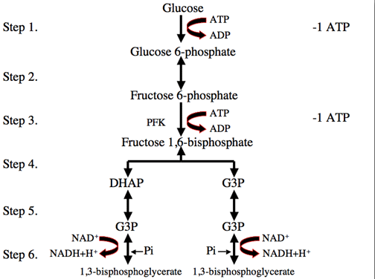
Brief Overview: Glycolysis

Slide 3
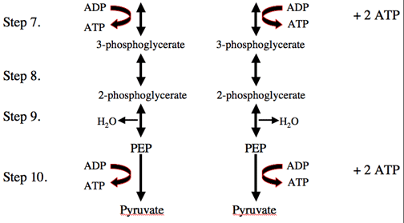
Brief overview: Glycolysis
Notes:
NET YIELD OF GLYCOLYSIS
2 ATP, 2 H2O, 2 Pyruvate, 2 NADH+ H+ (which are shuttled to ETC via FADH2)

Slide 4
Pyruvate Dehydrogenase PDH
Pyruvate dehydrogenase is the enzyme that converts pyruvate to acetyl-CoA, as well as reduce NAD+ to NADH.
Pyruvate is decarboxylated by PDH, releasing a CO₂ molecule, and the remaining two-carbon unit (acetate) is combined with CoA to give Acetyl CoA.
Rate limiting enzyme, determines the rates of glycolysis, lactate production, and carbohydrate supply for mitochondrial oxidation.
Notes:
Pyruvate dehydrogenase, PDH, converts pyruvate to Acetyl-CoA, and an NAD+ molecule is reduced to NADH. NADH is termed the “universal hydrogen carrier.” Pyruvate dehydrogenase functions in concert with coenzyme A (CoA), which is referred to as coenzyme or a cofactor. A cofactor is a low-molecular-weight substance whose presence is required to allow an enzyme to work.

Slide 5
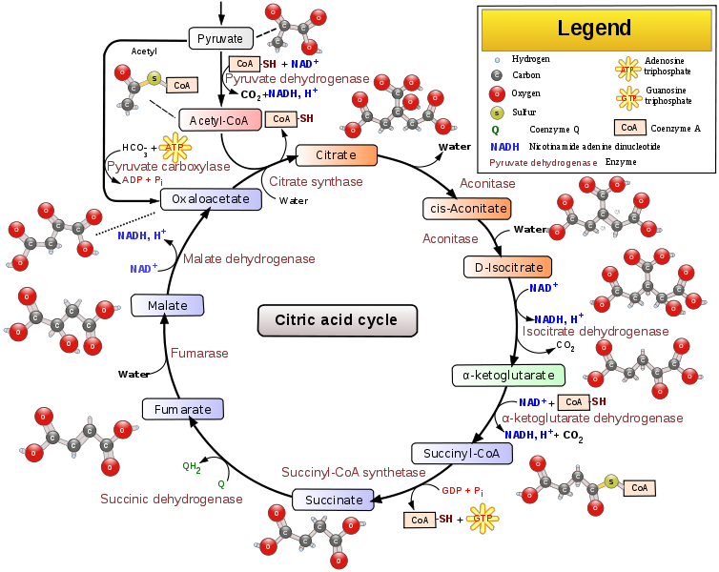
Acetyl CoA can also come from Beta Oxidation
Notes:
As a result of one Acetyl-CoA entering and traversing the cycle, one GTP (guanosine triphosphate, energetically equivalent to an ATP) and several high-energy reducing equivalent compounds (NADH and FADH₂) are formed. These substances result in significant mitochondrial electron transport and ATP production. (Brooks, 103)
One turn of the citric acid cycle consumes one acetyl group and produces four pairs of electrons, one guanosine triphosphate (GTP), and two CO₂. Two water molecules are also consumed. (Houston, 66)
For the citric acid cycle to operate at a high rate, there must be sufficient oxaloacetate to accept acetyl groups from acetyl CoA in the first reaction of the cycle. If oxaloacetate is used for any other purpose, the maximal power of the citric acid cycle may be reduced.

