Slide 1
Why Netpresenter?
Award winning new media pioneer
Cross media integrated visual communications solution
Increase employee commitment
Ensures your message gets across
Safety – Instantly warn everyone with Emergency Alerts
Generate more traffic to your intranet
Solve E-mail stress & Information Overload
Some of our customers

Slide 2
Gentle Push
The psychology behind Netpresenter
The right mix of media ingredients
Learning theory (gently repetition)
Quantitative reach* (cross media / time in front of medium
Reduced information overload / stress (limbic system, 20 minutes)
Catalyst / signpost function (e.g. Sony, increased traffic to other media)
Stimulating returning visits to websites / intranet (up to 70% more traffic)
* Sjoerd Sipkema, Twente Technical University, Increasing the reach of internal communications

Slide 3
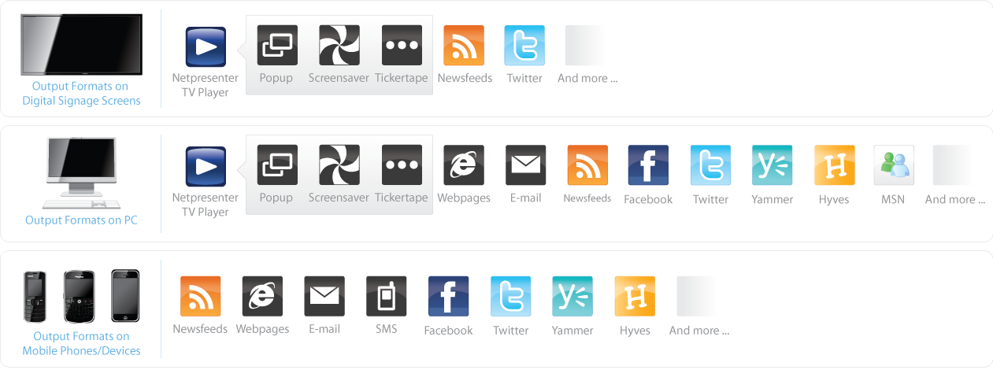
Publish your Message to any Device
Unlimited Amount
of Mobile Phones / Devices
Unlimited Amount
of Digital Signage Screens
Unlimited Amount
of PCs

Slide 4
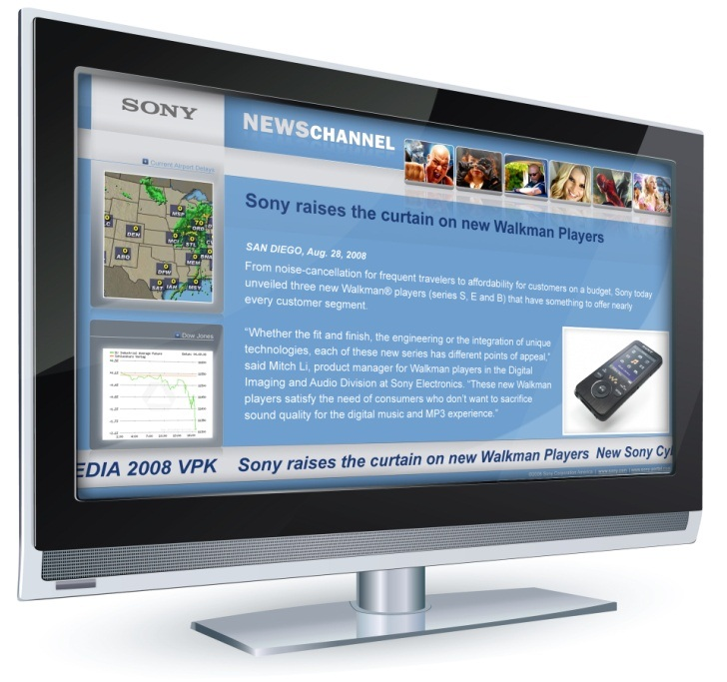
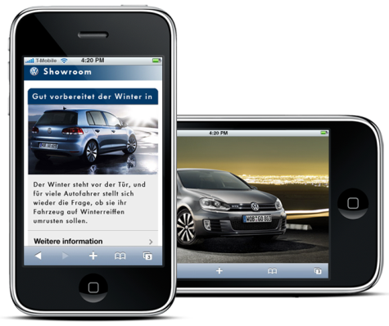
Publish your Message to any Device

Slide 5
3 Solutions in One
External: POS / POI displays & other media at the dealer
Internal Communications: wide range of media
Alert Notifications
Click here to watch the Netpresenter Digital Signage Promo

Slide 6
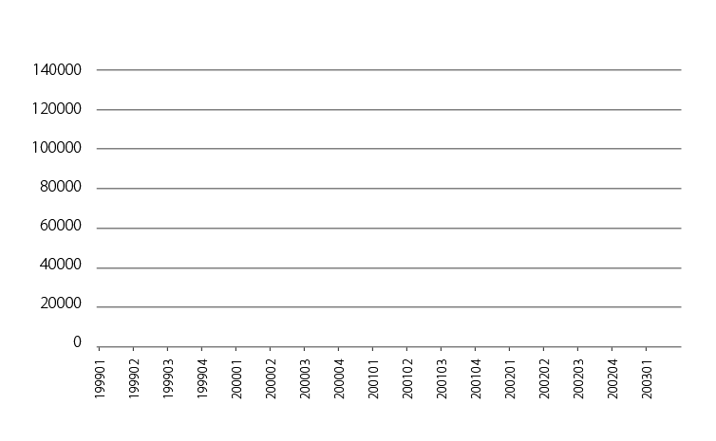
Increasing Profits (ROI)
Instore displays drive attention & sales*
Electronic brochures drive response (mobile sites, Twitter & SMS)
Increasing the reach of marketing & communications (paper)
Better trained staff & dealers (learning theory)
Respond instantly to competitors & press
Dealer gets media ‘a la carte
Electronic brochures (mobile sites & SMS)
* Digital Signage media awareness & attitude study, Seesaw networks

Slide 7
Changing Behavior begins with Effective Communications
Features
Breaking News
Inform
Enable
Change
Engage
Customer Perception
Bringing the Market Inside
Effective European
Communication Channels
Training,
Products
Introductions
Business
Progress
Aligning People with Business Priorities
Succes Stories

Slide 8
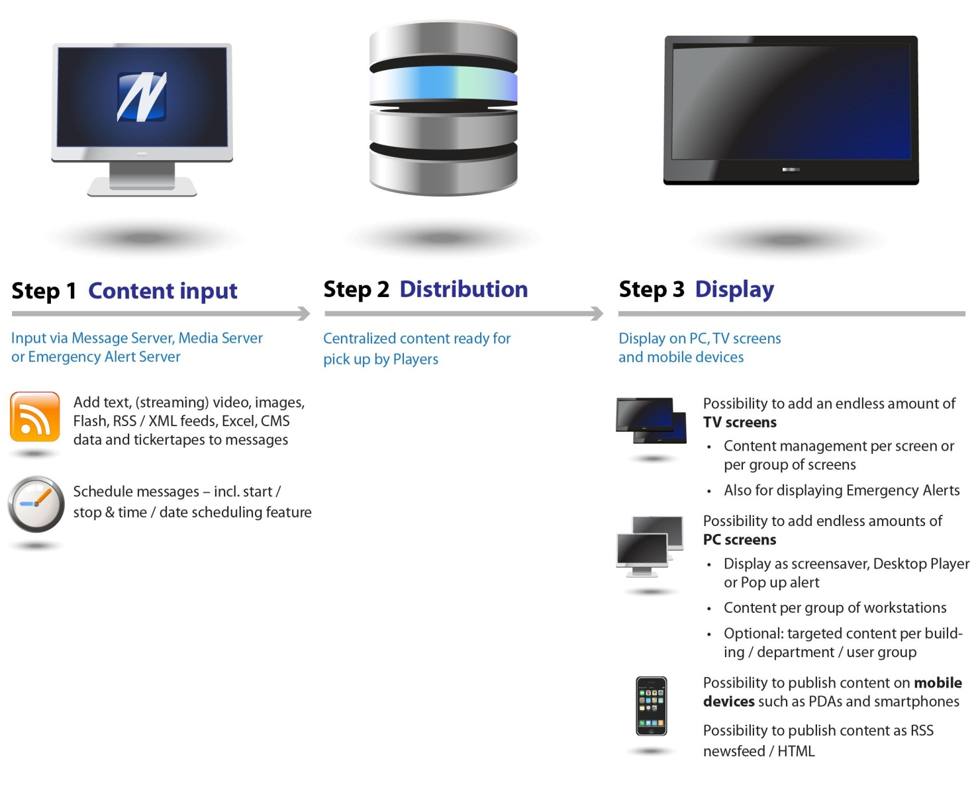
Publish your Message in 3 Steps

Slide 9
The Proof
Intranet usage increased by more than 50% after implementing Netpresenter at Amsterdam Airport (actual internet web statistical chart)*
Launch Netpresenter Screensaver
Amount of Intranet Sessions per Trimester Amsterdam Airport Intranet
* Bron: Schiphol

Slide 10
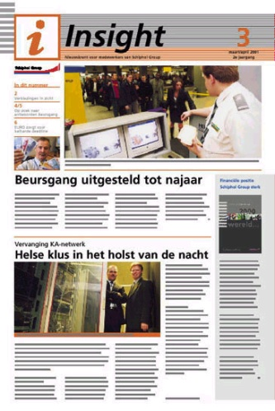
The Proof
Netpresenter at Schiphol Airport is a part of the communication mix
Netpresenter and Intranet
Frequency: Several times a day
Messages: Short messages with hyperlinks to
intranet for background information
Insight printed newsletter
Frequency: 1x per month and 1x each quarter
Messages: Newspaper; operationele actualiteit
Magazine; achtergronden

Slide 11
Some quotes from our customers
“I would recommend this solution to all corporations, companies, even multi-computered families to get information out there quickly and timely. The Netpresenter Suite is so easy to install and the creation and maintenance of the slide shows is exceedingly simple.” Cat Rosenau-Fryman, ICT Manager Nokia USA
“As a network guy, the way that Netpresenter handles updates is great. There is a far lower utilisation of bandwidth.” Bill Wheeler, Network Systems Engineer of Volkswagen Credit
“Netpresenter ensures that internal communications gets noticed, and gives Sony a competitive advantage.” Jane Sparrow, General Manager of Employee Communications Sony Europe → An excerpt from her presentation at a Marcus Evans event on the next pages

Slide 12
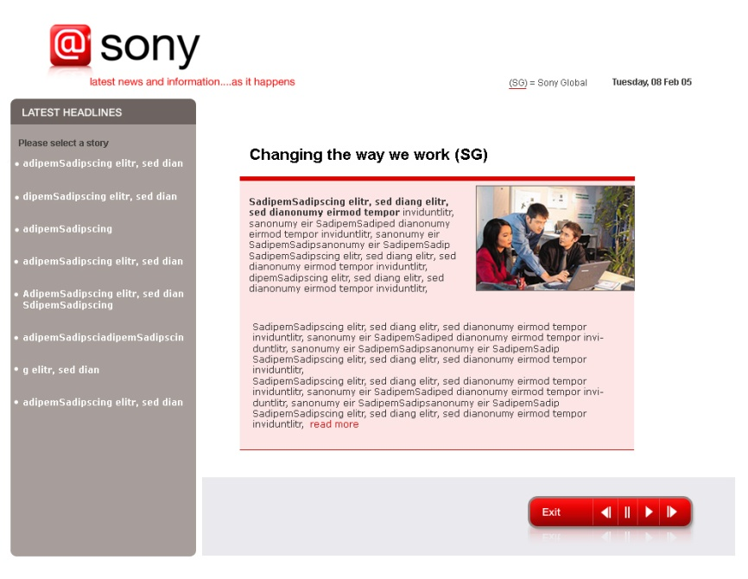
The Solution Phase 1
COMMUNICATION AUDIT
BEST PRACTICE EXAMPLES
EMPLOYEE ATTITUDE SURVEY
Screensaver to give daily updates, working with Netpresenter

Slide 13
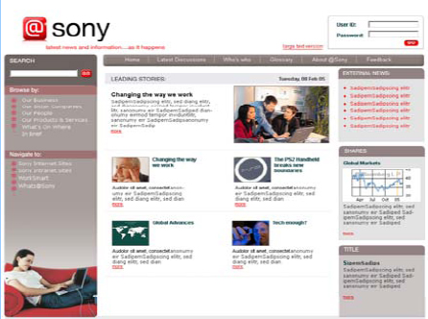
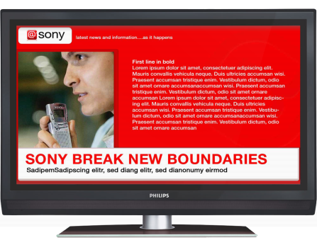
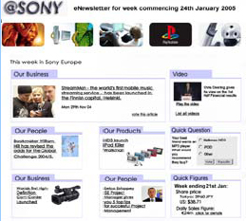
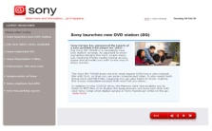
The Solution Phase 1
EXTERNAL NEWSFEEDS
INTERNAL NEWS
WEEKLY
E-NEWSLETTER (with personalisation)
PLASMA SCREENS act as a signpost to news
AUTOMATIC UPDATES
SCREENSAVER across Europe to act as a signpost
Communications mix @ Sony: Netpresenter Screensaver & Digital Signage

Slide 14
Measurement
First formal measurement survey showed employees are better informed about business
direction, strategy, market trends and operational issues
Almost 90% of staff use the @sony suite of tools
Screensaver is accessed mostly at lunchtime and is the most popular channel because it is a
“signpost”!
Direct connection between @sony messages and customer satisfaction/sales
Over 150 unprompted emails to the @sony team from employees to congratulate them on the
implementation of such a valuable tool (even though not all sites are live)

Slide 15
Examples

Slide 16
Examples

Slide 17
Examples (PC)

Slide 18
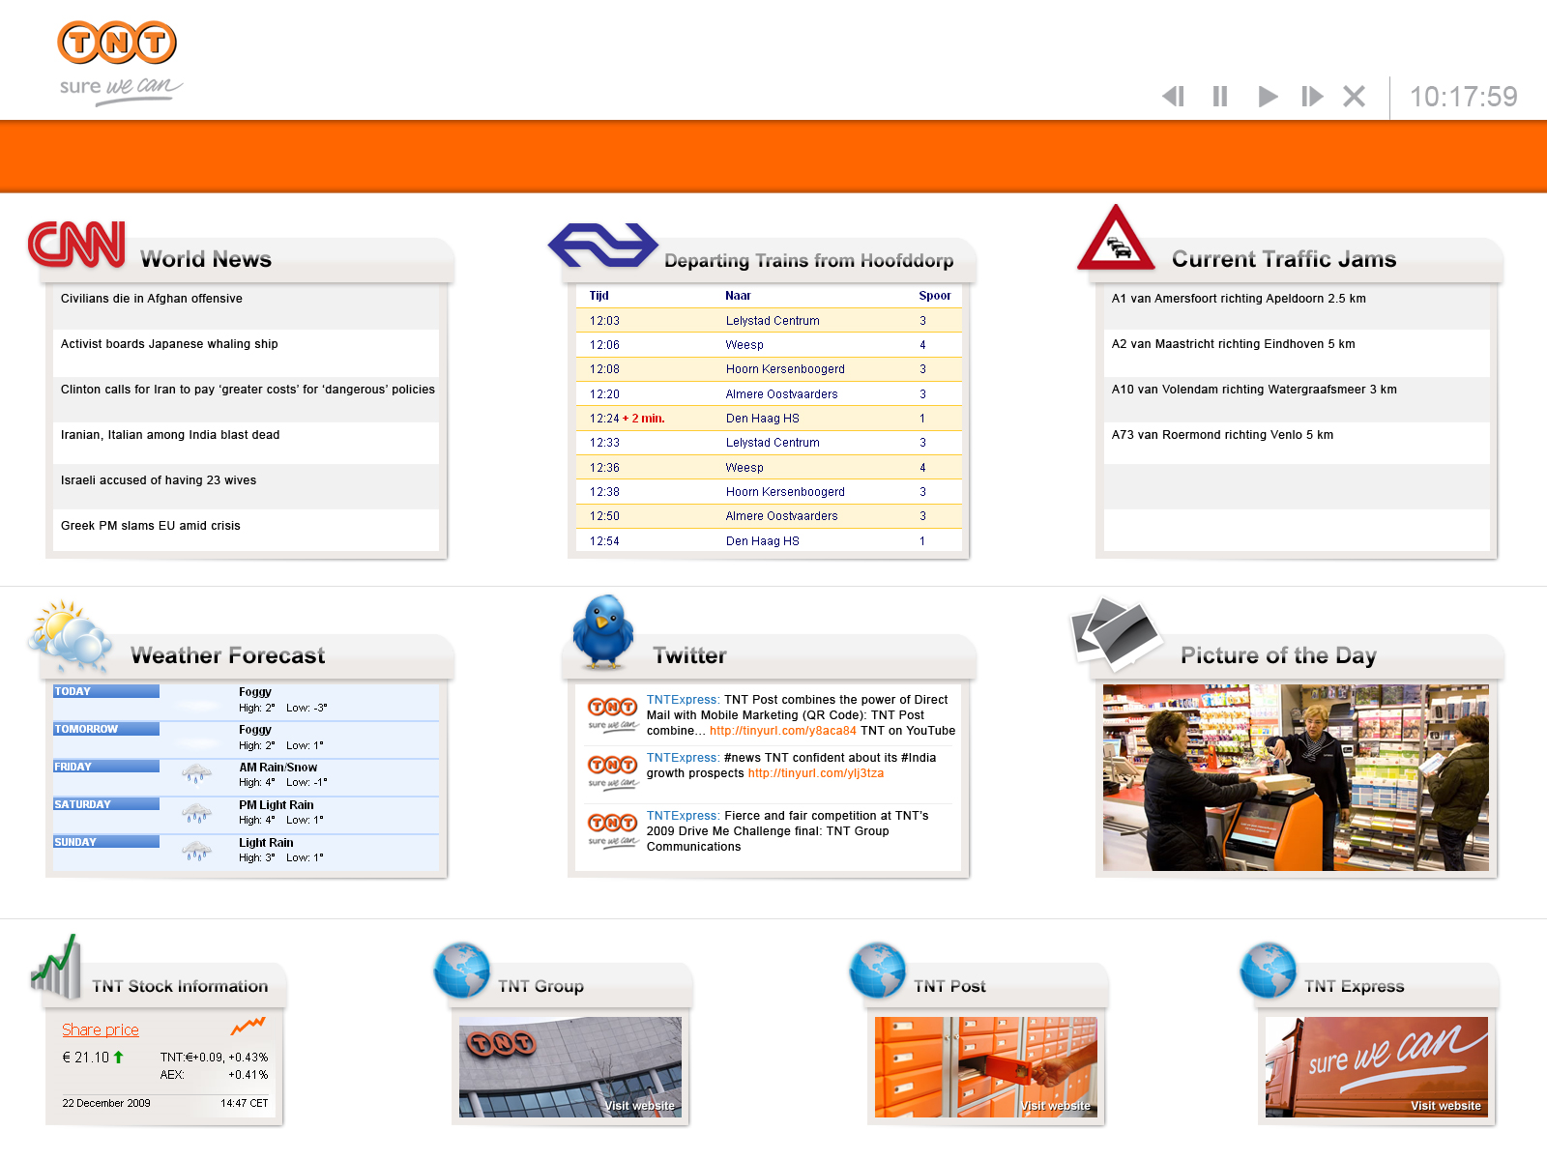
Examples (PC)

Slide 19
Examples (PC)
Automatic import of RSS/XML feeds via the Netpresenter Newsfeedserver

Slide 20
Examples (TV)

Slide 21
Examples (PC)

Slide 22
Examples (TV)

Slide 23
Examples (TV)

Slide 24
Examples (TV)

Slide 25
Examples (TV)

Slide 26
Examples (TV)

Slide 27
Examples (TV)

Slide 28
Subchannels
With corporate and local messages
1
2
3
Subchannel
4
Example
Netpresenter presentation with country-wide (corporate) part that’s visible for everyone and a local
part that is only visible at the one office.
Corporate news is managed by the headquarters, local news is managed by the local office. It’s possible to add as many layers required.

Slide 29
Various Levels of Instant Communication

Slide 30
Customized News Mix at DSM Worldwide on 21.000 pc’s

Slide 31
Netpresenter Screensaver at DSM

Slide 32
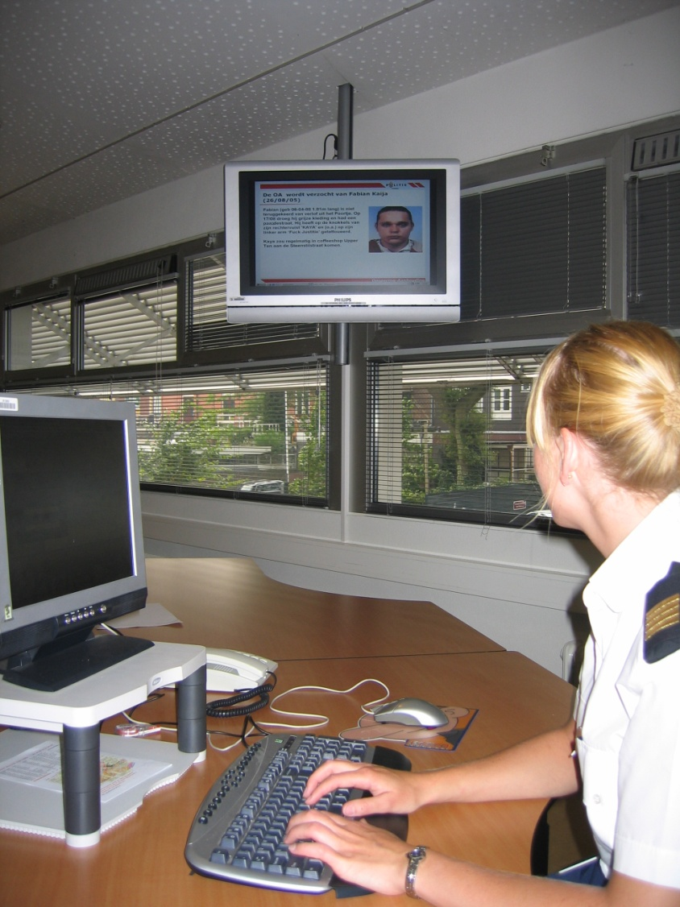
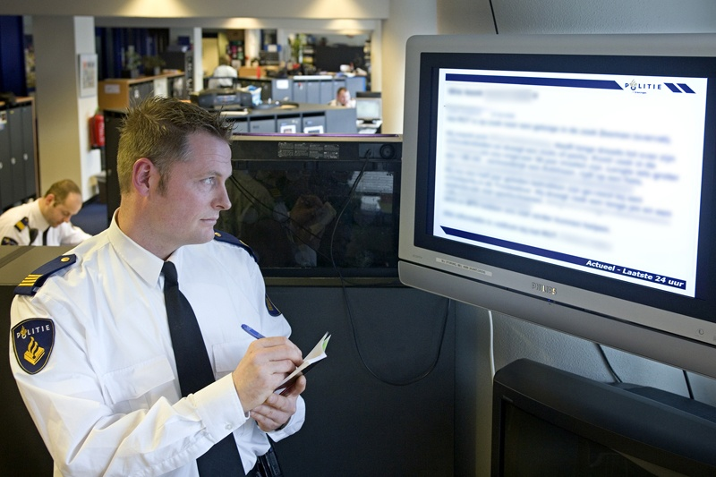
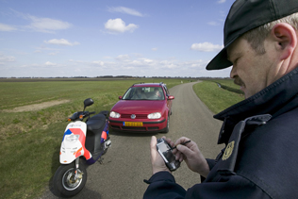
Police Forces
Push your APB 24/7 on plasma, PC and mobile devices

Slide 33
The Effect of Digital Signage Advertising*
Digital Signage advertising has stopping power
63% of adults report that Digital Signage advertising catches their attention
Better than any other media (incl. Billboards, magazines, TV and internet
Digital Signage is more positively rated than any other media
More unique (58%) and more interesting (53%) than all other media
More entertaining than most other media by 48% (only TV scores higher)
Less often perceived as annoying than any other media except newspaper
Digital Signage advertising drives action
36% of adults (and 51% of 18 to 24 year olds) reported to take action as a result of seeing ads on
digital signage
* Digital Out-Of-Home Media Awareness and Attitude study 2007, conducted by consumer research company OTX, October
2007, based on a survey of a US representative sample of 900 adults aged 18 and 55

Slide 34
Staff Absence Cases Automatically Visible in Netpresenter

Slide 35
With Ability to Toggle Between Two Channels, French/Dutch

Slide 36
Netpresenter on Plasma Screens and PCs at Hospitals

Slide 37
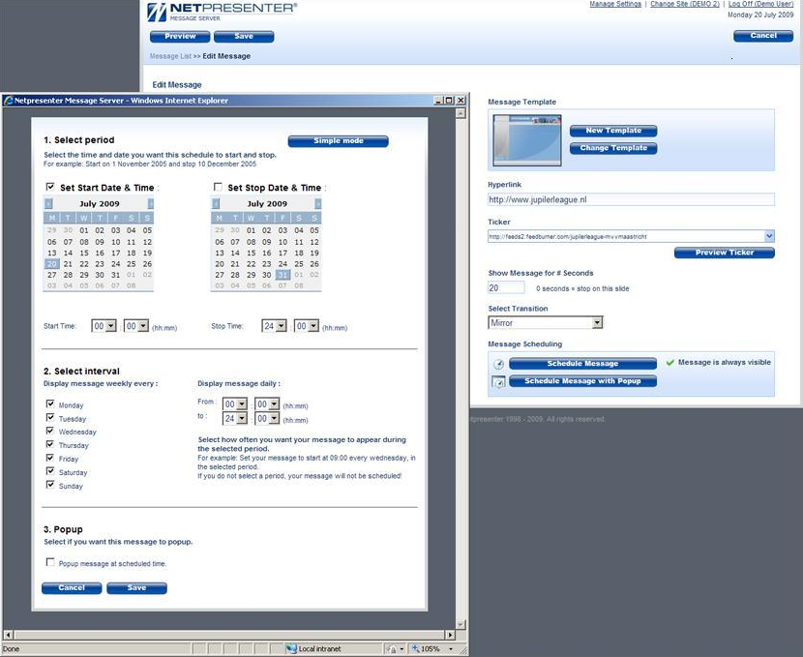
The software

Slide 38
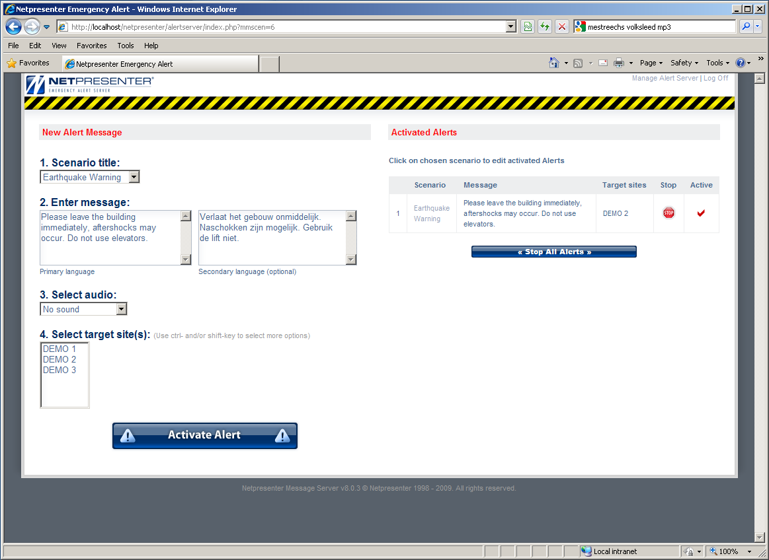
The software

Slide 39
Emergency Alert via Netpresenter Emergency Alert Server

Slide 40
Possibilities for your Netpresenter Screensaver

Slide 41
Possibilities for your Netpresenter Screensaver

Slide 42
Possibilities for your Netpresenter Screensaver

Slide 43
Possibilities for your Netpresenter Screensaver

Slide 44
Possibilities for your Netpresenter Screensaver

Slide 45
Possibilities for your Netpresenter Screensaver

Slide 46
Possibilities for your Netpresenter Screensaver

