Slide 1
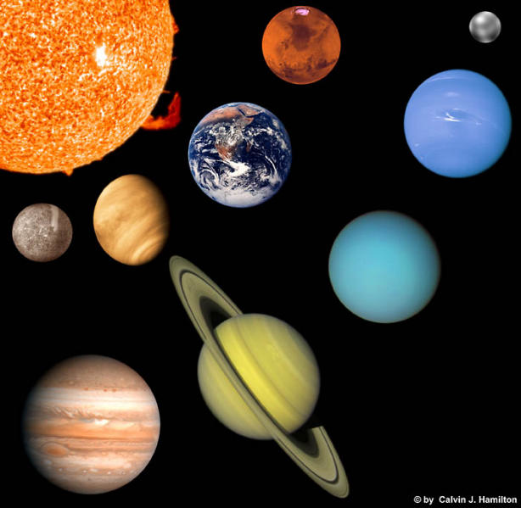
Our Solar System

Slide 2
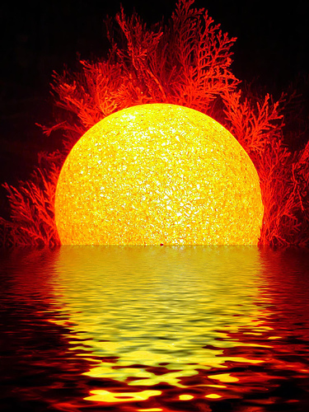
Our Solar System has:
A Sun
It’s the center of our solar system
It’s a ball of hot gases that produce light

Slide 3
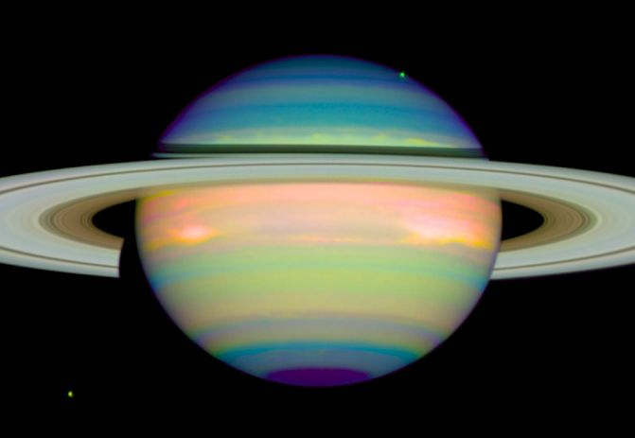
Planets
Some bigger than others
Some, such as Earth, have moons
Some, such as Saturn, have rings,
ALL revolve around the sun
ALL reflect light

Slide 4
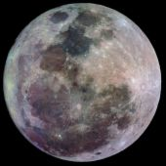
Moons
Reflect light
Revolve around planets

Slide 5
Early Astronomy
3000 BC – Chinese begin recording and predicting movements of the Sun, Moon, and planets
260 BC – Aristarchus (Greek) – proposed Earth and other planets were sphere that revolved around the Sun
145 AD – Ptolemy (Egypt) – geocentric model – earth – centered system

Slide 6
497 AD – Indian mathematician proposed the earth rotated on it’s axis (1st to explain day and night)
900 AD An Arabian astronomer noticed Ptolemy’s model wouldn’t work
1543 AD Copernicus confirms heliocentric solar system model

Slide 7
Inner Planets
Known as terrestrial planets – Earthlike
Mercury, Venus, Earth, Mars
Close to the Sun
Close to Earth size, density, mostly rocky

Slide 8
Mercury
Closest to Sun
Looks like our moon – covered in craters
Hot enough to melt led
1 yr = 3 month

Slide 9
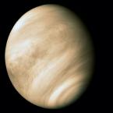
Venus
2nd planet from Sun
Atmosphere is mostly carbon dioxide and sulfuric acid clouds
900 degrees F

Slide 10
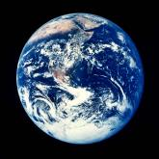
Earth
3rd planet from the Sun
Only planet known to have life
Largest inner planet
Atmosphere 78% nitrogen, 21% oxygen
1 natural satellite – the Moon

Slide 11
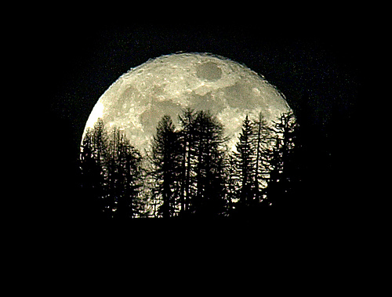
Moon
No atmosphere
One of the largest satellites
Gravity holds orbiting around Earth (once a month)
Goes through phases throughout the month
Reflects the Sun’s light
Rotates on it’s axis

Slide 12
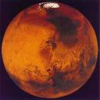
Mars
4th planet from the Sun
Most like the Earth
Smaller / less gravity than Earth
1 day is only 41 minutes longer than 1 day on Earth
Has 4 seasons
Temperature between -130 F – 32 F
Iron Oxide gives the soil it’s color

Slide 13
Outer Planets
5 planets – Jupiter, Saturn, Uranus, Neptune, Pluto
4 are: very large, have rings, made mostly of gases – known as the Gas Giants (J, S, U, N

Slide 14
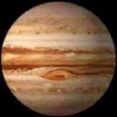
Jupiter
5th planet from the Sun
Almost became a star
Atmosphere – liquid hydrogen
Has Great Red Spot
Thin set of rings
Io (moon) lots of volcanoes!!!

Slide 15
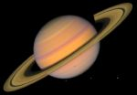
Saturn
6th planet from the Sun
Last planet you can see easily from Earth
Has strong winds (1100 mph)
Beautiful rings – made up of ice and rock fragments
Has the most known satellites
Titan –Saturn’s largest satellite

Slide 16
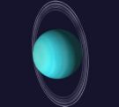
Uranus
7th planet from the Sun
Thin dark rings (faint)
Very cold! – 355 F
Horizontal axis!!!

Slide 17
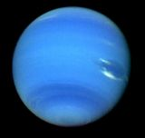
Neptune
8th planet from the Sun
Faint rings
Atmosphere – swirling blue and white
Triton – moon – has geysers

Slide 18
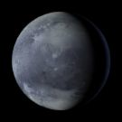
Pluto
9th planet from the Sun
Remote from other planets
Smallest and least known about
About same size as our moon

Slide 19
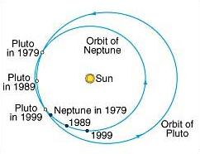
Neptune and Pluto’s Orbit

Slide 20
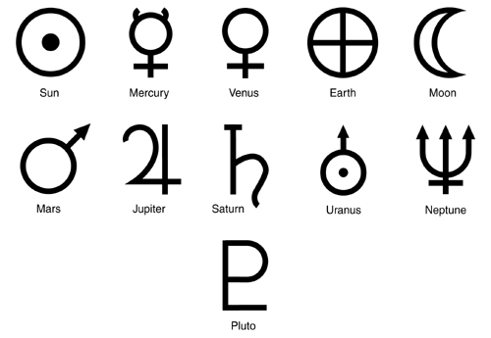
Planet Symbols

Slide 21
My Very Energetic Mother Just Served Us Nine Pizzas!

