Slide 1
ACS 560 Microblog 911 Project Status
Kassie M. Bowman
September 27, 2011

Slide 2
Vision Document
Key User Needs
Need | Priority | Concerns | Current Solution | Proposed Solutions
Receive notification of an emergency situation | 1 | Need to ensure notification is accurate, timely, and relevant to users | Users are alerted to ongoing events through their social network or the news. Social media is timely but can be inaccurate or irrelevant; the news is accurate, but less timely. | Provide notification to users in the affected area via text message or other notification as soon as situation is identified.
Provide information about an observed emergency | 2 | Need to find a way to assess the credibility of users to ensure information is factual | Users must call 911 to report an emergency. This is typically only done in the case of personal emergencies (such as injuries and house fires) and often not done when weather or traffic emergencies are observed. | Users will use their normal social media application to report details of an observed emergency.
Set preferences regarding notification method and frequency | 3 | Need to allow users to specify about which types of events they wish to be notified | There is no way to filter this information in social media or the news. | The application will provide user opt-in settings for the different types of notifications (such as traffic, weather, terrorism, etc.)

Slide 3
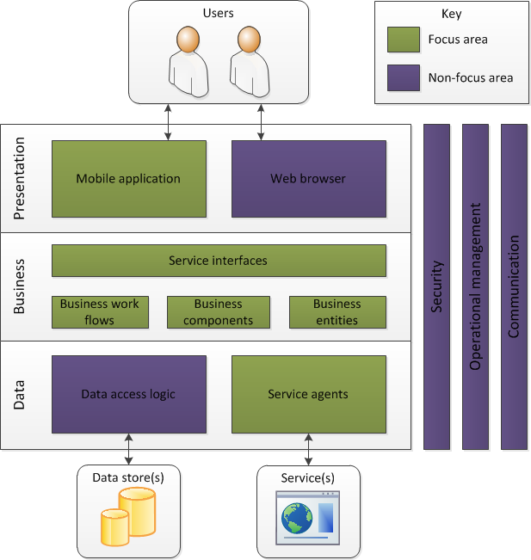
Application Architecture

Slide 4
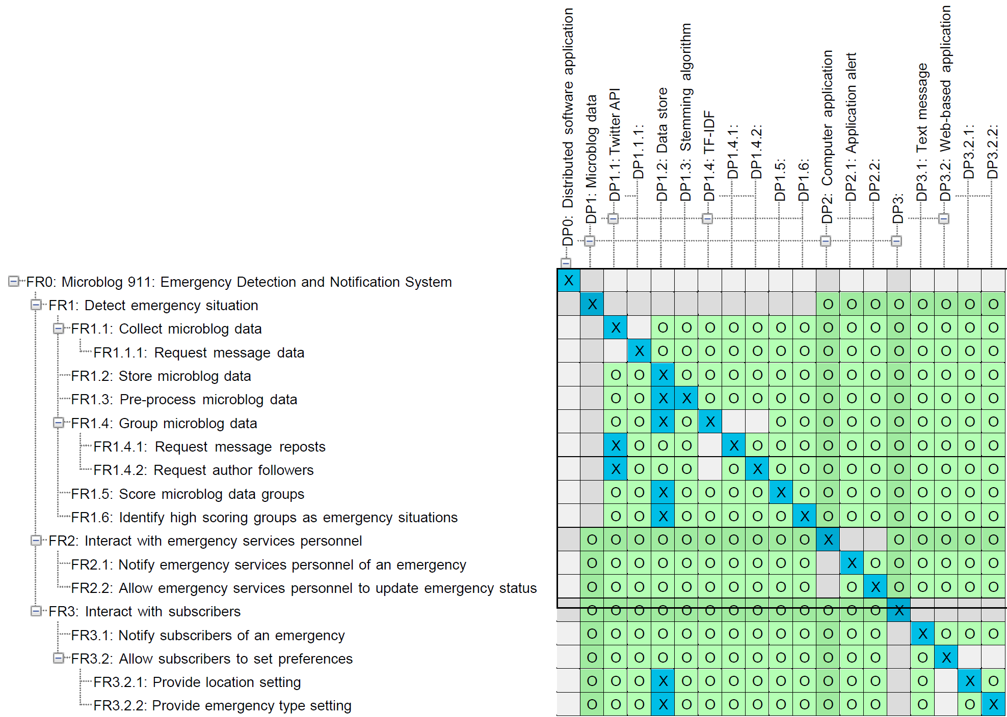
Axiomatic Design
Design Matrix

Slide 5
Software Requirements Specification
Completed:
Section 1: Introduction
Section 4: Change Management Process
Section 5: Document Approvals
In progress:
Section 2: The Overall Description
Section 3: Specific Requirements

