Slide 1
Bitácora 0
Laura Rodríguez Mejía

Slide 2
Through my learning experience I came to use the computer when I was around the last three or four years of school. Personally I’m not very fond of technology but I can deny that it offers great things for teaching and learning. I don’t consider myself a book worm but certainly I’m more like to be so than a technology worm (if that is even the right way of saying it).

Slide 3
This class presents itself as an opportunity to get more in touch with ICTs and to go out of my comfort zone and see all the good things they have to offer. Again with the guidance and company of Harold; a teacher that has opened my heart to education.

Slide 4
The topic of the seminar is the use of ICTs in the language classroom. It is indeed a very important topic for us, future language teachers.

Slide 5
The first thing we had to do, was to answer three questions:
What are your expectations?
Have you taught?
Why could you use ICTs in your language lessons?

Slide 6
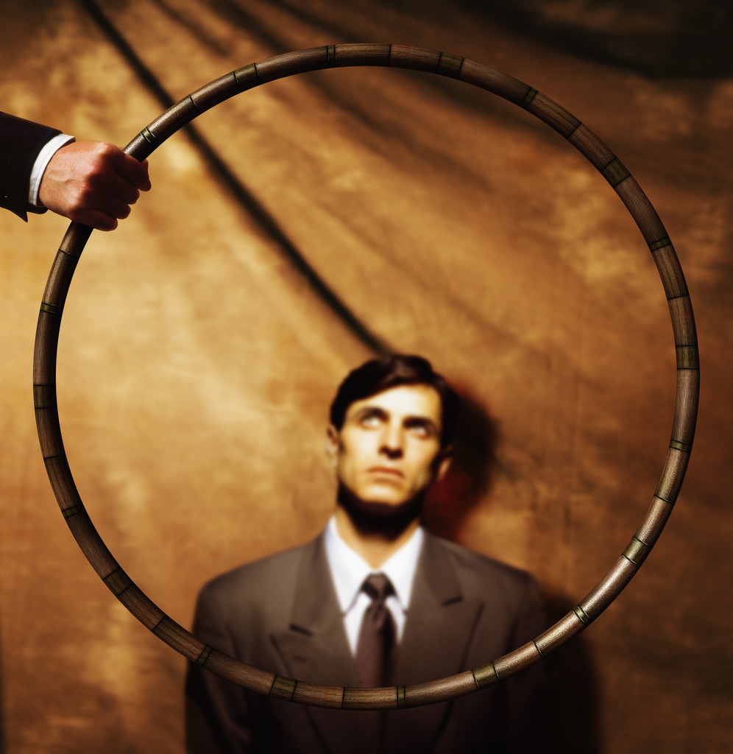
To begin with I’m glad that our preparation as future teachers is being taken more seriously; this course is prove of that.
Like the course of Metodología y Didáctica, I hope to fall more in love with teaching and to be able to use ICTs not only for teaching but also for learning. I’m steel very old fashion in that sense. I use a lot of books and not that much the ICTs.

Slide 7
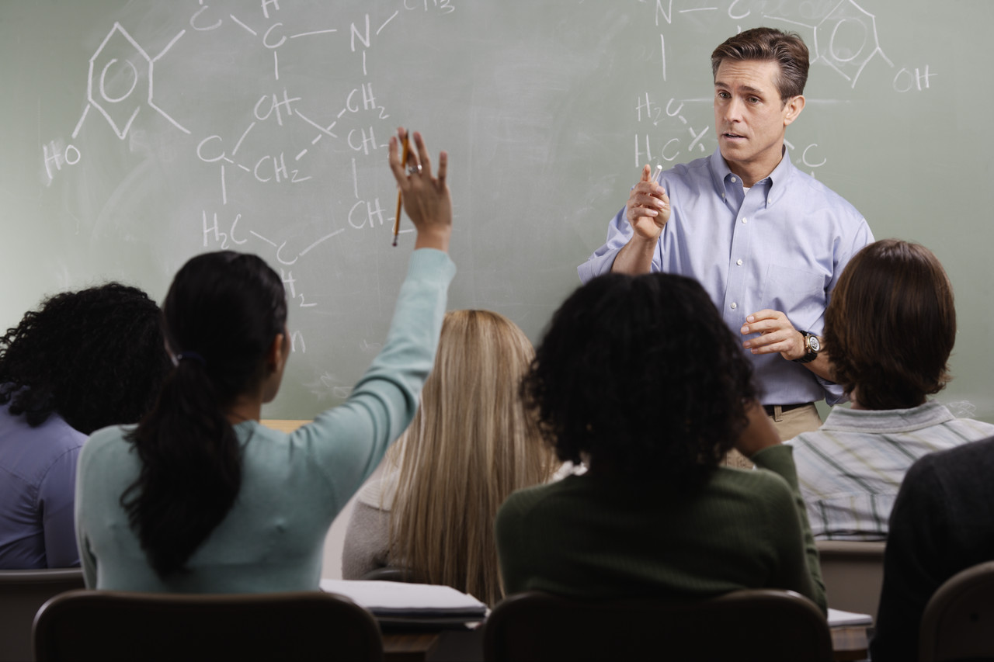
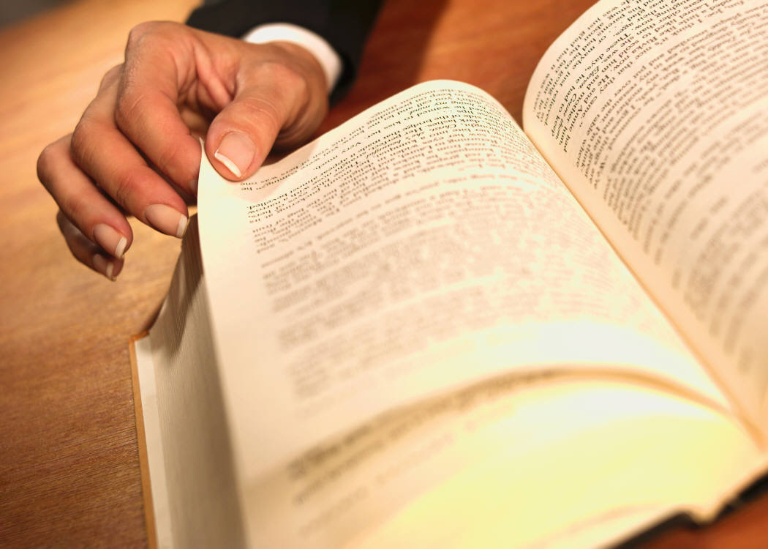
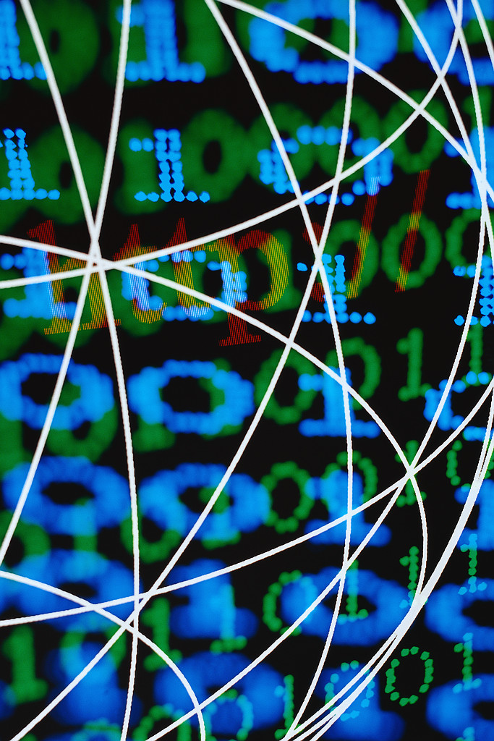
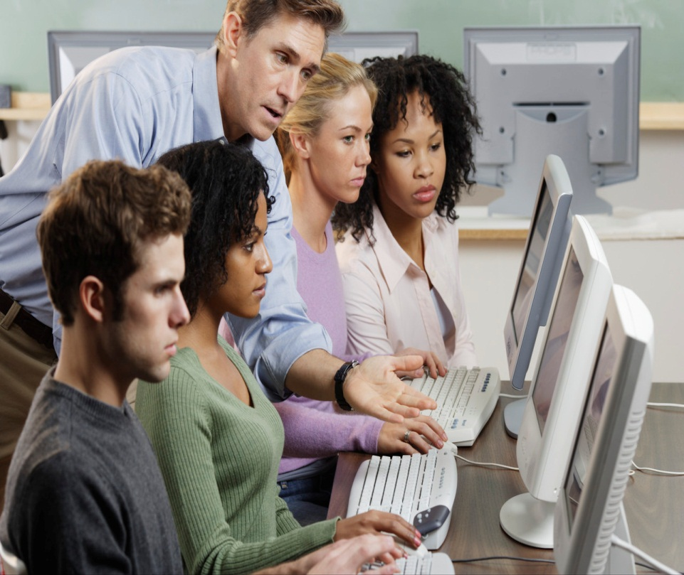
Up to this point, I haven’t taught. Nevertheless, I believe that ICTs help students have a wider amount of information and use of it for different purposes.

