Slide 1
Groups of Reptiles
Lizards and Snakes
Have legs & clawed toes (lizards) external ears, moveable eyelids
Highly evolved specialized forms (venom)
Crocodiles and Alligators
Long, typically broad snout and squat appearance
All are carnivorous
Protective of young; carry hatchlings in their mouth
Live in tropics and subtropics
Alligators live in freshwater
Crocodiles live in fresh or saltwater

Slide 2
Groups of Reptiles (con.)
Turtles and Tortoises –
All are shelled
Turtles are aquatic; tortoises are terrestrial
Tuatara –
Primitive reptiles found on small, remote islands

Slide 3
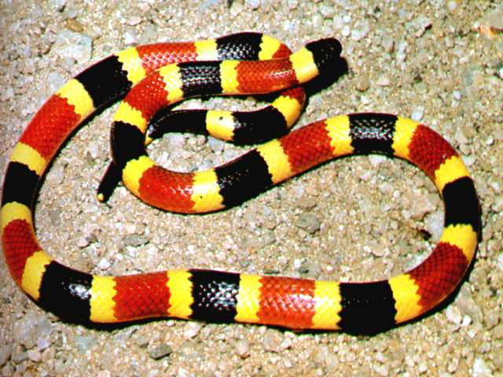
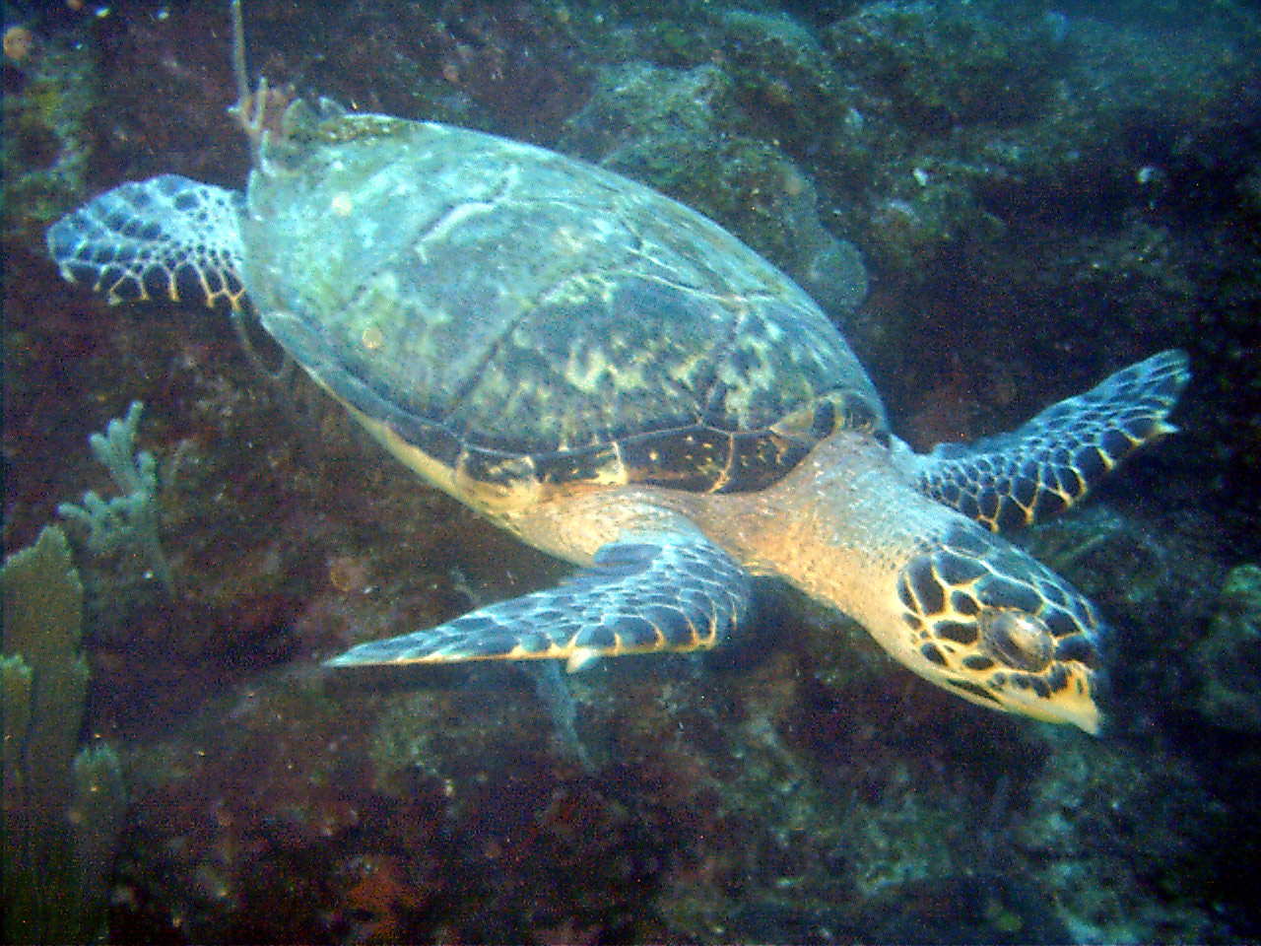
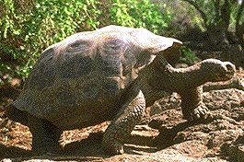
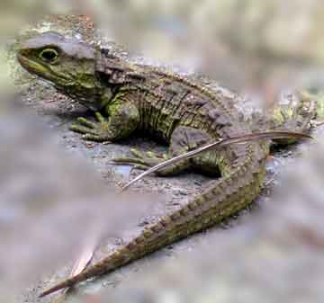
Coral Snake
Sea Turtle
Galapagos Tortoise
Tuatara

Slide 4
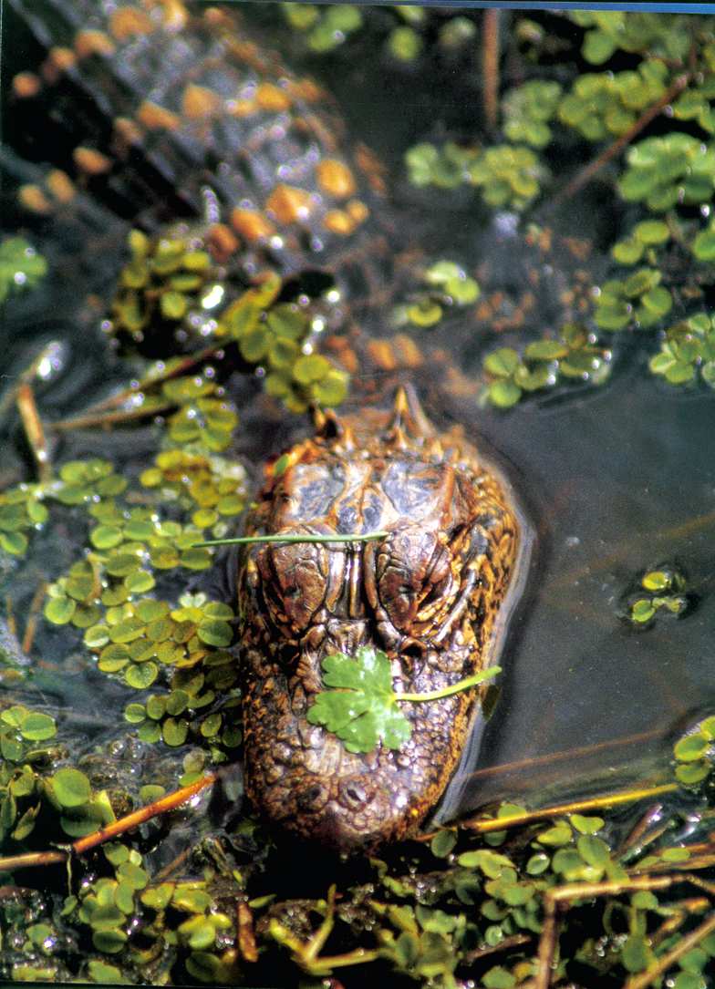
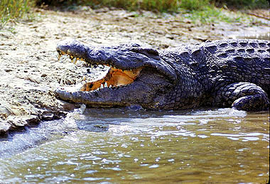
Nile Crocodile
North American Alligator

