Slide 1
Birds – Basic Facts
Nearly 10,000 modern bird species
Birds are closely related to reptiles (scales on legs)
Have outer covering made of feathers, two legs used for walking or perching, and forelimbs modified into wings
Feathers separate birds from all other animal species
Feathers provide insulation for warmth; can generate on body heat
Beak/Bills adapted to type of food they eat
Highly efficient respiratory system; lungs only exposed to Oxygen rich air
Internal fertilization; amniotic eggs; many mate for life

Slide 2
Section 31-2
Birds
have the following adaptations to flight
Wings
Feathers
Strong chest muscles
Efficient respiratory system
Efficient circulatory system
which are
that also
that power
that provide
that ensure
Homologous to front limbs in other vertebrates
Provide warmth
Upward and downward wing strokes
One-way flow of O₂-rich air
O₂ distribution to body tissues

Slide 3
Groups of Birds
More than thirty orders of birds
Some of the most common
Perching Birds – largest order; many are songbirds (sparrows, crows, cardinals, etc.)
Birds of Prey – fierce predators with hooked bills; large talons (condors, hawks, owls, eagles, etc.)
Herons & Relatives – Wade in aquatic habitats (storks, herons, cranes)
Ostriches & Relatives – flightless birds move by running or swimming (ostriches, emus, etc.)

Slide 4
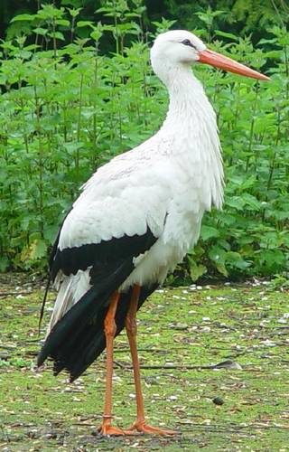
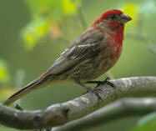
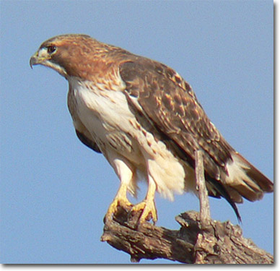
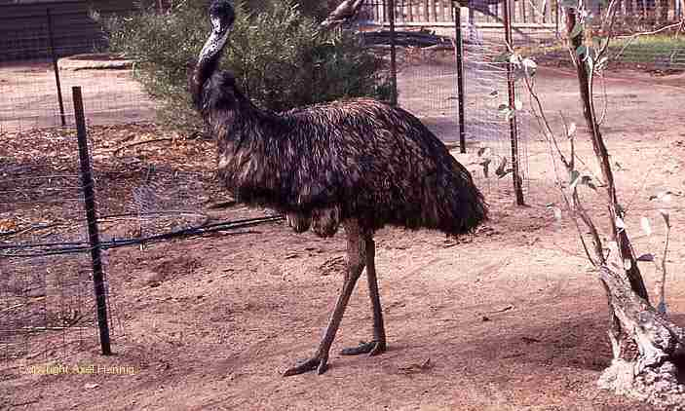
Purple Finch
Stork
Red-Tailed Hawk
Emu

