Slide 1
Amphibians – Basic Facts
Amphibian = “double life”
Live in both water and land
Most larvae are fishlike; adults are terrestrial carnivores
Larvae respire through skin/gills; Adults use lungs
Descendants of ancestral organisms that evolved some, not all, adaptations for life on land
First appeared 360 million years ago
External fertilization
Closed circulatory system; three chambered heart

Slide 2
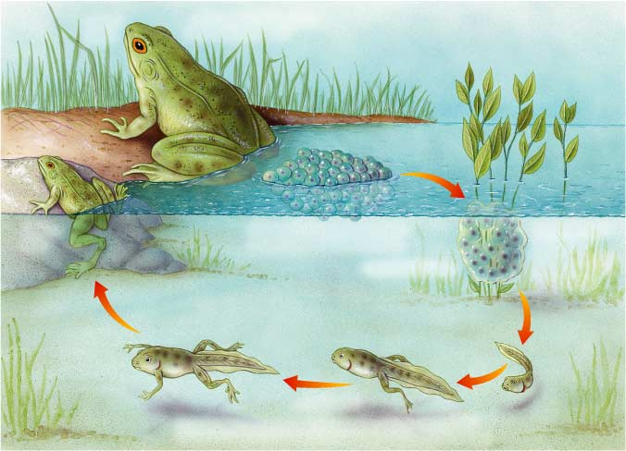
The Life Cycle of a Frog
Section 30-3
Adult Frog
Adults are typically ready to breed in about one to two years.
Young Frog
Frog eggs are laid in water and
undergo external fertilization.
The eggs hatch into tadpoles a few days to several weeks later.
Fertilized Eggs
Tadpoles
Tadpoles gradually grow limbs, lose their tails and gills, and
become meat-eaters as they develop into terrestrial adults.

Slide 3
Section 30-3
Amphibians
means
“Double life”
as
larvæ they live in
adults they live on
Water
Land
and have special adaptations such as
Bones
Lungs
Ribs
are
that allow for
that allow
that provide
Efficient movement
Breathing air
Support and protection
are

Slide 4
Groups of Amphibians
Salamanders –
Long bodies and tails
Adults are carnivorous
Usually live in moist woods
Frogs and Toads –
Lack tails
Frogs have long legs and are usually tied to water
Toads have shorter legs and not as closely tied to water
Caecilians –
Legless animals that burrow in moist soil
Have fishlike scales

Slide 5
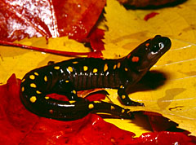
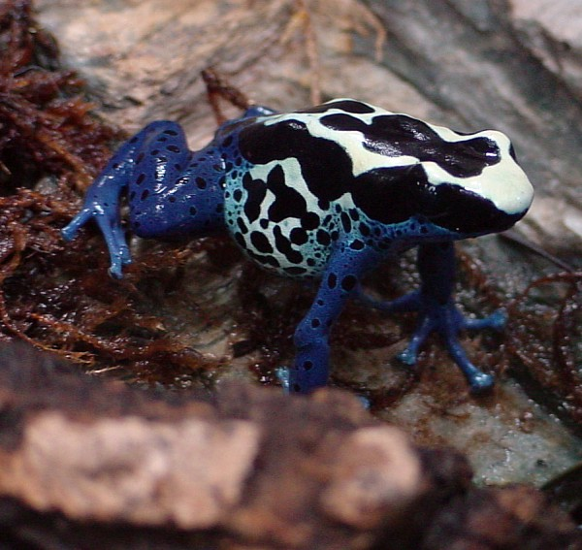
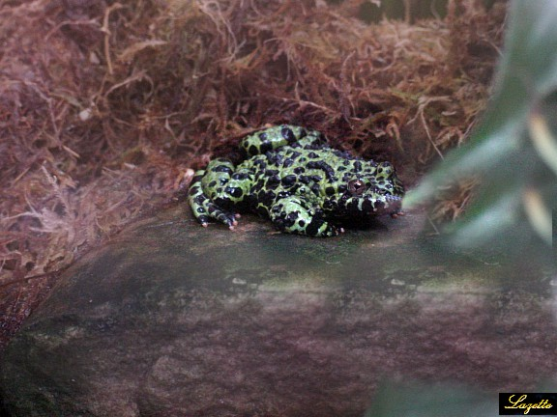
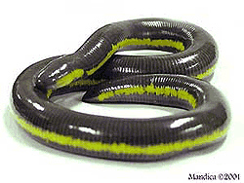
Spotted Salamander
Poison Dart Frog
Fire Bellied Toad
Caecilian

