Slide 1
Alejandra Rodríguez Peña
PUJ
Pedagogía y didáctica 1

Slide 2
Which are your expectations about this class?
I would like to organise my thoughts about teaching and how students could learn in a way that promotes their own motivation . I would like to have more new ideas to apply in my classes and learn to manage ICT’S.

Slide 3
Have you ever taught before?
Yes, I have taught to little kids personally and I have worked as a volunteer in a NGO and for MIRA. I love teaching but I am scared because I don’t know if those students are studying and learning extra things by themselves.

Slide 4
Would you use ICT’S in your language lessons?
Indeed, because I think nowadays is an innovative and this kind of things are very appealing to the students as they are each day closer to them (technology)and maybe in a near future classes would begin to use even more this kind of trends.

Slide 5
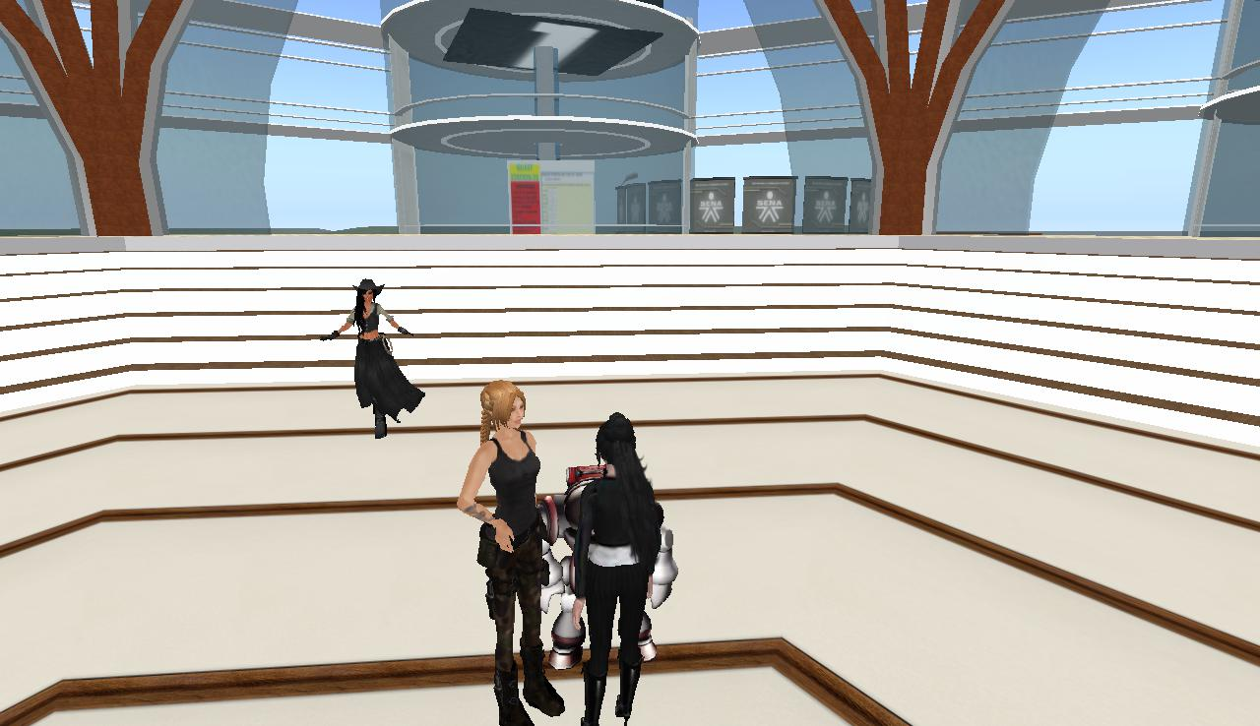
My Second life avatar
Her name is Alondra7 , she’s blonde and strong, she looks like a soldier ☺

