Slide 1
Classifying Lacerations of the Teat

Slide 2
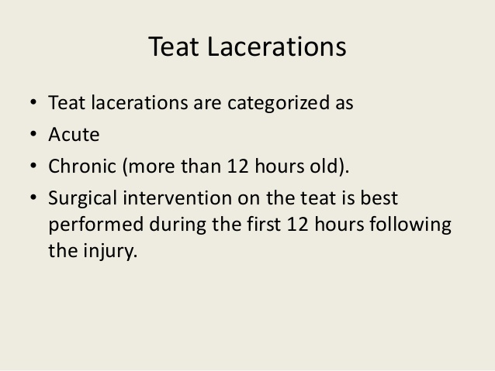

Slide 3
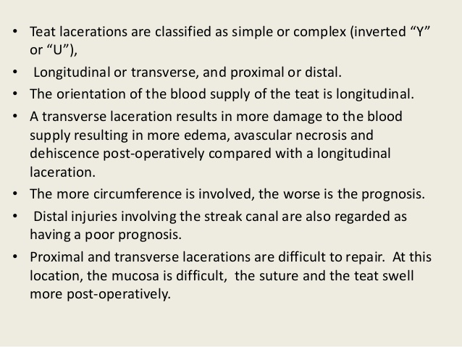

Slide 4
