Slide 1
Nerve Blocks for Teat Surgery

Slide 2
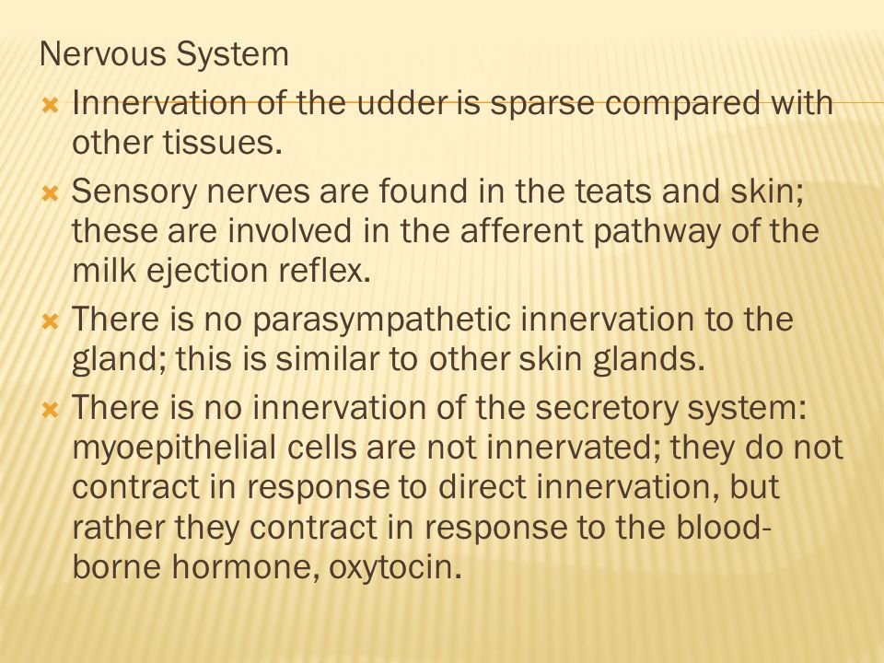
Nerve Blocks

Slide 3
Teat cistern infusion
Provides anaesthesia of the mucosa and submucosa of the teat cistern.
Under adequate physical restraint and sedation, milk out the teat cistern.
Cleanse the teat orifice thoroughly using alcohol.
Place a tourniquet (e.g. narrow gauze bandage or suture material) at the base of the teat. This prevents milk from entering the teat cistern and diluting the local anaesthetic.
Place a teat cannula in the teat and through this infuse 8 to 10 ml of local anaesthetic solution (2% lidocaine) through the streak canal into the teat cistern.
Analgesia of the mucosa of the teat cistern should occur in five to ten minutes.
Milk out the local anaesthetic solution once time has been allowed for analgesia to develop.
Remove the tourniquet.
Analgesia should remain for about 90 minutes

Slide 4
Ring Block
For most procedures done on teat. Easily done and does not affect healing.
Thoroughly cleanse the whole teat and teat base.
Ensure appropriate restraint of the cow.
Place an elastic band around the base of the teat if desired, to prevent diffusion of local anaesthetic into the udder.
  Do not place a tourniquet if a supernumerary teat is being removed
Insert a 2.5 cm 25 gauge needle into the skin and muscularis layer of the teat, transverse to the direction of the teat, dorsal to the area at which analgesia is required at the junction of the teat and the udder.
Inject local anaesthetic solution in a ring pattern around the teat.
Each insertion of the needle should take place through an area which has already been desensitized.
Inject a total of 4 to 6 ml 2% lidocaine; a volume of up to10 ml 2% lidocaine is acceptable.
Following injection, massage the solution into the tissues
Analgesia develops distal to the tourniquet in about 10 minutes and lasts for about two hours.

Slide 5
Inverted V Block
For surgical procedures on the teat such as repair of lacerations or fistulas
Thoroughly cleanse the whole teat and teat base.
Insert a 2.5 cm 25 gauge needle into the skin and muscularis layer of the teat dorsal to the area at which analgesia is required.
Inject a total of 4 to 6 ml of 2% lidocaine in an inverted V-shape enclosing the area in which analgesia is required (e.g. site of a laceration).

Slide 6
Intravenous Regional
Anesthesia of the Teat
For most surgical procedures on the teat
Restrain the cow, preferably recumbent.
Place a tourniquet (e.g. narrow gauze bandage or suture material) around the base of the teat.
Into any superficial vein distal to the tourniquet, using a 2.5 cm 22 to 25 gauge needle, inject 5 to 7 ml of 2% lidocaine
Provide digital pressure and gentle massage over the injection site to prevent formation of a haematoma
Analgesia develops in the area distal to the tourniquet within three to five minutes.
Analgesia persists until the tourniquet is removed.
Remove the tourniquet once the operation is completed; sensation returns in five to ten minutes once the tourniquet has been removed.

Slide 7
Perineal Nerve Block
Restrain the cow.
At the ischial arch, about 2.0 to 2.5 cm lateral to the midline on both sides, inject 5.0 to 7.0 mL of 2% lidocaine solution into the subcutaneous and subfascial tissues.

