Slide 1
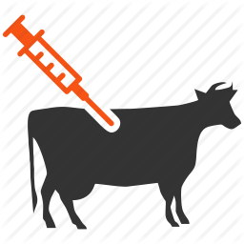
VOLUME OF 2% LIDOCAINE ADMINISTERED:
Toxic dose of Lidocaine: 10mg/kg, however half the toxic dose was used (5mg/kg)
Weight of cow: 600kg
Concentration of Lidocaine: 2% = 20mg/ml
Volume of drug: (5mg/kg x 600kg)/ 2mg/ml = 6ml of 2% Lidocaine
Since 1ml of Lidocaine was used initially to desensitize the skin the total amount of Lidocaine in the syringe before administration was 7ml.
Dosage x Weight Concentration

