Slide 1
INDICATION:
Ruminants are poor candidates for general anesthesia because of the increased risk of complications such as regurgitation, bloating, and muscle damage. Therefore, surgical interventions under local anesthesia in standing animals are preferred.
Paravertebral nerve block, local infiltration of anesthetic agents, intravenous regional limb perfusion, and epidural anesthesia are commonly used in ruminant surgery.
Various obstetrical operations, surgical procedures of the anus, vulva, perineum, caudal udder, and scrotum are performed under epidural analgesia. Epidural analgesia is also used as an adjunct for the treatment and control of tenesmus

Slide 2
Caudal epidurals can either be high or low.
High caudal epidural analgesia involves the administration of a relatively large volume of local anesthetic to provide analgesia to more cranial body regions and is used for performing hindlimb and flank surgery.
Low caudal epidural analgesia is more frequently used than the high epidural technique and differs only in the volume of the local anesthetic solution injected. Areas blocked: anus, perineum, vulva and vagina. Nerves blocked: coccygeal and posterior sacral nerves.

Slide 3
ADVANTAGES | DISADVANTAGES
Minimal effect on cardiovascular and respiratory systems. | Technically difficult if Co 1 and Co 2 interspace is not identified.
Little effect on organ systems. | Technically difficult if the sacrococcygeal interspace is ossified in older cows.
Little problem with toxicity.
Good muscle relaxation.
Good postoperative analgesia
Rapid recovery
Relatively simple
Inexpensive

Slide 4
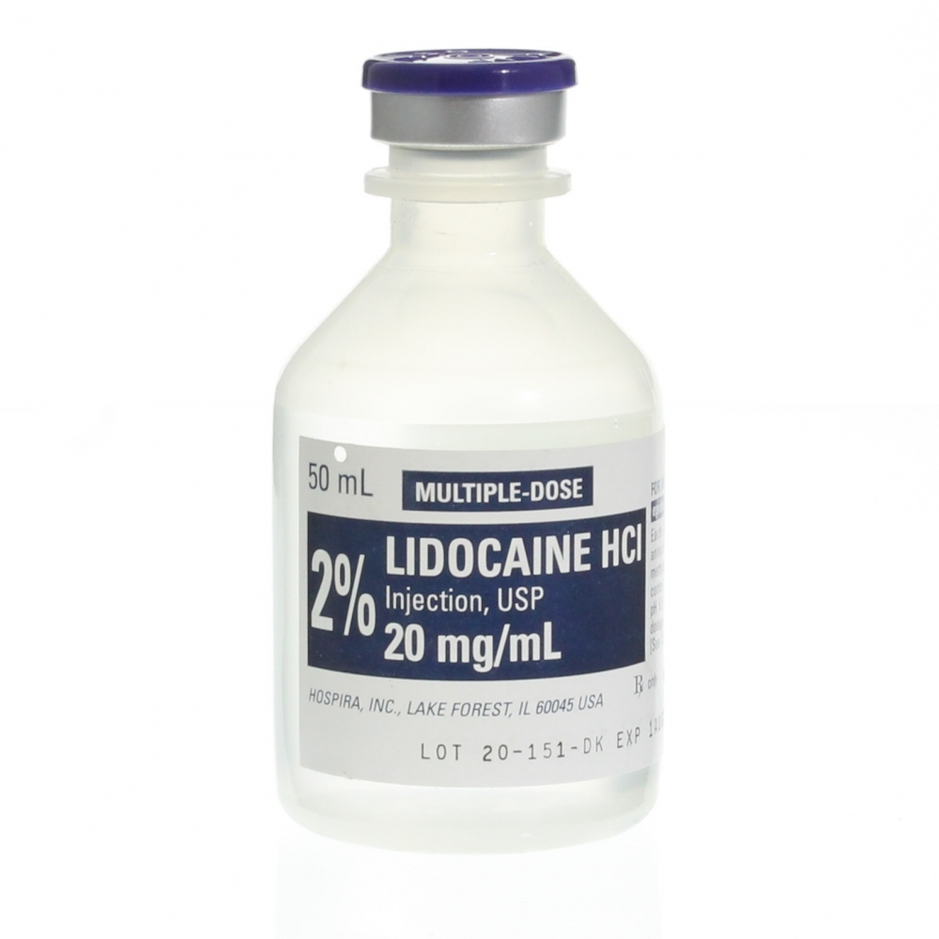
The recommended dose for adult cattle:
5-7ml of 2% Lidocaine.
This technique produces analgesia restricted to the
caudal perianal region and is useful for several
diagnostic and surgical procedures.
The number of ascending nerve blocked depends on dose
administered. Sacral nerves blocked are S5, S4 and S3. Lumbar nerves are left
unblocked to avoid issues associated with patient’s locomotion and
hind limb function.

