Slide 1
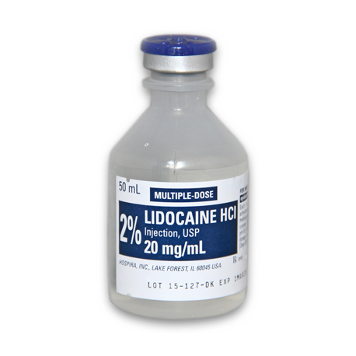
AGENT: Lidocaine HCL 2%
TRADE NAME: Xylocaine
CHEMICAL NAME: Diethylaminoacet -2,6 xylidiide
ONSET: Rapid (5-10 minutes)
DURATION: Intermediate (60-90 minutes)
INDICATIONS:
Lidocaine HCl with Epinephrine is a local anesthetic agent which can be used for infiltration or conduction (nerve blocking) anesthesia. It is twice as potent as procaine hydrochloride and produces more prompt, longer lasting and more extensive anesthesia than the latter preparation.
Lidocaine HCl is stable and non-irritating and although it is highly effective without an accompanying vaso-constrictor, epinephrine (1:100,000) has been included to lengthen the duration of anesthesia.
It is compatible with most commonly used IV infusion solutions. Compatibility is dependent upon factors, such as pH, concentration, temperature, and dilutants used. It is considered to be a class IB (membrane-stabilizing) anti-dysrhythmic agent. It is use as a local and topical anesthetic, lidocaine is used to treat ventricular arrhythmias.

Slide 3
Alternative Drugs
Xylazine 0.05 mg/kg. Inject after diluting to 5ml in 0.9% saline. Provides analgesia of the perineum and reduces straining during parturition.
  Analgesia develops by 20 minutes after injection and lasts for about two hours.
  Tail is flaccid, mild ataxia may occur.
  Also mild sedation, decreased ruminal motility (therefore bloat), bradycardia and decreased mean arterial pressure, due to some systemic absorption.
Medetomidine 0.015 mg/kg diluted to 5ml in 0.9% saline.
  Analgesia induced within 10 minutes and lasting for 412 +/-156 minutes (mean and standard deviation).
  Mild to moderate sedation and mild ataxia due to some systemic absorption. (B205.12.w12)
Combined lidocaine and xylazine. 2% lidocaine at 0.22 mg/kg together with 10% xylazine at 0.05 mg/kg, combined into a total volume of 5.7 ml per 500 kg bodyweight, produced analgesia from the coccyx to T13, with faster onset than administration of xylazine (0.05 mg/kg) alone and longer lasting than lidocaine (0.22 mg/kg) alone.

Slide 4
 | Lidocaine | Lidocaine/Xylazine
Castration | Common | Most common
Vaginal Prolapse | Common | Common
Uterine Prolapse | Common | Common
Foetotomy | Most common
Caesarian | Most common
Table1: Application of low dose epidural anesthesia in cattle and the most common drugs used for the different applications.
The choice of drug depends on the desired effect. In castrations analgesia is required, not only during the procedure but also during recovery. A combination of xylazine and lidocaine is therefore the best option. For caesarean sections and fetotomies it is necessary that the animal stops straining during the procedure. Lidocaine on its own can be sufficient in these cases depending on the length of the procedure. However, it is essential to ensure flank anaesthesia in addition to the epidural anaesthesia – epidurals do not fully anaesthetise the flank skin, muscles or peritoneum

