Slide 1
AURICULOPALPEBRAL NERVE BLOCK
DRUG USED:
LIDOCAINE HCL 2%

Slide 2
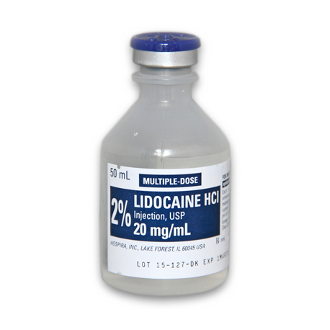
AGENT: Lidocaine HCL 2%
TRADE NAME: Xylocaine
CHEMICAL NAME: Diethylaminoacet -2,6 xylidiide
ONSET: Rapid (5-10 minutes)
DURATION: Intermediate (60-90 minutes)
INDICATIONS:
Lidocaine HCl with Epinephrine is a local anesthetic agent which can be used for infiltration or conduction (nerve blocking) anesthesia. It is twice as potent as procaine hydrochloride and produces more prompt, longer lasting and more extensive anesthesia than the latter preparation.
Lidocaine HCl is stable and non-irritating and although it is highly effective without an accompanying vaso-constrictor, epinephrine (1:100,000) has been included to lengthen the duration of anesthesia.
It is compatible with most commonly used IV infusion solutions. Compatibility is dependent upon factors, such as pH, concentration, temperature, and dilutants used. It is considered to be a class IB (membrane-stabilizing) anti-dysrhythmic agent. It is use as a local and topical anesthetic, lidocaine is used to treat ventricular arrhythmias.

