Slide 1
AURICULOPALPEBRAL NERVE BLOCK
EQUIPMENT AND
INJECTION APPARATUS

Slide 2
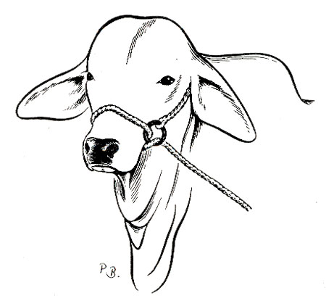
RESTRAINT
Halter- Along with being placed in a chute, a halter was placed on the cow.

Slide 3
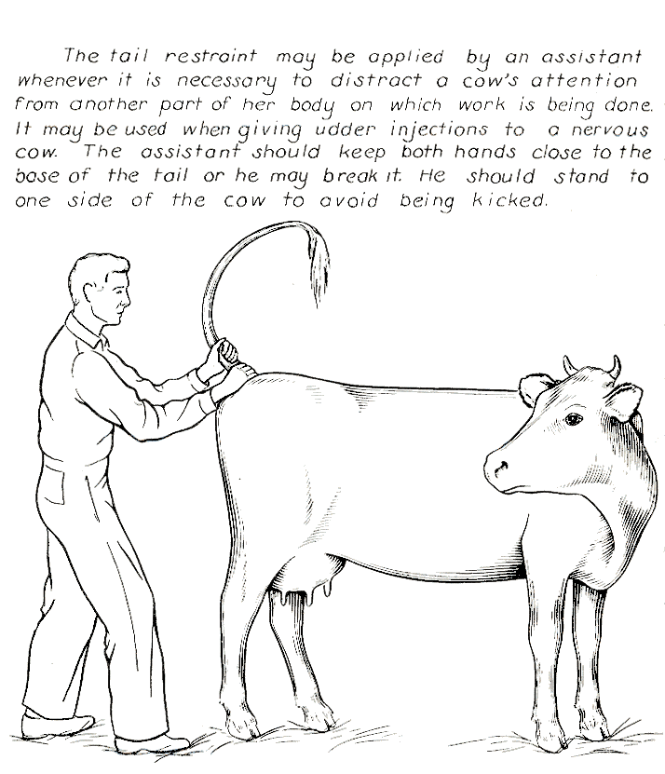
RESTRAINT
Tail Jack

Slide 4
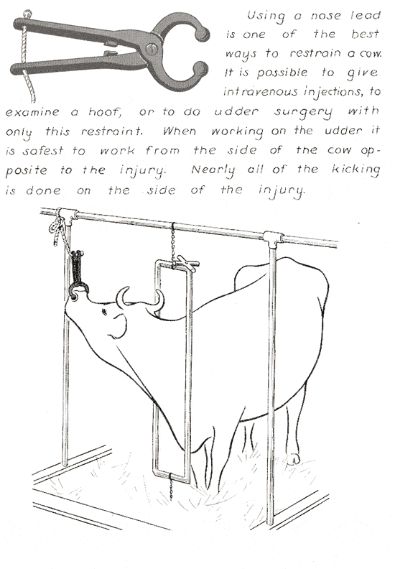
RESTRAINT
Nose Lead

Slide 5
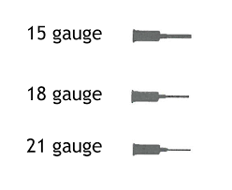
INJECTION APPARATUS
10ml Lidocaine HCL 2%
Sterile 21-Gauge 1.5 inch needle
Sterile 20ml Syringe
Cotton ball soaked with alcohol to thoroughly clean area to be injected

