Slide 1
AURICULOPALPEBRAL NERVE BLOCK
METHOD

Slide 2
SITE OF BLOCK/ANATOMY:
Anaesthesia of the eyelid is accomplished by performing a line block of the eyelid or by blocking the auriculopalpebral branch of the facial nerve. The site is directly at appoint midway between the imaginary line drown from the lateral canthus of the eye and the temporal fossa.

Slide 3
TECHNIQUE:
In bovine a 22- gauge,3-5 cm long needle is inserted subcutaneously at a point midway between the imaginary line drown from the lateral canthus of the eye and the temporal fossa and inject 3-5 ml of 2% Lidocaine HCL is injected subfacially.

Slide 4
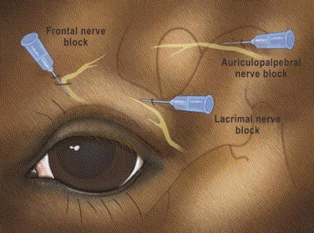
FIGURE 1: ILLUSTRATION DEMONSTRATING THE DIRECTION OF INSERTION OF THE NEEDLE INTO THE BRANCHES OF THE FACIAL NERVE TO ACHIEVE THE AURICULOPALPEBRAL NERVE BLOCK.

Slide 5
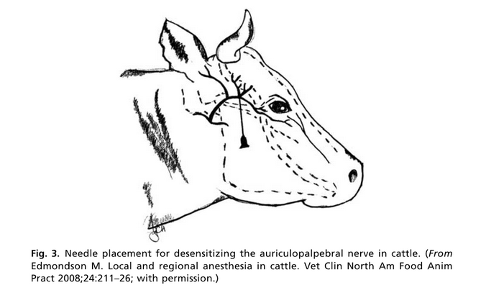
FIGURE 2 SHOWING NEEDLE PLACEMENT FOR DESENSITIZING THE AURICULOPALPEBRAL NERVE IN CATTLE.

