Slide 1
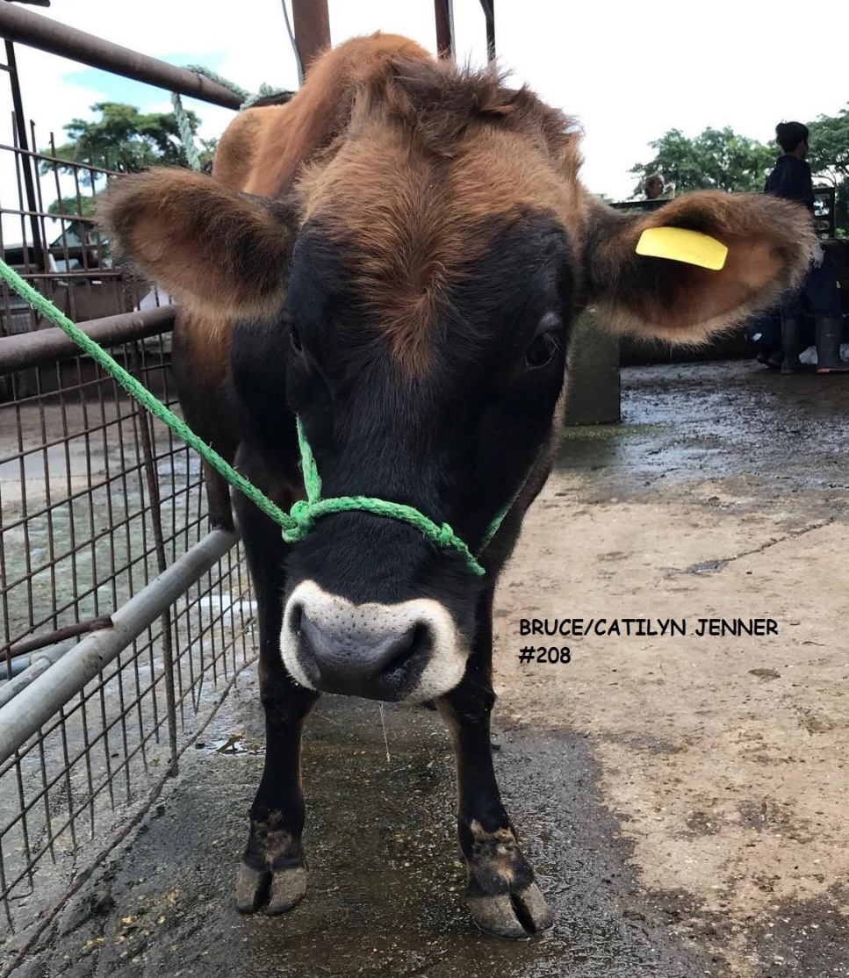
CASTRATION IN BULLS
Subtle

Slide 2
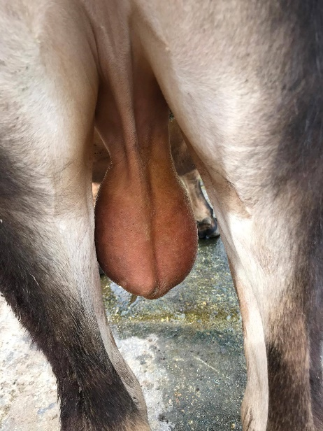
What is castration?
The removal of testicles in a male animal.
The functioning of the testicles is stopped by preventing the production of the male hormones so that the animal is unable to reproduce.

Slide 3
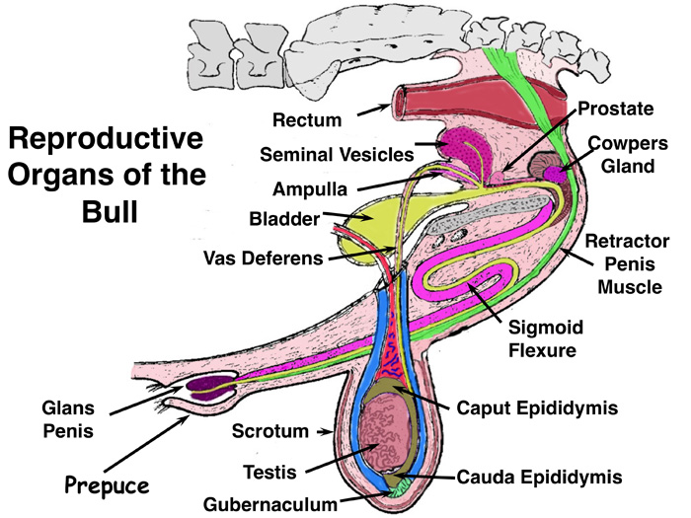
The Male Reproductive Tract - Overview
The reproductive tract of a bull has two parts –
1. The testicles, including
  Seminiferous Tubules
  made of Leydig Cells
  and Sertoli Cells
2. The secondary sex
organs, including…
  Epididymis
  Vas Deferens
  Seminal Vesicle
  Prostate Gland
  Cowper’s Gland
  Urethra and Penis

Slide 4
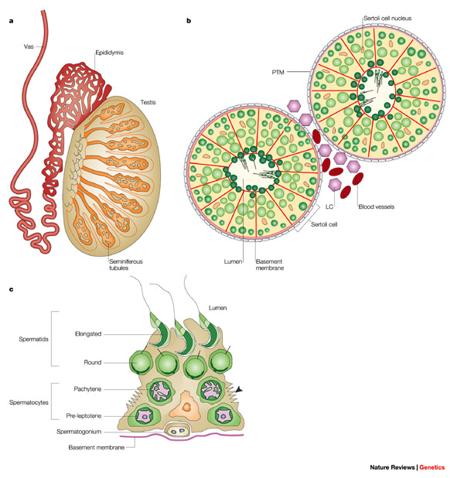
The Testicles
The testicles have two functions:
1. Production of the spermatozoa that will become the sperm cells
2. Production of testosterone, the ‘male’ hormone
The testicle is the entire organ, consisting of the testis (plural: testes), the scrotum (outer covering of skin), and beginning of the epididymis

Slide 5
Why do we castrate cattle?
To prevent them from mating after they reach puberty.
Steers (young neutered males) are usually more docile and easier to handle than bulls.
Steers are also not as rough on equipment and are easier to manage as new individuals added to feedlots.
Steers are finished earlier (fatten quicker) than bulls because fat deposition occurs at a faster rate in bulls.

Slide 6
Steers produce a carcass with finer texture of lean and more marbling.
Beef marketing system favours steer carcasses.
Steer carcasses can be marketed through a greater number than bull carcasses.
Steers can be mixed with females in pastures or in lots without causing any management problems.
Eliminates possibility of using inferior bulls.

Slide 7
When to castrate?
Can be done at any age up to 12 months, but is better before 2 months of age.
Older calves tend to suffer a great set back from the castration (which cost the producer money).
Easier to handle animals when they are young.
Avoid extremes in weather. Too hot, too cold, or wet days should be avoided.

Slide 8
Testosterone effect
Some producers delay castration to take advantage of the growth effects of the male hormone testosterone. Testosterone secretion commences between 3.5 and 5.5 months. The differences in liveweight gain of castrates and bulls are first apparent at four to five months.

Slide 9
Choice of castration methods
Castration may be accomplished by physical, chemical or hormonal techniques. Physical methods are most common.
Testicles may be removed surgically or killed by obstructing the blood supply.
Young calves may be castrated with rubber rings, Burdizzo or by surgery.
Surgical castration may be more appropriate for calves that are not handled until weaning.

Slide 10
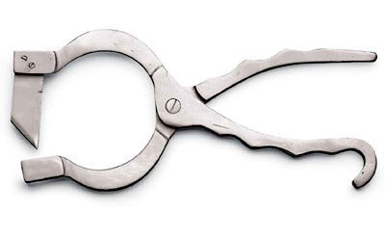
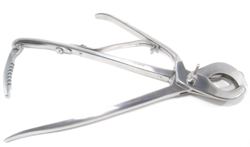
Methods of castration
Open method: Surgical technique- Emasculator / knife
  Open uncovered or “open open” method
  Open covered or “ open closed”

Slide 11
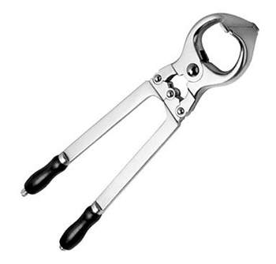
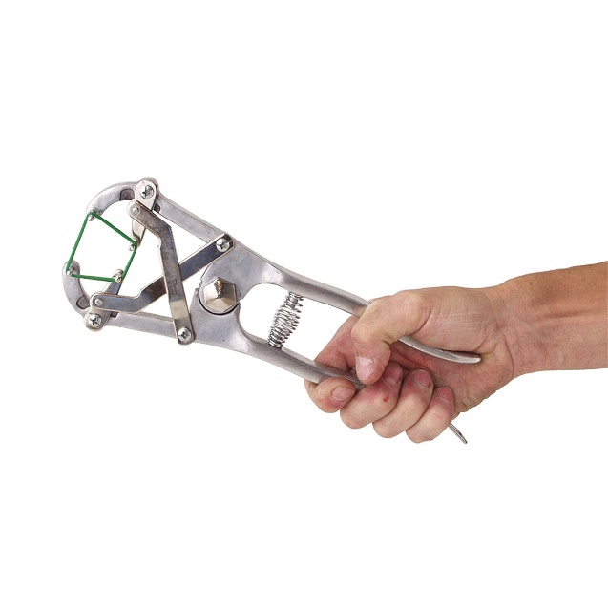
Closed method: Bloodless technique
  Emasculator- Burdizzo®
  Elastic banding - Elastrator
    - EZE Bander, Calicrate Bander

Slide 12
Immunocastration and chemical castration:
  Immunocastration involves the use of hormones to suppress the production of testosterone. Chemical castration includes the injection of toxic chemicals, such as lactic acid, directly into the testes to cause irreparable damage.
  Immunocastration only offers a temporary effect and the injections must be repeated (usually at six month intervals) throughout the animal’s life.
  Chemical castration requires a lot more skill than other methods of castration and has a much longer healing time – and therefore a greater negative impact on animal welfare than other forms of castration. It also has a high failure rate.
  Therefore this method is not recommended and any producer who wishes to use these methods must provide justification and get prior approval from Animal Welfare Approved.

Slide 13
Conclusion
Calves should be castrated as young as possible utilizing a method that causes the least chronic (long-term) pain. Surgical castration or using an emasculatome is preferable to banding, unless calves can be banded within a week of birth.
The use of an emasculatome may be preferable when environmental conditions increase the risk of complications related to other castration methods.
Regardless of castration age or method, proper surgical techniques and tool sanitation are imperative to minimize infection.

