Slide 1
CASTRATION Procedure USING THE BURDIZZO CLAMP
The calf’s testes were cleaned with Chlorohexidine and alcohol. Bruce testicles were measured, 18 cm by 8 cm, it is usuful to compare the testicular sizes before and after to assess the success of this procedure.
The left spermatic cord was palpated and pinched to the outside edge of the scrotum between the thumb and forefinger.
The spermatic cord was placed in between the Burdizzo clamp. The Burdizzo jaws were placed just above the top of the testicle. The spermatic cord was palpated regularly to ensure that it was within the jaws of the Burdizzo.
The Burdizzo clamp was closed and a “POP” sound was noted. The spermatic cord was held in the jaws for one (1) minute and was then released.
The spermatic cord was re-palpated to confirm that it was indeed crushed by the Burdizzo.
Steps 1-5 were repeated 1.5 cm under the first crush site to make a second crush site.
Steps 1-6 were then repeated for the right spermatic cord. The crush lines must not overlap the center-line of the scrotum
Generally, after 3 months both testicles should have atrophied, noted by a comparative decrease in size, indicating a successful procedure

Slide 2
ADVANTAGES and disadvantages OF USING THE BURDIZZO CLAMP
ADVANTAGES
Bloodless
Less reduction in weight gain after castration compared to surgical or latex-band
DISADVANTAGES
Slow to perform and requires expertise
Unreliable when done incorrectly, leads to stags
Equipment becomes ineffective after long-term use and must be replaced

Slide 3
PAIN MANAGEMENT WHEN USING THE BURDIZZO CLAMP
Local anaesthesia (e.g. Lidocaine 2%) plus a non-steroidal anti-inflammatory drug are needed to eliminate acute pain caused by Burdizzo castration
Acute pain caused by Burdizzo clamps is less than that caused by surgical, rubber-ring or latex-band castration

Slide 4
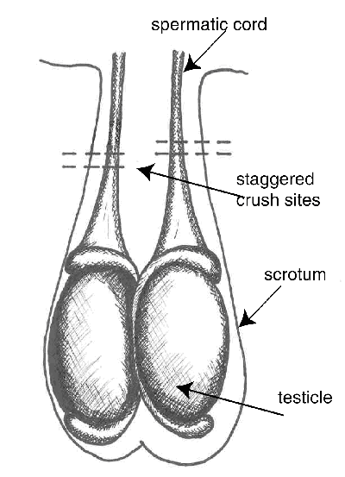
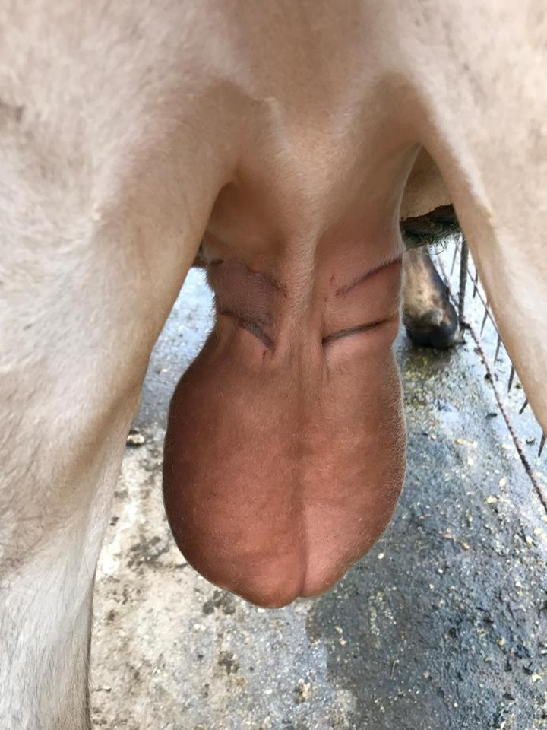
PRINCIPLE OF THE BURDIZZO CLAMP
Staggered crush sites
The Burdizzo (emasculatome) method crushes the blood vessels within the spermatic cord, shuts off blood supply to the testicle resulting in its atrophy and resorption when properly applied.
Staggered crush sites on “Bruce” after the Burdizzo was applied twice on each side.

