Slide 1
Basic Anatomy

Slide 2
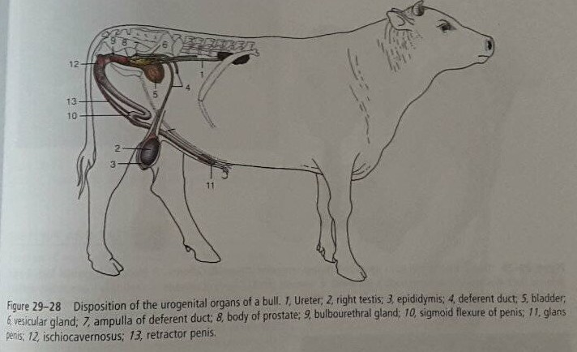

Slide 3
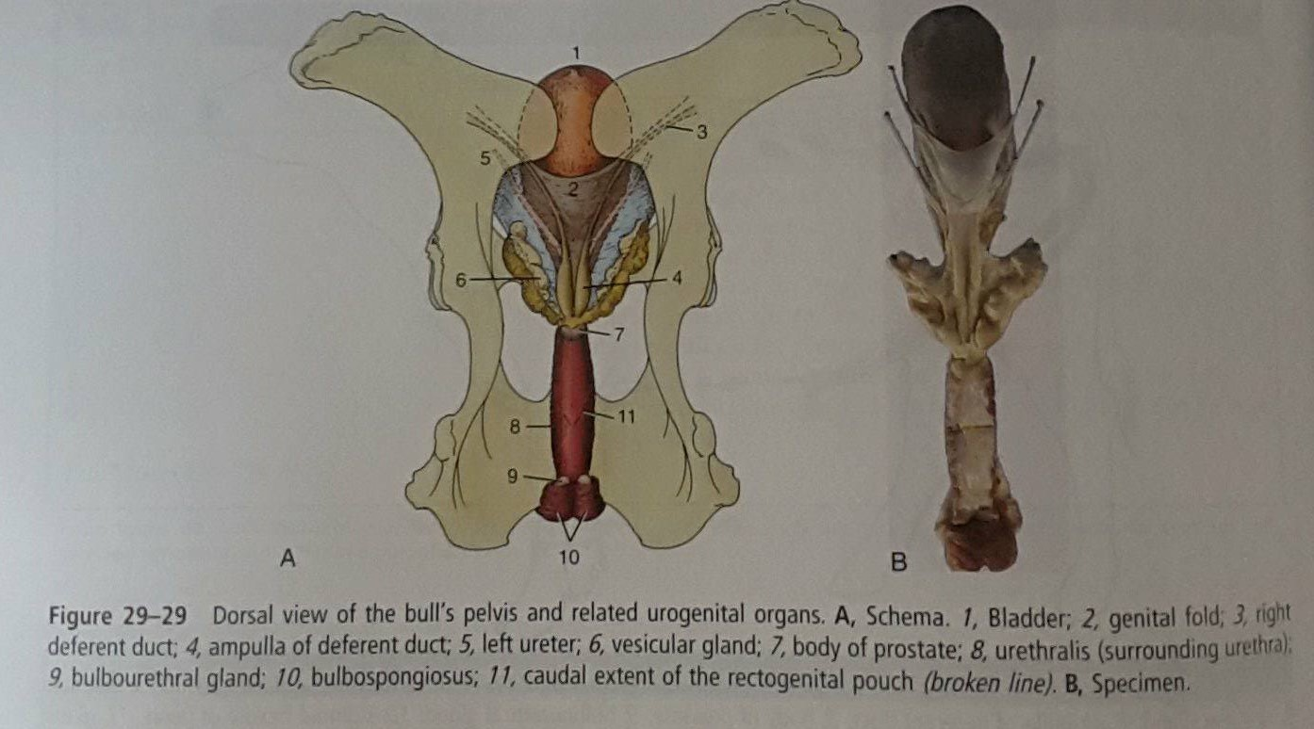

Slide 4
