Slide 1
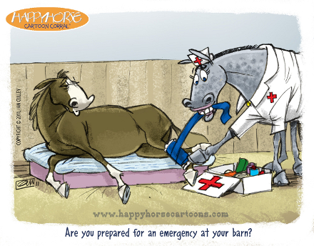
palmar digital neurectomy: INTRA-Operation

Slide 2
SURGICAL TECHNIQUE
In both the simple guillotine method and the technique of epineural capping, the approach to the nerve is the same. In the simple guillotine technique, a 2-3cm long incision is made over the dorsal border of the flexor tendons.
If epineural capping is to be performed, the incision is generally 3-4 cm long and is continued through the subcutaneous tissue. It is important that the tissues be subjected to minimal trauma. An incision over the dorsal border of the flexor tendons generally brings the operator close to the palmar digital never.
Variation exists, but the relationship of vein, artery, nerve and the ligament of the ergot assists the surgeon’s orientation. At this stage of the dissection, the surgeon should look for accessory branches of the palmar digital nerve. These branches are commonly found near the ligament of the ergot. If an accessory branch is found, a 2cm portion is removed using a scalpel.

Slide 3
GUILLOTINE METHOD
A 3cm skin incision is made parallel and axial to the palmar digital nerve.
The jaws of a curved haemostat is used to separate the subcutaneous tissues and to expose and isolate the palmar digital nerve from the adjacent palmar digital artery.
After identification, the nerve is elevated from its bed and the distal portion is transected sharply using a scalpel blade.
Haemostats are then placed on the proximal end of the transected nerve to allow traction over a sterile tongue depressor.
The nerve is transected under tension about 2.5cm long using a razor blade so the proximal end is recoiled proximal to the incision.
The surgical site is flushed with sterile saline and closed using a simple continuous layer of 2.0 polyglactin 910 in the subcutaneous tissue and simple interrupted sutures in the skin.

Slide 4
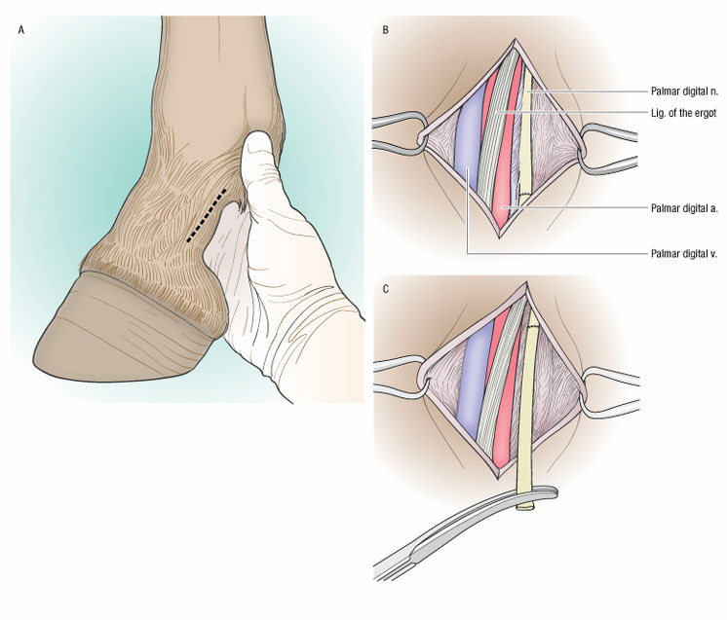
GUILLOTINE METHOD

Slide 5
EPINEURAL CAPPING TECHNIQUE
As in the guillotine technique, the surgical dissection and exposure of the nerve are accomplished.
A section of nerve 3-4cm long is exposed and freed from all fascia, connective tissue and palmar digital artery.
The nerve is severed as distally as possible and is raised from the incision.
The end of the nerve is then held with forceps and the epineurium is carefully reflected for 2-3cm.
Two incisions are made through half the nerve on each side.
The nerve is then severed distal to these cuts and the epineurium is pulled back over the severed and is ligated with 2.0 polypropylene suture.
The surgical site is flushed with sterile saline and closed using a simple continuous layer of 2.0 polyglactin 910 in the subcutaneous tissue and simple interrupted sutures in the skin.
A padded pressure bandage is applied extending from distal to the coronary band to the proximal cannon bone region.

