Slide 1
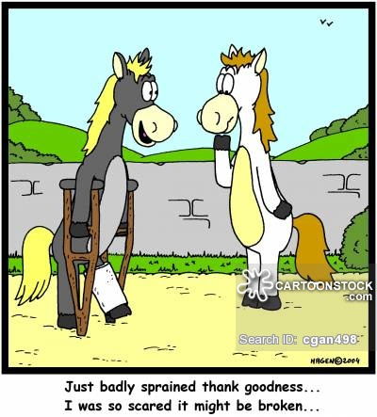
palmar digital neurectomy:
POST-Operation

Slide 2
POST-OPERATION MANAGEMENT and Client information
The bandage pressure bandage is changed every 4 to 5 days for 2 weeks at which time the skin staples are removed.
The horse is stall-confined for 30 days after which time light exercise can resume. Return to full training occurs 60 days postoperatively.
Administer tetanus prophylaxis.
Bute –2 gm daily for 5 days then 1 gm SID for 5 days
It is important to minimize movement and inflammation at surgery site to decrease scar tissue.
SKIN SUTURE REMOVAL AT 2 WEEKS:
  6 mg triamcinolone at proximal nerve stump subcutaneously
  Decreases post-op painful neuromas
  Rebandage for 2 more weeks

Slide 3
POST-OPERATION MANAGEMENT and Client information
PREVENTION:
  The most important thing you can do to prevent Navicular Syndrome in your horse is to be sure he has proper shoeing. This can mean more than just using a quality farrier. The use of performance radiographs to maximize the balance in the foot is very important to get optimal performance and to prevent Navicular Syndrome.

Slide 4
POSSIBLE COMPLICATIONS
  Painful neuroma formation
  Rupture of deep digital flexor tendon
  Regeneration of transected nerve
  Incomplete desensitization of the heel or navicular area from aberrant branches
  Loss of hoof wall
  Some horses stay pain free for several months while others stay pain free for several years.
  Pain or chronic lameness often remains even after proper treatment and rehabilitation due to enlargement of the ligament, causing a compartment-like syndrome and compression on the nerve.

Slide 5
RETURN TO ATHLETIC PERFORMANCE
  Navicular bone fractures:
    Some horses have been returned to performance with a palmar digital neurectomy, but many of these horses develop osteoarthritis of the distal interphalangeal joint, and there is an increased risk of catastrophic failure of the DDFT in those patients.

Slide 6
SUCCESS RATE OF PALMAR DIGITAL NEURECTOMY
  In approximately 70% of horses which undergo palmar digital neurectomy, about 90% of their lameness is resolved.

Slide 7
NEED TO REPEAT PALMAR DIGITAL NEURECTOMY
  When the horse begins to show signs of navicular syndrome again, including heel soreness, short, choppy steps in front, tripping and lameness in one or both front feet, he can undergo a second neurectomy, but its effective duration is potentially only half as long as the first procedure. In performing a second neurectomy, the surgeon has to cut higher on the nerve and dissect around scar tissue, which makes the procedure more difficult and unpredictable.

