Slide 1

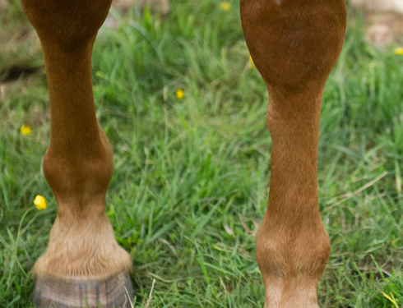
Anatomy of splint bone

Slide 2
Anatomy
The small metacarpal and metatarsal bones (splint bones) are an important and integral part of the supporting and stabilizing structures of the equine limb.
There is dynamic relationship between the splint bones, the cannon bone and the proximal articulations.
This relationship is modulated by the interosseous ligament that attaches the proximal two thirds of the splint bones to the cannon bones and by the prominent soft tissue attachments to the proximal end of each splint bone.

Slide 3
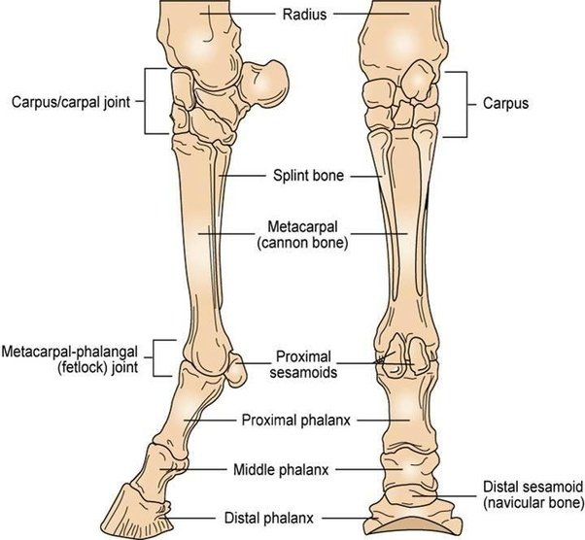
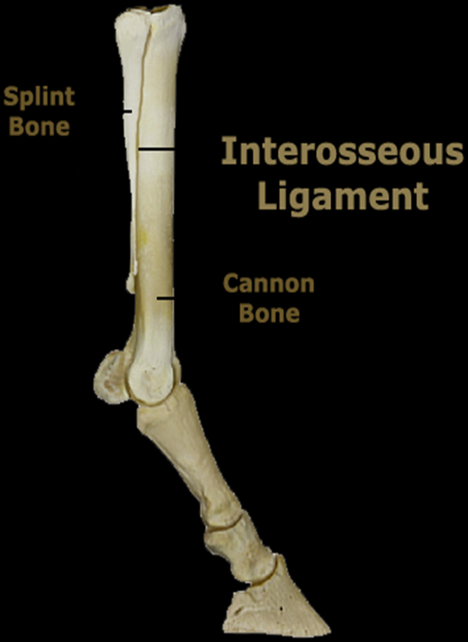

Slide 4
Indications for splint bone removal

Slide 5
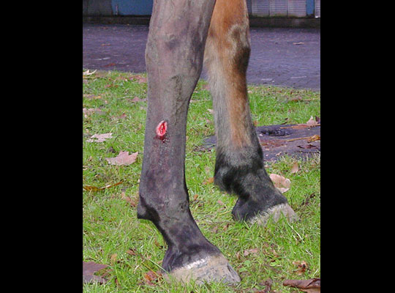
Fractures of the splint bones are common in horses and can occur anywhere along the length of the bone.
These fractures have historically been classified as involving the proximal, middle or distal third of the bone; being simple or complicated.
Fractures can result from either external or internal trauma. External trauma comes from interference, a direct blow from an inanimate object, or more often a kick from another horse.

Slide 6
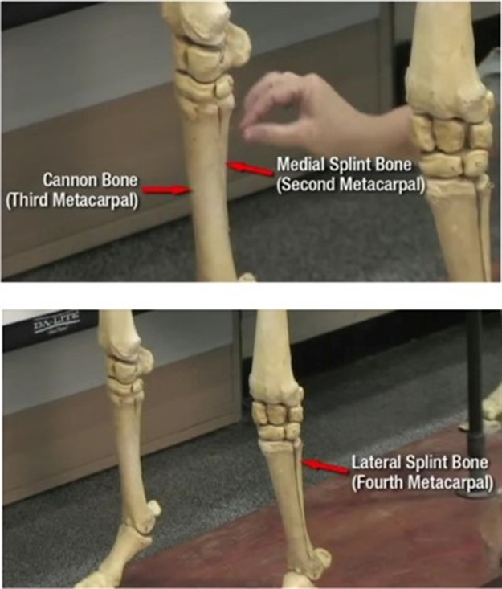
External trauma often causes open fractures with sequestration of the fracture fragments and osteomyelitis at the fracture site.
Open fractures occur more commonly in the lateral splint bones (4th metacarpal and metatarsal bones), owing to their exposed anatomic location.
Fractures from internal trauma occur most frequently in racehorses.
Axial compressive loading of the splint bones can result in fractures of the proximal third of the bone. Such a fracture is more likely in the small metacarpal bones (esp. 2nd metacarpal) because of the prominent articulations of the carpus.
More commonly internal fractures have been implicated in fractures of the distal third of the splint bone. There are strong fascial (ligamentous) attachments from the distal end of the splint bones to the suspensory apparatus in the area of the proximal sesamoid bones and fetlock fascia.

Slide 7


Clinically, these findings are consistent with the reports indicating that 81% of the Standardbreds and 67% Thoroughbreds with distal splint bone fractures have concurrent suspensory desmitis

Slide 8
Diagnosis of splint bone injury

Slide 9
Diagnosis
Clinical Examination
  Most splint bone fractures will result in some degree of lameness which is evident during clinical examination. Swelling and pain associated with the fracture site is usually present. In severe cases of open fracture, bone fragments within the wound may be visible to the naked eye.

Slide 10
High palmer nerve block
Needle and anesthetic volume = 25 gauge, 5/8” (1.6 cm); 3 ml per site. This block requires desensitizing both the palmar nerves and the palmar metacarpal nerves.
With the horse bearing weight, insert the needle just distal to the carpometacarpal joint and perpendicular to the palmarolateral or palmaromedial aspect of the limb, advancing the needle to the dorsal surface of the deep digital flexor tendon and location of the palmar nerve.
To block the palmar metacarpal nerve, the limb is held in hand. Again, just distal to the carpometacarpal joint, the needle is inserted between the axial surface of the splint bone and the palmar third metacarpal bone

Slide 11
DRUG | ONSET | DURATION
Lidocaine http://equimed.com/drugs-and-medications/reference/lidocaine-hydrochloride | Fast | 1-2 hours
Mepivicaine (Carbocaine) http://equimed.com/drugs-and-medications/reference/mepivacaine-hydrochloride | Fast | 2-3 hours
Bupivicaine https://www.dropbox.com/home?preview=Bupivacaine.docx | Intermediate | 3-6 hours

Slide 12
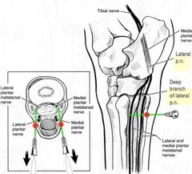
This block anesthetizes the:
deep and superficial digital flexor tendons
splint bones and their interosseous ligaments
proximal suspensory ligament
inferior check ligament

Slide 13

Radiographic Examination
  Most veterinarians elect to confirm a suspicion of splint bone fracture through radiographic examination (i.e. by taking “x-rays”) of the affected limb. A tangential view (which highlights the area in question independently of surrounding bone) is generally diagnostic.

