Slide 1
Complications of resulting from spine bone removal

Slide 2
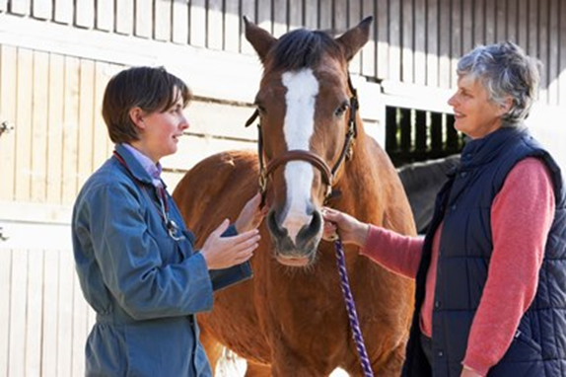
Client considerations for post operative care for splint bone removal

Slide 3
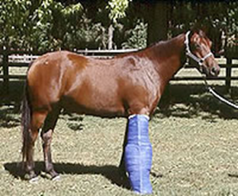
Majority of horses with splint bone fractures are allowed to recover from anaesthesia with limb in a heavy pressured bandage. With proximal fractures, especially in forelimbs, consideration should be given to applying the Robert- Jones bandage with splinting or full limb cast for recovery.
The amount of external support required depends on the temperament of the animal, the recovery facility, and the type and stability of the repair.

Slide 4
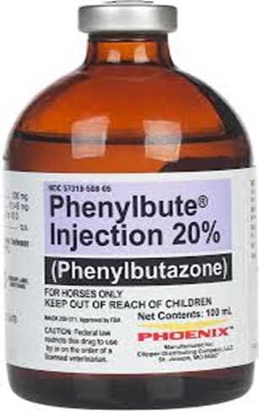
NSAID drugs; Phenylbutazone (2.2 to 4.4 mg/kg b.w) for 5-7 days post operatively to control pain and inflammation.
Antibiotics are not necessary in simple closed fractures unless implants are used in which case preoperative antibiotics may be instituted prior to surgery 48-72 hours postoperatively. For open fractures or those with radiographic evidence of osteomyelitis or sequestration, antibiotics should be administered

Slide 5
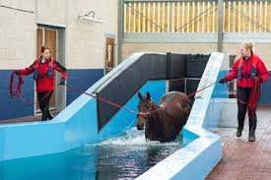
Bandages should be changed every 3-4 days until sutures are removed in 10-14 days.
After removal of the sutures, a mild rubefacient may be applied to help control the swelling, and the leg should remain bandaged for an additional 7-10 days.
Horses should be confined to a stall for 7 days, followed by an additional 30 days of stall rest with hand walking 15-20 minutes twice a day.
Swimming may be started 14-21 days post operatively, if the wounds are healed, to maintain fitness and provide hydrotherapy for swollen soft tissues.

Slide 6
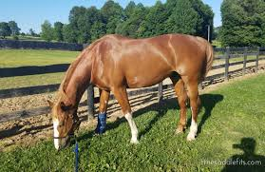
After initial confinement period, horses may be turned out to pasture or started in a controlled exercise program, depending on the degree of sot tissue damage and the temperament of the animal.

Slide 7
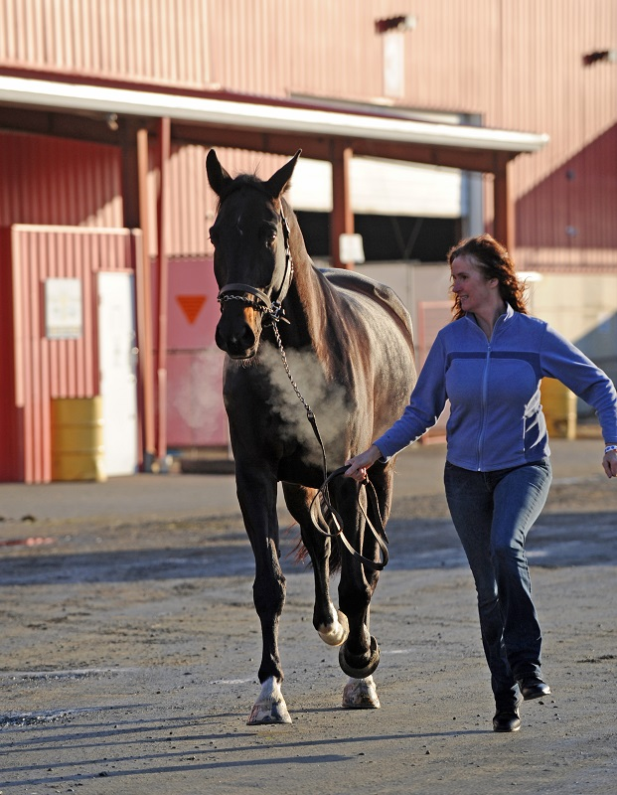
Prognosis
The prognosis for racehorses with splint bone fractures is worse than that for horse who engage in other athletic endeavours. The prognosis for return to athletic function for horses with fractures of the distal third of the splint bone is largely dependent on the presence of suspensory desmitis.
In one study, none of the Thoroughbreds and only 25% of the Standardbreds that had preoperative suspensory returned to their previous level of performance.
Fractures of the middle third of the splint bone treated by amputation of the fracture and distal splint carry a very good prognosis for soundness, regardless of whether the fractures are open or closed or simple or complicated.

