Slide 1
Medial Patellar Ligament Desmotomy Pre-operation

Slide 2
Indications
Upward patellar fixation (UPF) occurs when the patellar fibrocartilage and the medial patellar ligament fix over the medial trochlear ridge of the femur, inhibiting flexion of the hock and stifle.
Some predisposing factors are poor muscle tone and condition, straight hind limb conformation, stifle trauma and hereditary factors.

Slide 3
Indications
Depending on the duration and severity for the recurrent UPF, the medial patellar ligament desmotomy should be considered as the last resort, since many cases respond to more conservative therapy. Example young horses will improve after appropriate conditioning and development of quadriceps muscle tone through training.

Slide 4
Contraindication
Long-term osteoarthritis may result due to mal-tracking of the patella and/or altered gait.
May predispose to patella fragmentation.

Slide 5
Welfare consideration
http://www.thehorse.com/articles/31656/equine-field-anesthesia-considerations
Please refer to the link for field anaesthesia considerations.
Also refer to the pdf for general welfare considerations.

Slide 6
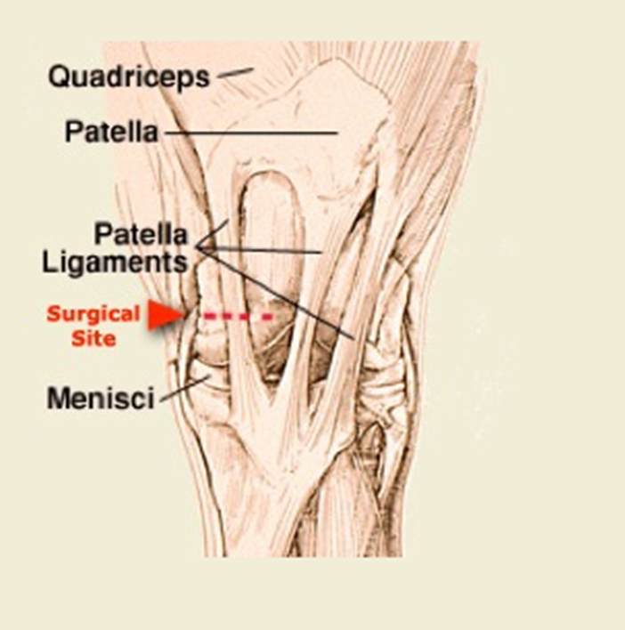
Anatomy

Slide 10
Equipment
Halters
Chlorhexidine
Iodine solution
Alcohol
Cotton/ gauze
Sterile pack
Radiography/ Ultrasound Equipment
Blunt-ended bistoury (tenotomy) knife.
Scalpel blade
Non-absorbable suture(polypropylene/ nylon)
Needle and syringes
Surgical drapes
Sterile instruments.

Slide 11
Physical Examination
https://www.youtube.com/watch?v=0t5jfk4ainU
Please refer to the link that shows distance and physical examination of a horse.
Also note the ASA grade of a horse must be 1 to preform the surgery.

Slide 12
Drugs
$\frac{DOSE X WEIGHT}{CONCENRATION }$ = (Volume of drug) ml
Sedatives: xylazine (Rompun), detomidine (Dormosedan) and romifidine (SediVet)
Tranquilizer: sacepromazine (short-acting), fluphenazine (long-acting)
Tetanus Antitoxin
Useful link drugs categorized by name:
http://equimed.com/drugs-and medications/reference/xylazine

Slide 13
Drugs

Slide 14
Preparation for the surgery
Ensure the surgery room/stall in clean thoroughly to avoid any contamination during surgery.
Further more pre-surgery radiographs should be done before the animal is prep.
Administer Tetanus antitoxin by injecting 1 mL dose intramuscularly using aseptic technique. Administer a second 1 mL dose 4 to 8 weeks after the first dose. Revaccinate annually using one 1 mL dose.
The surgical procedure is performed with the animal standing.
The horse is sedated using sedatives
Depending on the horse’s temperament tranquilizers can be used.

Slide 15
Preparation for the surgery
Next the horses tail is wrapped to avoid contamination of the surgical site.
After the horse is sedated, the area of the middle and medial patellar ligament is clipped.
Following that the site is surgically prepared. This is done by scrubbing the area with alcohol (removing any heavy debris) and then wiping the area with iodine in a unilateral manner starting from the center of the site.
2ml of the local anesthetic are injected subcutaneously over the medial border of the middle patellar ligament.

Slide 16
Preparation for the surgery
A 1 inch, needle is then inserted through this bleb, and the subcutaneous area around the distal part of the medial patellar ligament is infiltrated with the local anesthetic of choice.

