Slide 1
Intra Operation Pictures
A flow of the procedure

Slide 2
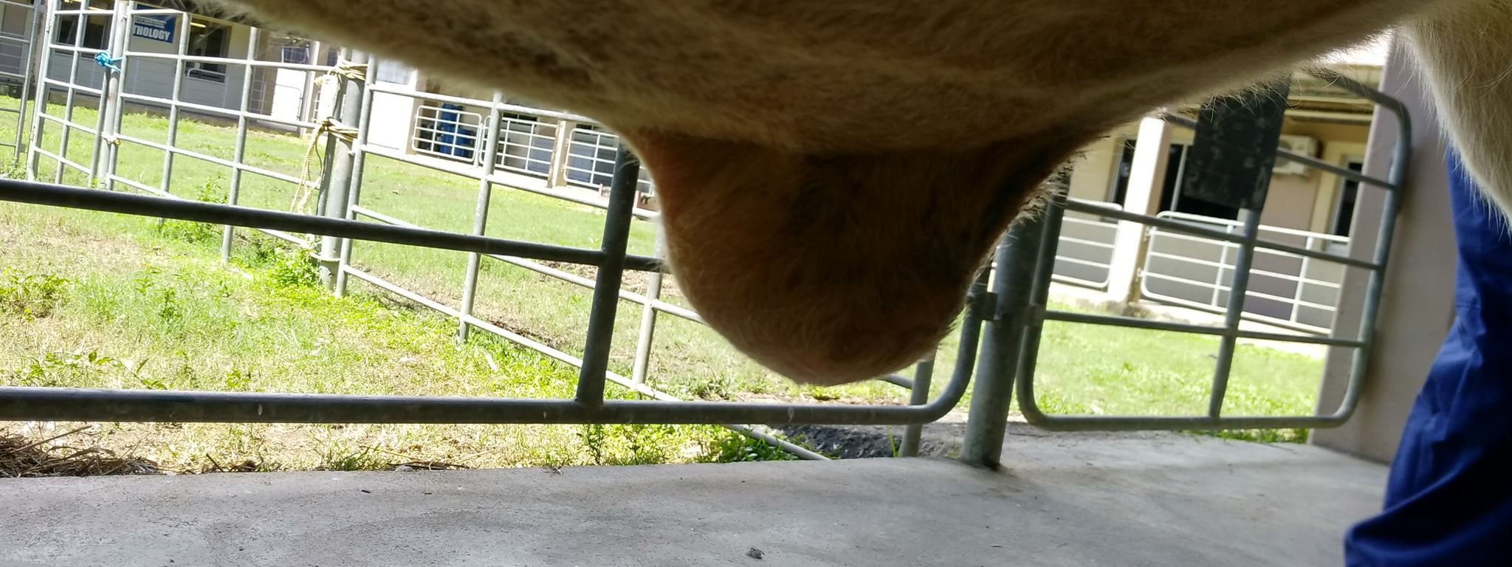
1. Hernia before

Slide 3
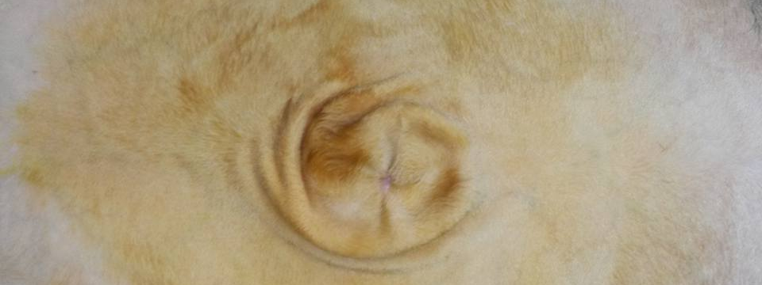
2. Reducible hernia

Slide 4
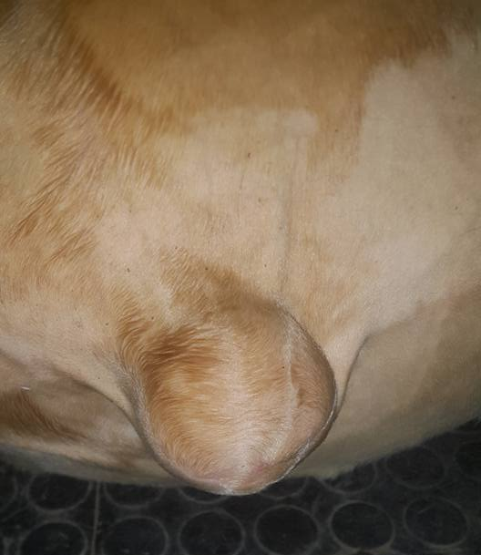
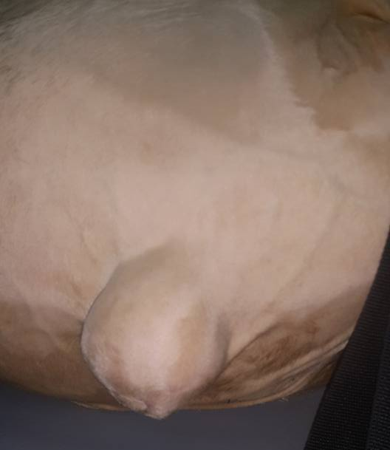
Hernia After Chlorohex→
3. Cleaning with Chlorohex
← Hernia Before Chlorohex

Slide 5
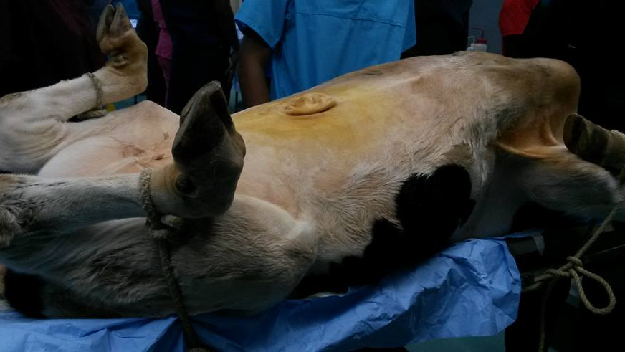
4A. Peppy before surgery- Reducible Hernia and Calf in dorsal recumbency

Slide 6
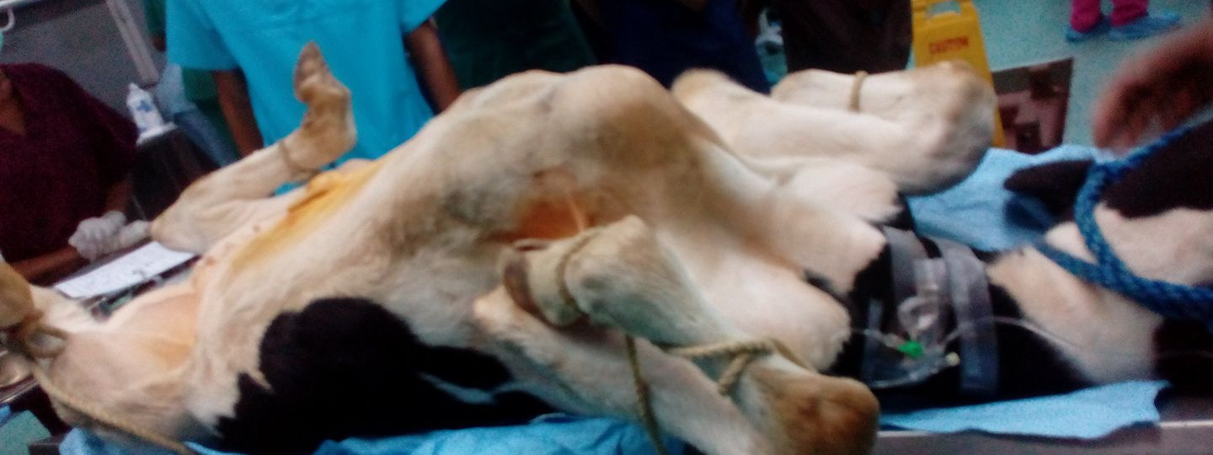
4B. Peppy before surgery- With Restraint on all limbs

Slide 7
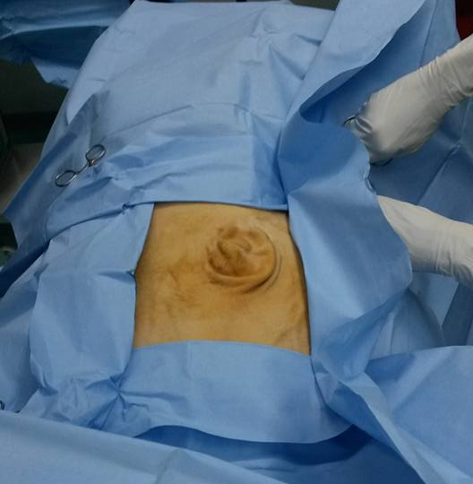
4 c. Preparation of surgical site- with draping

Slide 8
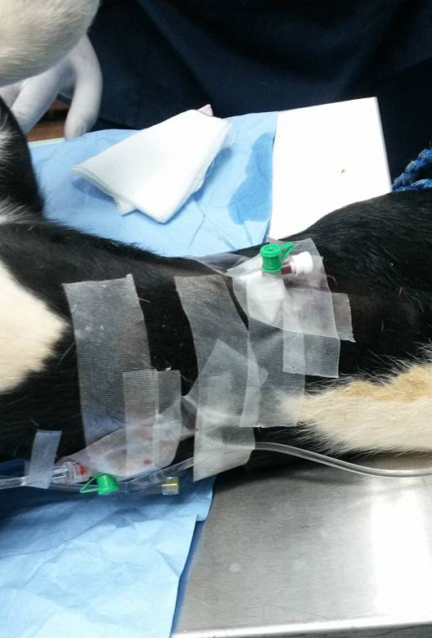
5. Double catheter on calf

Slide 9
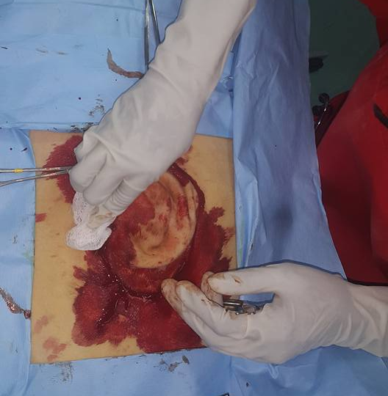
6. Fusiform incision around hernia

Slide 10
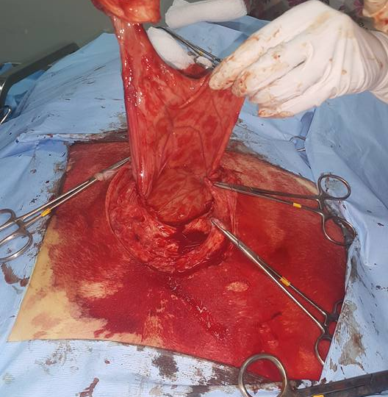
7. Caudally directed firm tubular structure within the omentum

Slide 11
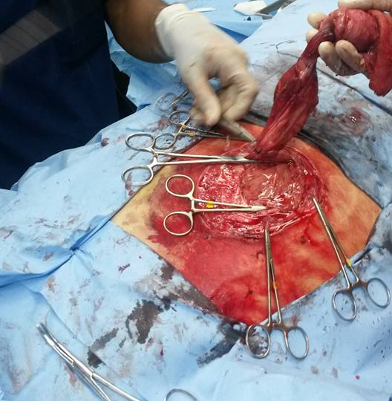
8. Transfixional suture around omentum

Slide 12
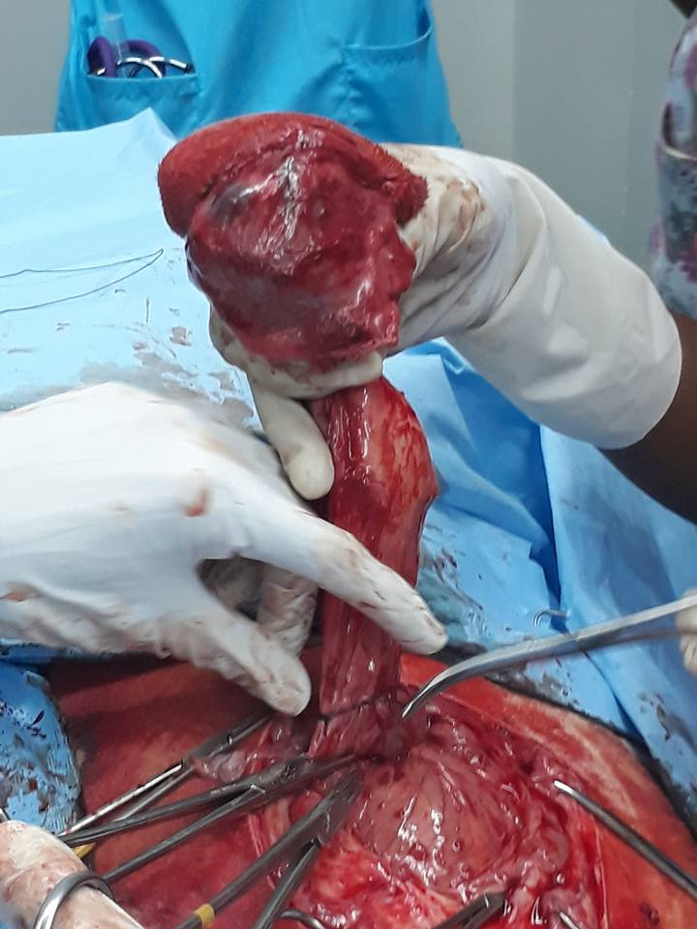
9. Transfixional suture around omentum too

Slide 13
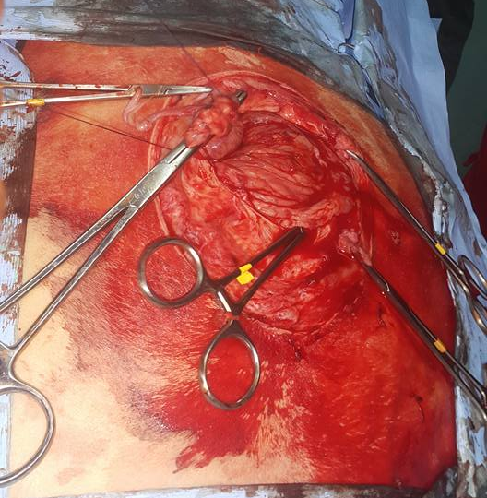
10. Additional Miller's knot

Slide 14
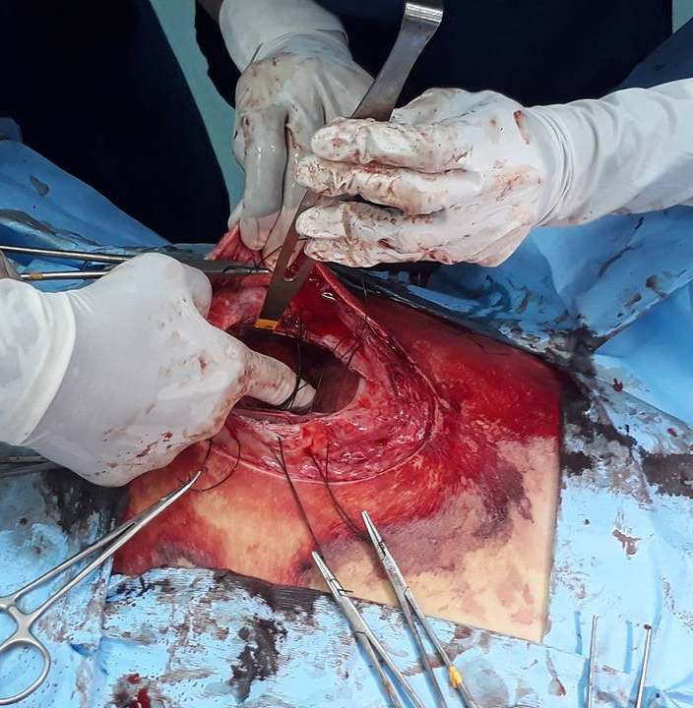
11. Vest over pants on abdominal wall during

Slide 15
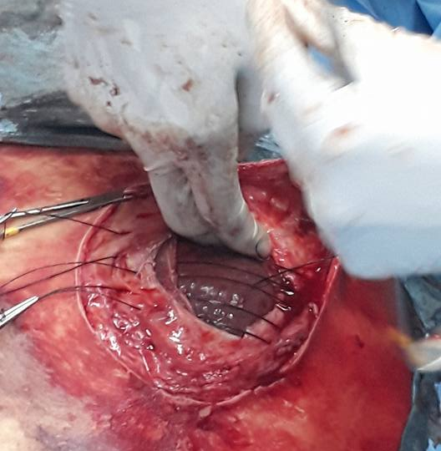
12. Pre-place all vest over pants before knotting

Slide 16
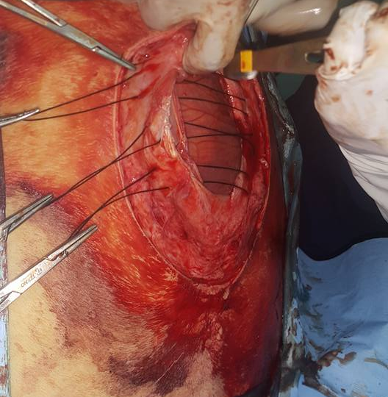
13. Pre-place all vest over pants before knotting too

Slide 17
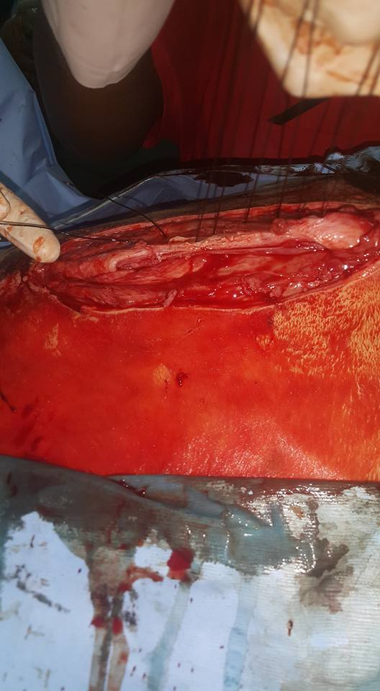
14. Vest over pants suture pulled taut before knotting

Slide 18
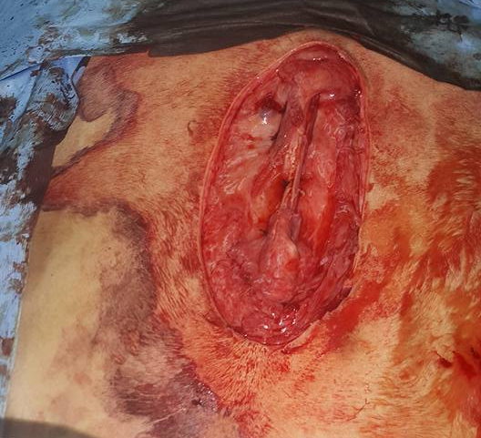
15. Vest over pants on abdominal wall

Slide 19
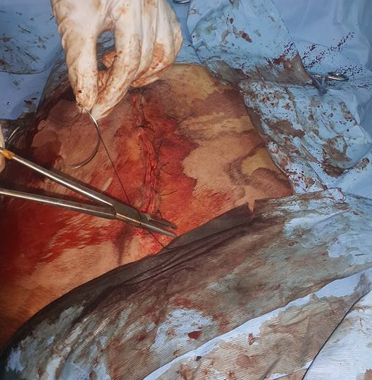
16. Horizontal mattress on skin

Slide 20
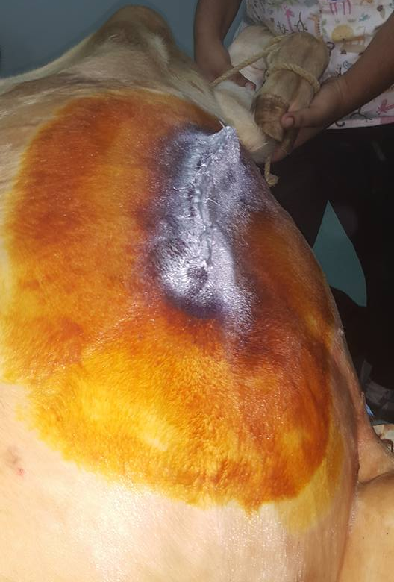
17. Calf after surgery

