Slide 1
Open castration
In horses

Slide 2
Open castration is the most commonly performed method of castration and can be performed either standing, under heavy sedation and local anaesthetic, or under a short general anaesthetic.
Standing castration is only possible in quiet, well handled horses, and is not safe to undertake in small ponies or horses that are difficult to handle. Guddling around between the hind limbs of a colt who is reluctant to give up his manhood can be quite a dangerous job.
Open castration under general anaesthesia is most commonly undertaken in ponies. Although all anaesthetics carry a small risk, this is minimal in healthy horses.
When performing the open technique of castration, the parietal tunic of testis is incised. The ligament of the tail of the epididymis (caudal ligament of the epididymis), which attaches the parietal tunic to the epididymis, is severed or bluntly transected.
By transecting the fold of the mesorchium and mesofuniculum, the testis, epididymis, and distal portion of the spermatic cord are completely freed from the parietal tunic and removed using an emasculator. The open technique of castration is probably the most commonly used technique

Slide 3
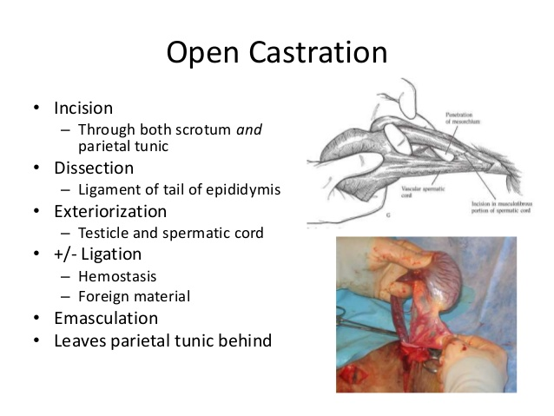

Slide 4
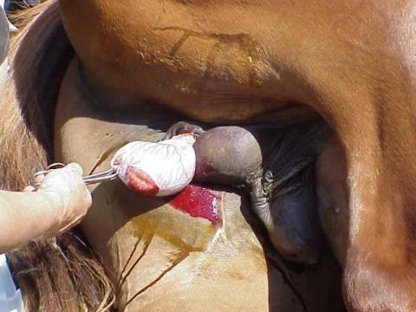
Open castration of a horse performed in the field under a general anaesthetic.
https://www.youtube.com/watch?v=qNrAPMBxLSE

