Slide 1
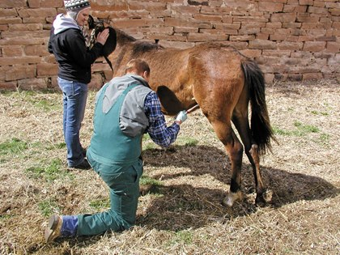
Equine castration
Introduction

Slide 2
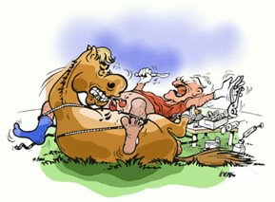
What is castration ?
Castration is a surgical procedure performed by a veterinarian that is defined as the removal of the testicles of a male horse.
The procedure can be accomplished through sedation and local anesthesia in a standing position or through general anesthesia and the horse lying on its side (lateral recumbency).
This procedure is typically performed once the horse is skeletally mature to reap the beneficial effects of testosterone.

Slide 3
Why castration?
This procedure is typically performed on colts to make them more manageable and easier to train.
Castration is also necessary if the horse has minimal breeding value. In horses with potential breeding value, castration may be delayed to determine if the horse has enough performance ability to make him attractive as a future sire.

Slide 4
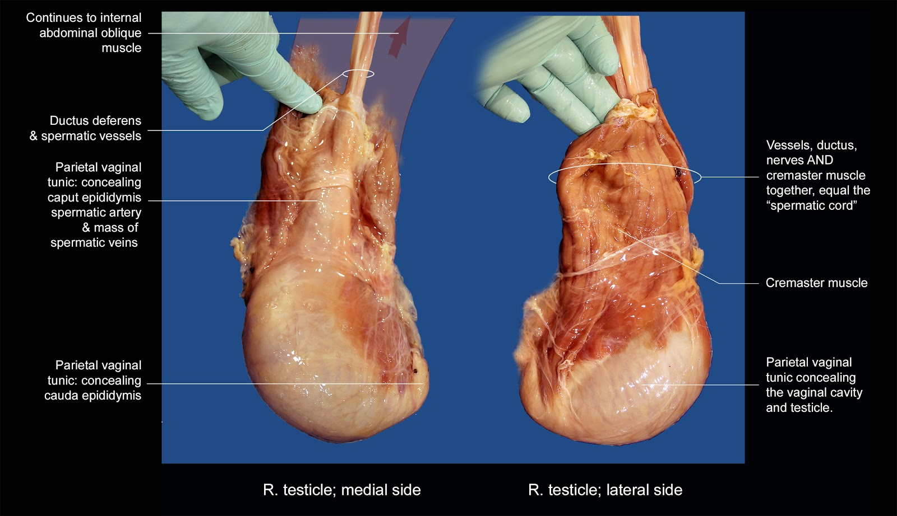
Testicular anatomy

Slide 5
Techniques for castration
Regardless of whether the horse is castrated standing or anaesthetized and recumbent, the testes can be removed using one of three techniques:
  Open: 3-4yrs
  Closed: for all ages including stallions
  Semi-closed: mature horses and stallions, ligatures and general anesthesia is used

Slide 6
Methods of restraint
Castration can be performed with the horse sedated and standing, after the spermatic cord is anaesthetized. Or, the horse can be anaesthetized and castrated in recumbency.

Slide 7
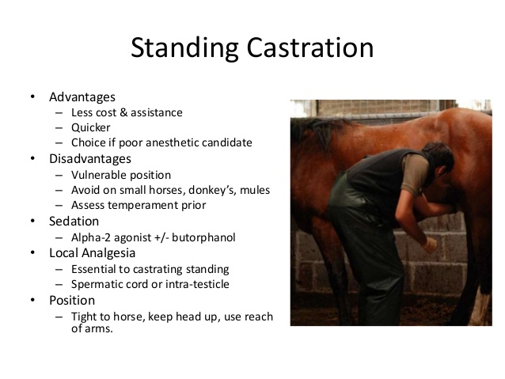

Slide 8
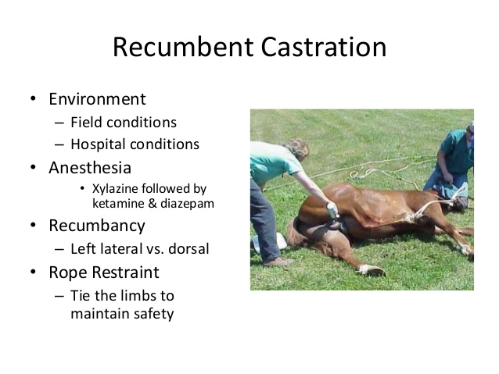

Slide 9
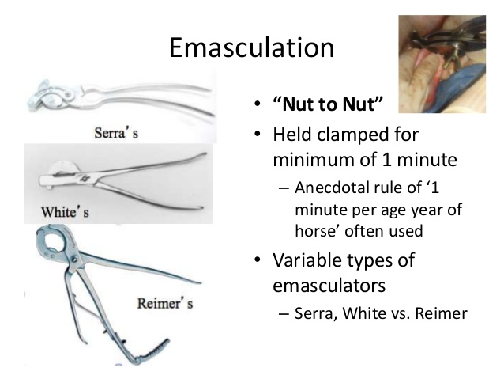

Slide 10
SUMMARY OF FIELD CASTRATION
http://www.r-vets.org/Castration-Basics.html

