Slide 1
Closed castration
In horses

Slide 2
This involves a general anaesthetic and the procedure can only be performed under sterile conditions in our operating theatre. The skin incisions are closed (stitched) following surgery. This method is generally recommended in older horses whose testicles and cord are more mature/larger. The closed method reduces the risk of haemorrhage.
With the closed technique, the parietal tunic is not incised, so it also is removed along with the testis and a portion of the cord. Using digital dissection, the parietal tunic surrounding the testis is freed from the scrotal ligament and scrotal fascia, and by placing mild traction on the testis with one hand, the parietal tunic surrounding the cord is separated from fascia surrounding the spermatic cord with the other hand.
After the parietal tunic is separated from the surrounding fascia, it and its contents are removed using an emasculator. Care should be taken, when separating the fascia from the spermatic cord, to include the large pudendal vessels that lie within the fascia, so that these vessels are not included in the jaws of the emasculator.
As the incisions are sutured closed they are unable to drain as well as open castrations and as a result these horses often develop significant swelling of the castration site.

Slide 3
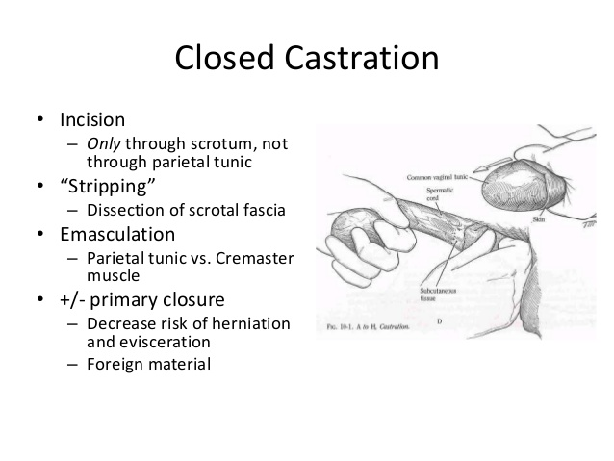

Slide 4
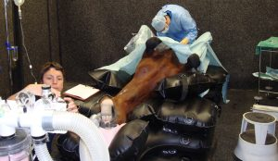
Closed castration of a horse performed in the sterile field under a general anaesthetic.
https://www.youtube.com/watch?v=-vAk1YlcKHM

