Slide 1
Pre – operative procedure
For exploratory laparotomy in Rebecca, the sheep

Slide 2
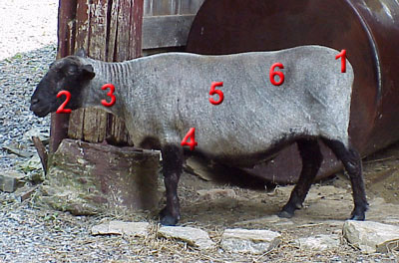
Physical exam of sheep
http://research.vet.upenn.edu/SmallRuminants/PhysicalExam/tabid/4092/Default.aspx

Slide 3
Normal vital signs of sheep
Sign | Range
Body temperature | 102-103°F
Heart rate | 60-90 beats/minute
Respiration | 12-20 breaths/minute

Slide 4
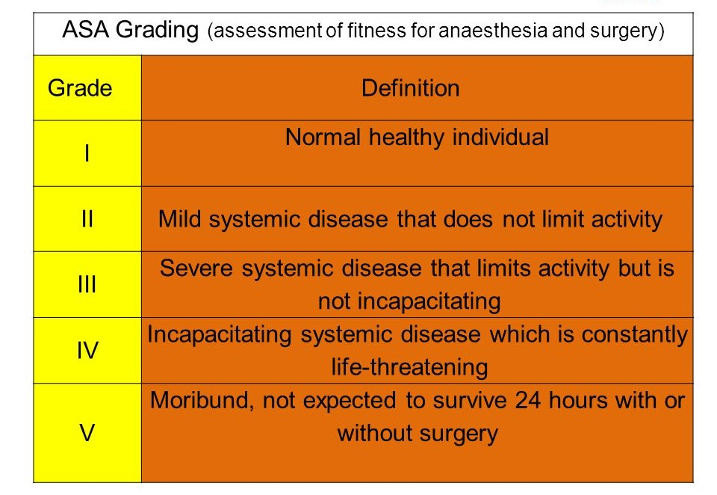

Slide 5
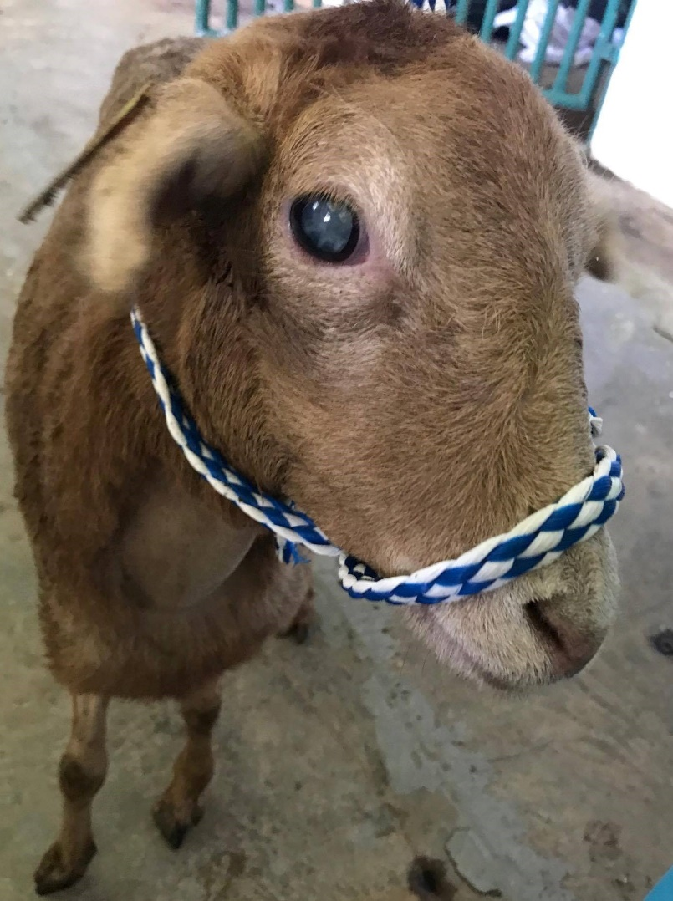
Signalment
Species | Ovine | Temperature | 39.4° C /102.94 °F
Breed | West African | Heart Rate | 80 beats/min
Sex | Female | Respiratory Rate | 40 breaths/min
Age | 18 months | Mucous Membranes | Pink
Weight | 17.8 kg | CRT | < 2 secs
History | Bilateral blindness with opaque appearance | ASA Grade | 1
REBECCA

Slide 6
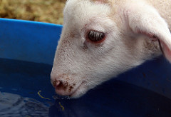
Fasting
Ruminants (e.g. sheep, goats, cattle)
Fast for 12-36 hours prior to surgery.
Reduces fermentation in the rumen
Placing stomach tube reduces ruminal tympany.
All animals should have free access to water.
Restricting water results in dehydration and more difficult anesthesia.

Slide 7
Set-up of Prep Area
Ensure prep area has:
Working heat support on table
Functioning anesthesia machine (if required)
Stethoscope and thermometer
Appropriate drugs and reversal agents (analgesics and anesthetics)
Functioning monitoring equipment
Prep supplies and clippers
Vacuum

Slide 8
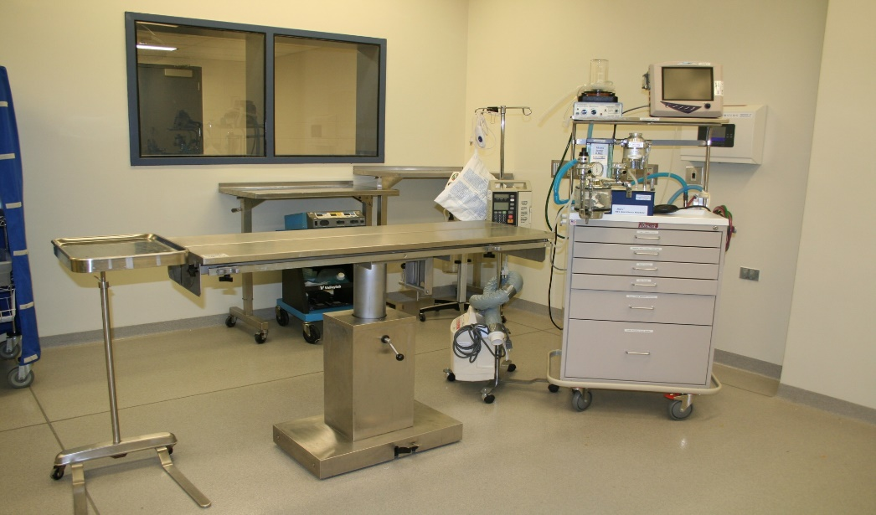
Set-up of OR
Ensure OR area has:
Working heat support on table
Functioning anesthesia machine (with ventilator)
Functioning monitoring equipment
Fluid support as needed
Emergency supplies (Ambu bag, and crash cart supplies)

Slide 9
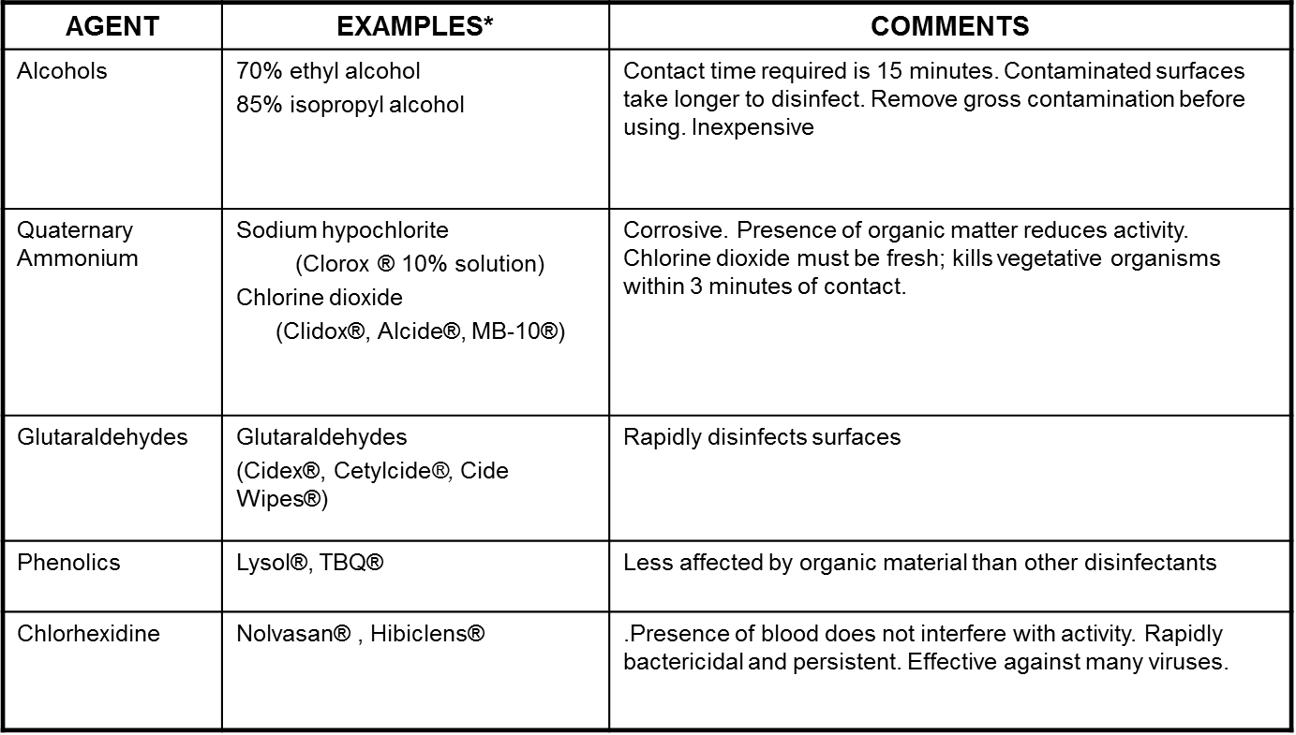
RECOMMENDED HARD SURFACE DISINFECTANTS
(e.g., table tops, equipment)
Always follow manufacturer's instructions for dilution and expiration periods

Slide 10
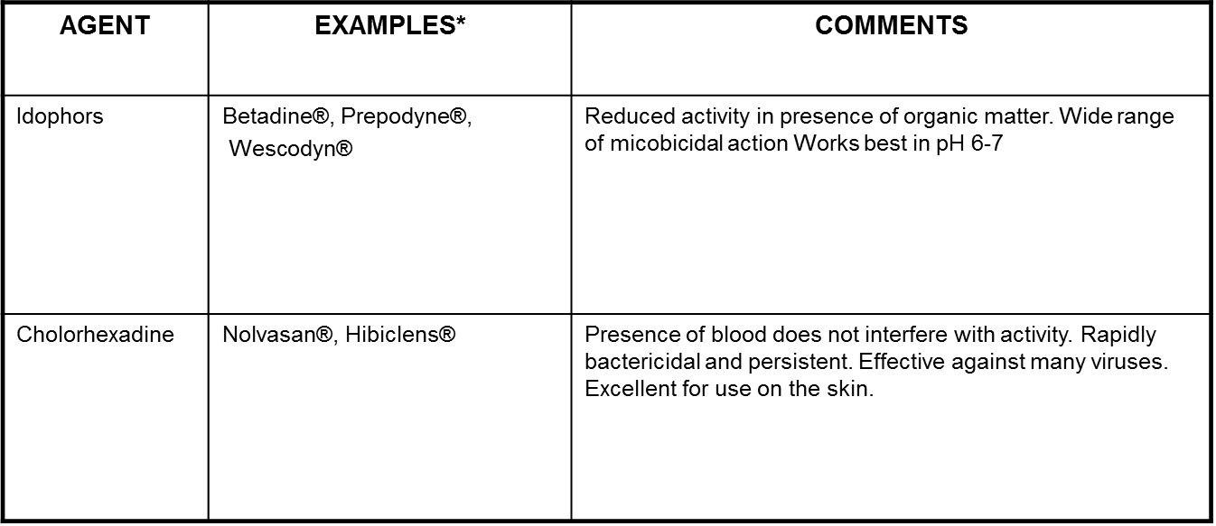
RECOMMENDED SKIN DISINFECTANTS
Alternating disinfectants is more effective than using a single agent.

Slide 11
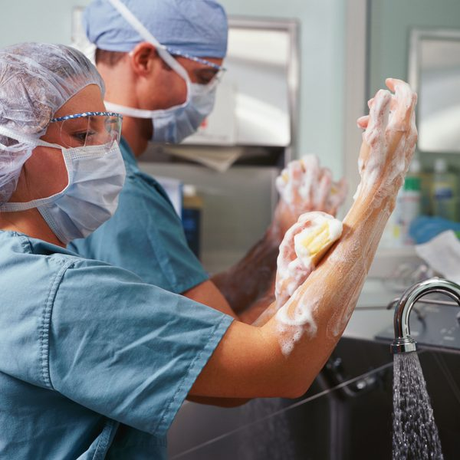
Surgeon Preparation
For survival surgical procedures (major and minor), the surgeon should wear clean scrubs, a surgical hat, and mask.
Surgeons should wash their hands with an antiseptic surgical scrub and dry their hands with a sterile towel.
Sterile surgical gloves and a sterile surgical gown should be worn.
https://www.youtube.com/watch?v=MpwMnjQR41Y

Slide 12
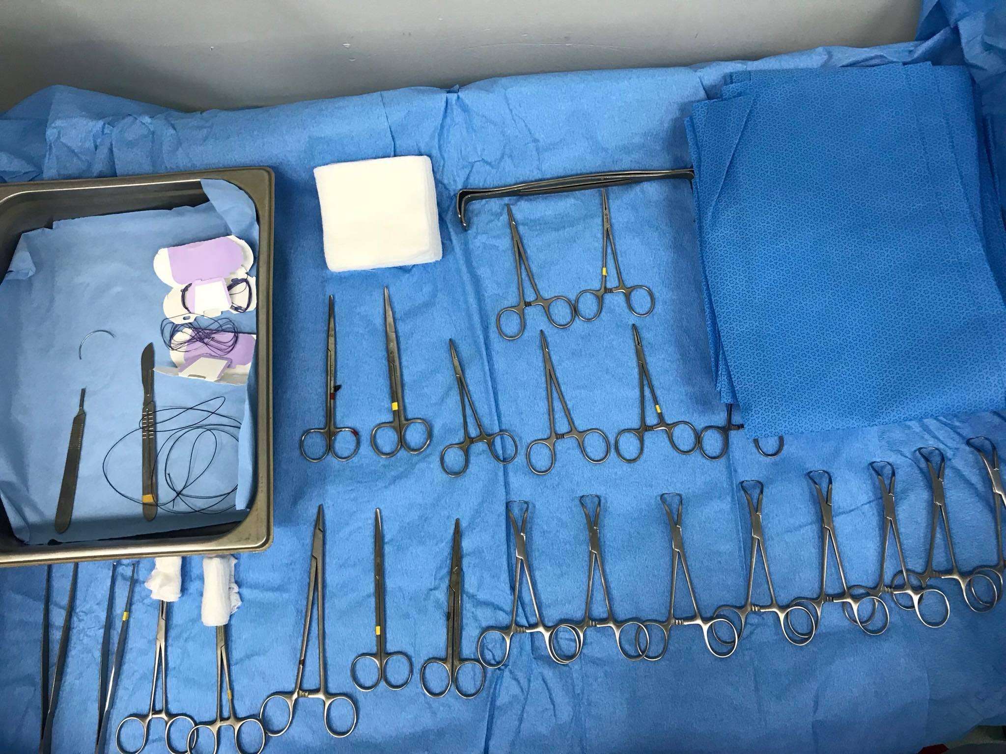
Surgical equipment

Slide 13
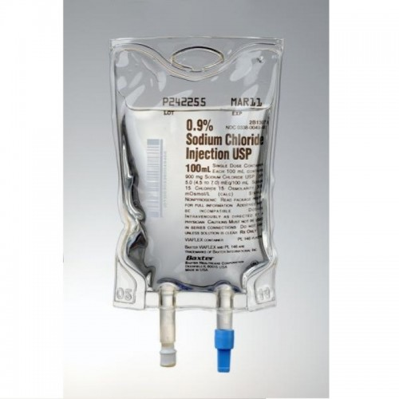
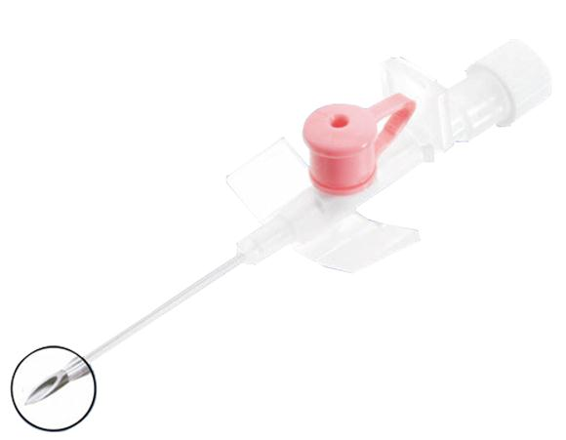
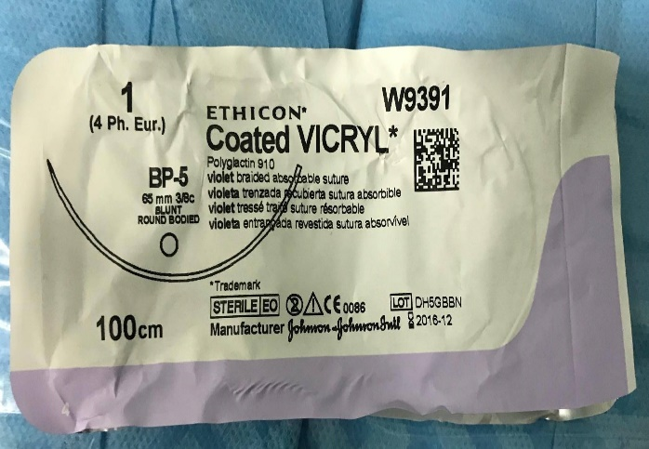
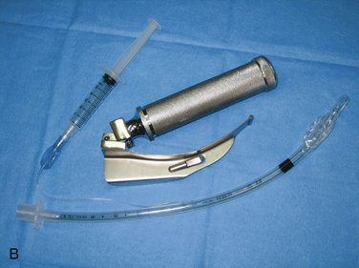
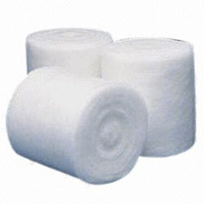
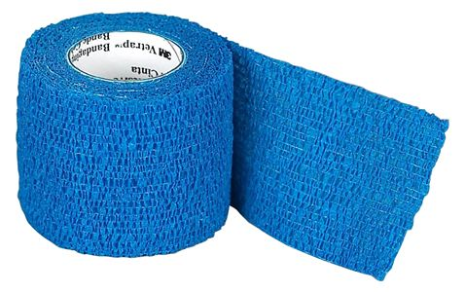

Slide 14
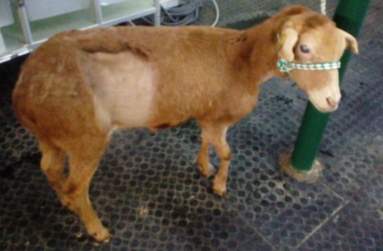
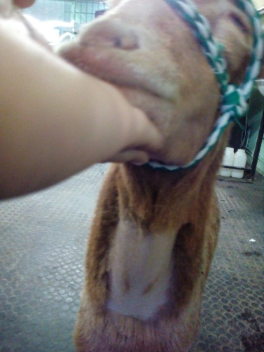
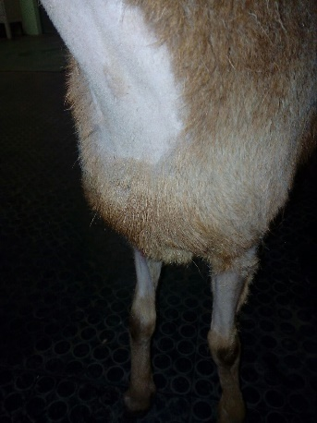
Animal preparation before entering the OR.
Animal preparation should take place in an area separate from where the surgery is to be conducted.
Hair should be removed from the surgical site using electric clippers.
The areas that were shaved included:
  The right flank
  Sites for insertion of catheters, cephalic and jugular areas
  Site for Epidural administration, over the sacrum and anterior coccygeal vertebrae.
  The area for intramuscular administration was cleansed with a cotton swab containing 70 % alcohol.

Slide 15
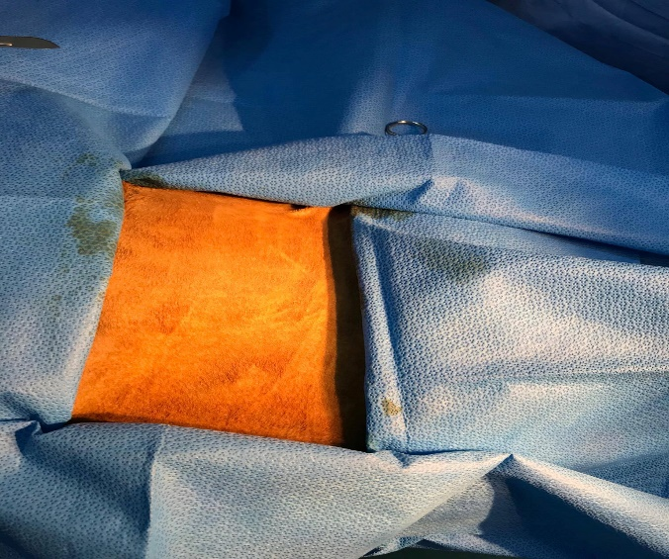
Aseptic technique
Initial or preparative scrub
      Povidone-iodine followed by alcohol rinse
      Chlorhexidine followed by saline rinse
Move to the operating room
Final surgical scrub
      Povidone-iodine followed by alcohol rinse
      Chlorhexidine followed by saline rinse
      Duraprep®, Chloraprep®
Sterile draping of surgical site
Bland ophthalmic ointment to eyes
A few drops of saline should inserted on the tongue after endotracheal intubation

Slide 16
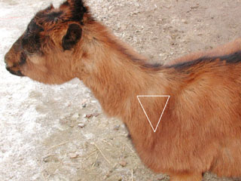
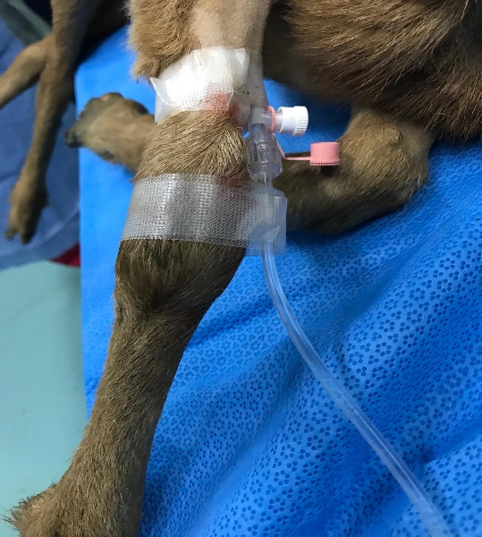
A combination of xylazine and ketamine (sedative) was administered intramuscularly within the triangular region before entering the operating room.
                After 10 minutes of administering the sedative a catheter was inserted into the cephalic vein while in the operating room.
                A second catheter was inserted into the jugular vein due to obstruction in the cephalic vein catheter.

Slide 17
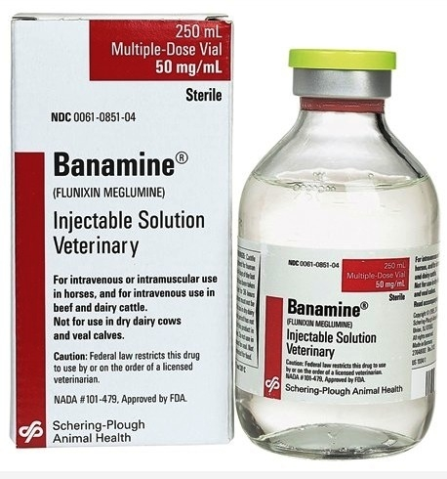
Pain management
Pain and painful stimulation causes physical discomfort and stress which result in altered homeostasis including cardiopulmonary, endocrine, metabolic and thermoregulatory abnormalities and behavioural changes.
Assessment of pain in sheep and ruminants generally is difficult. Painful animals may exhibit physical signs including tachypnea, tachycardia, elevated blood pressure and body temperature.
Ideally analgesia should be administered pre-emptively

Slide 18
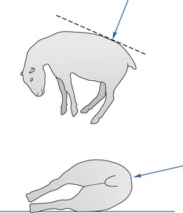
Lumbosacral epidural administration
Epidural block is produced by injection of local anaesthetic into the epidural space at the lumbosacral junction to provide analgesia and paralysis to allow surgery.
The animal may be standing or in lateral recumbency.
This avoids struggling and prolapse of the rumen through the laparotomy site as may occur following use of local infiltration.
https://onedrive.live.com/?authkey=%21AHlEwCZPXLAXOnQ&cid=536D605DB7A63B10&id=536D605DB7A63B10%212122&parId=536D605DB7A63B10%211338&o=OneUp

Slide 19
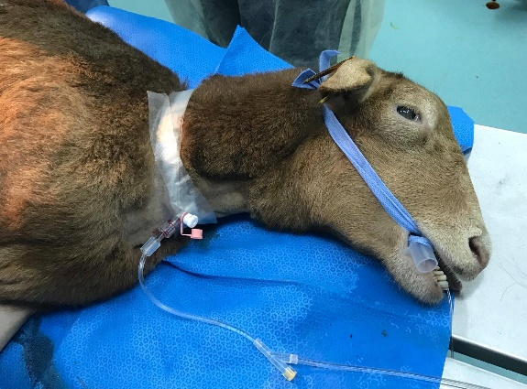
Endotracheal intubation
Patients undergoing general anesthesia should be intubated so that the anaesthetist can capture a patent airway.
Using injectable anesthesia for these longer anesthetic periods can have the side effect of a prolonged recovery.
It is essential that the small ruminant patient be intubated during anesthesia. The animal should remain in sternal recumbency until the tube is placed and cuff is inflated.
Rumen contents regurgitated before the airway is secure must be vigorously wiped out of the patient’s mouth.
The cuff should be inflated only until there is a small amount of negative pressure.
https://onedrive.live.com/?authkey=%21AAI2bwU5kWVCu_c&cid=536D605DB7A63B10&id=536D605DB7A63B10%212121&parId=536D605DB7A63B10%211338&o=OneUp

Slide 20
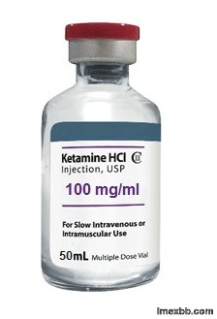
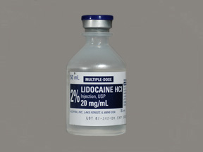
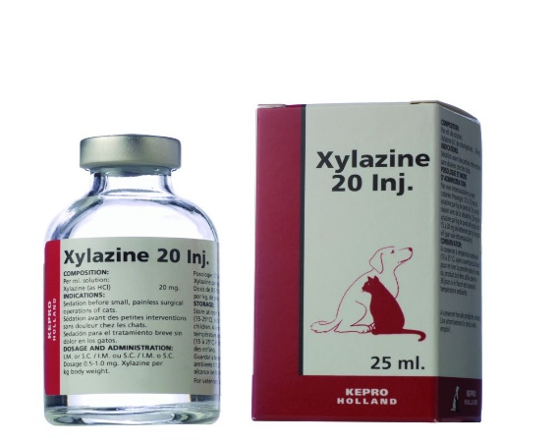
Constant infusion rate
https://www.cliniciansbrief.com/sites/default/files/sites/cliniciansbrief.com/files/0404_procedurepro.pdf

Slide 21
Checking Anesthetic Depth
Reflexes
Jaw tone
Eye position, pupil size and pupillary light response
Heart and respiratory rates
Response to surgical stimuli
https://www.youtube.com/watch?v=jV3MDFek1r0

Slide 22
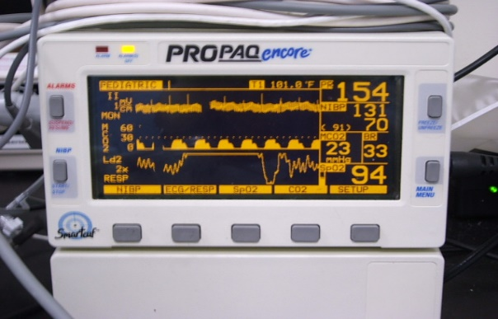
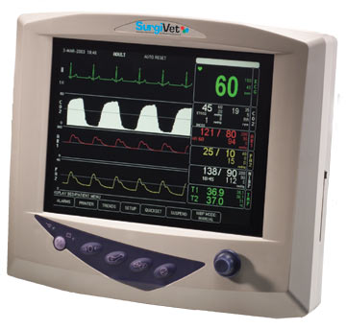
Parameters to Monitor
(every 5 minutes)
ECG (EKG)
Peripheral Perfusion
Pulmonary Monitoring
Temperature
Blood Pressure

