Slide 1
Ocular Surgical Techniques
A flow of the procedure

Slide 2
Auriculopalpebral nerve block

Slide 3
Spinal Needle for Peterson Block

Slide 4
Peterson and Auriculopalpebral nerve blocks

Slide 5
Removing stylet of Spinal needle before inserting syringe

Slide 6
Subconjunctival Injection

Slide 7
Attempt to clamp 3rd eyelid in 3 places at once
In retrospect the clamp at the base of the 3rd eyelid on the thick cartilage could have been clamped further back.

Slide 8
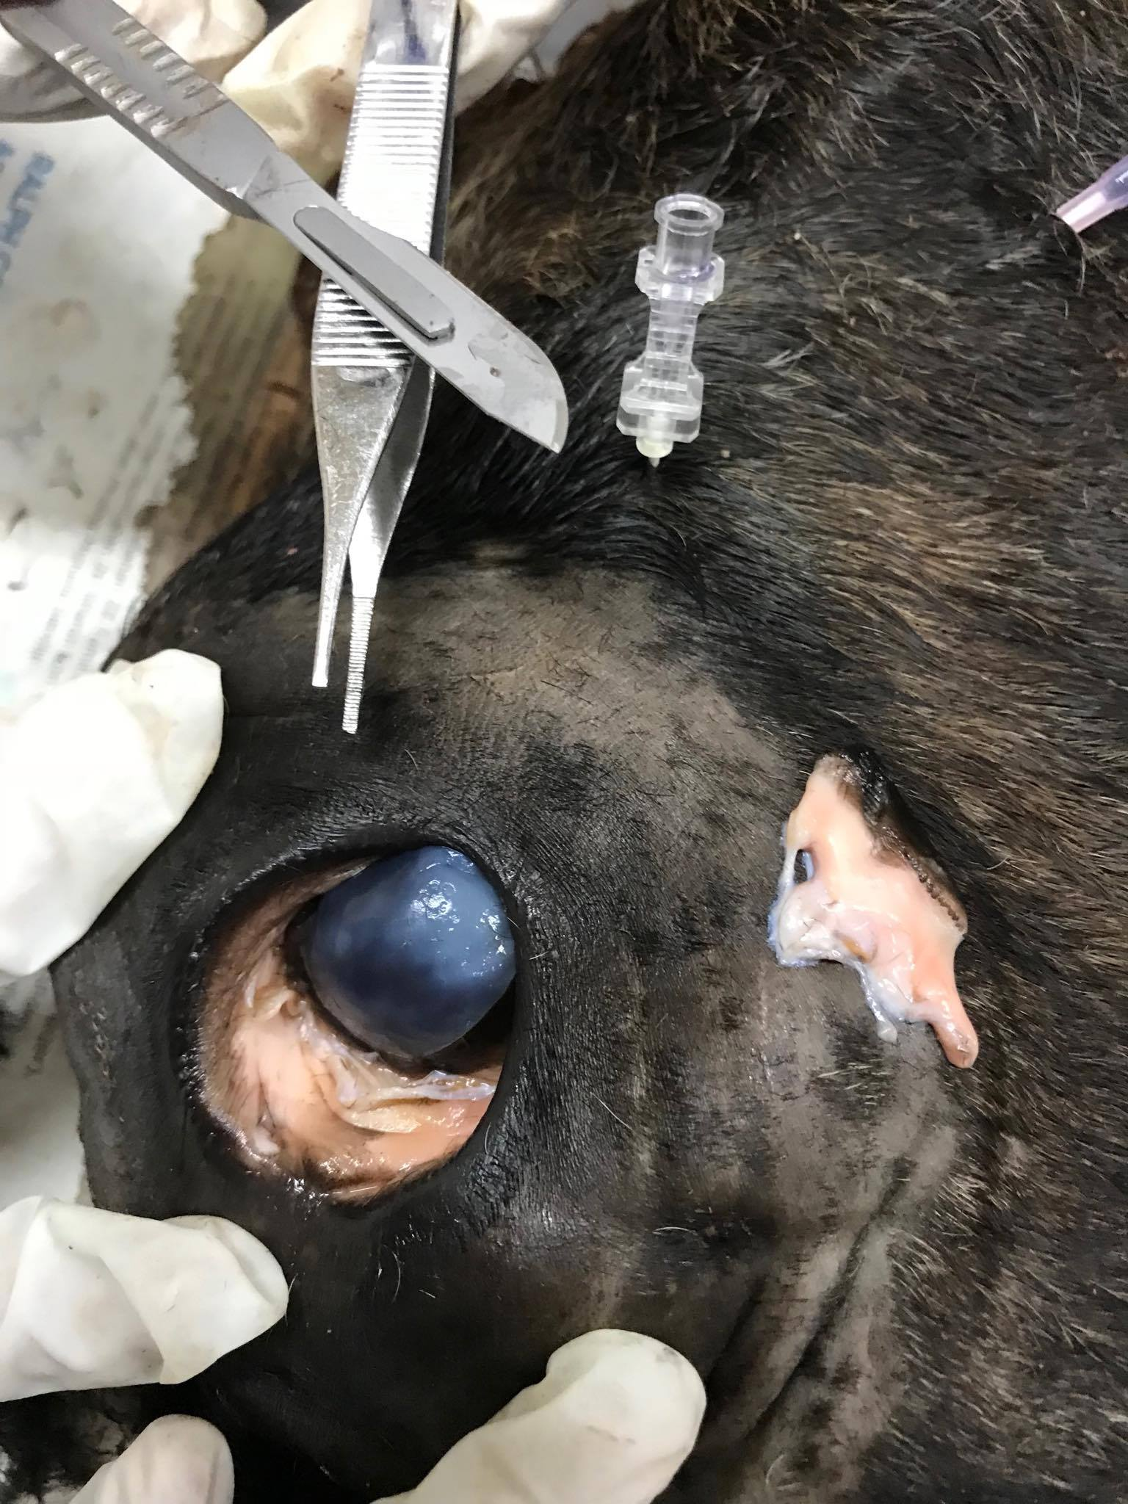
Removal of 3rd Eyelid
with cut segment of 3rd eyelid shown

Slide 9
Non absorbable Nylon Suture material
- for simple continuous pattern closing eye through eyelids

Slide 10
Circumferential incision at the eyelid margin

Slide 11
Incision along Orbital rim

Slide 12
Blunt dissection of ocular contents

Slide 13
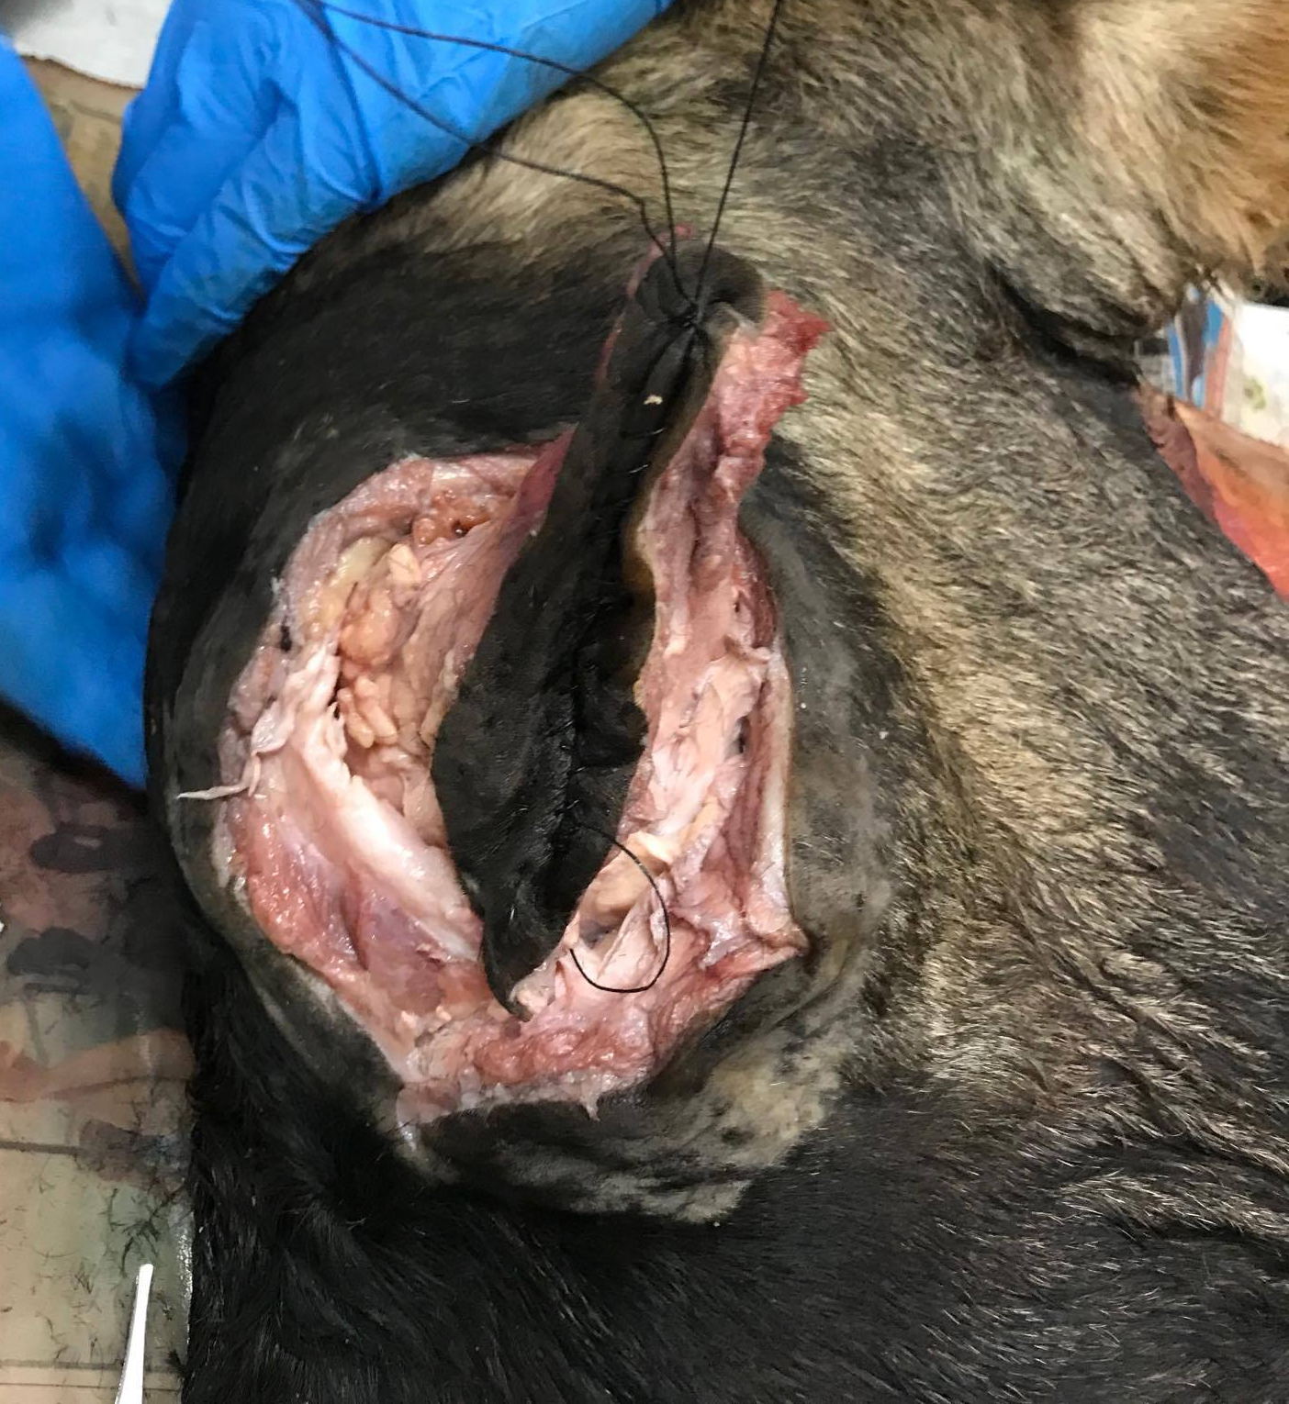
Blunt dissection of ocular contents and lifting globe

Slide 14
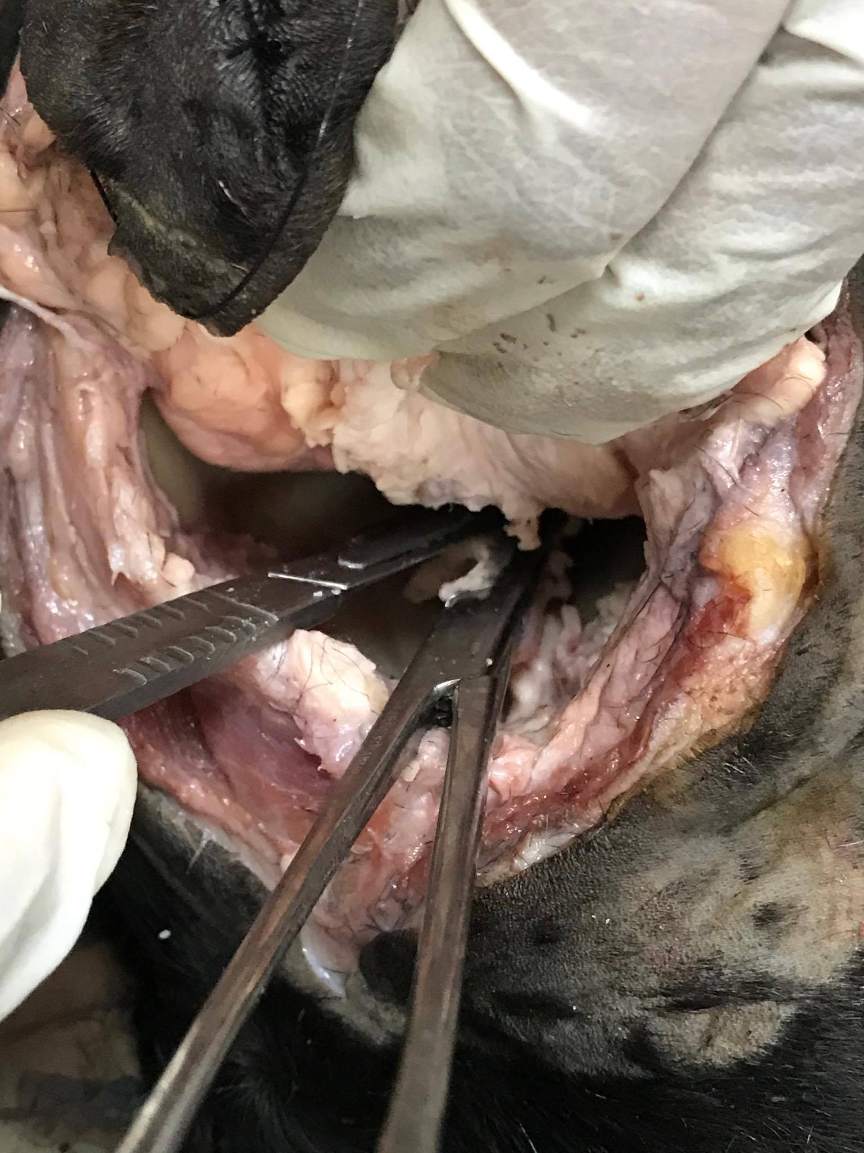
Clamping with curved forceps and cutting with scalpel -must use care with scalpel blade in orbit

Slide 15
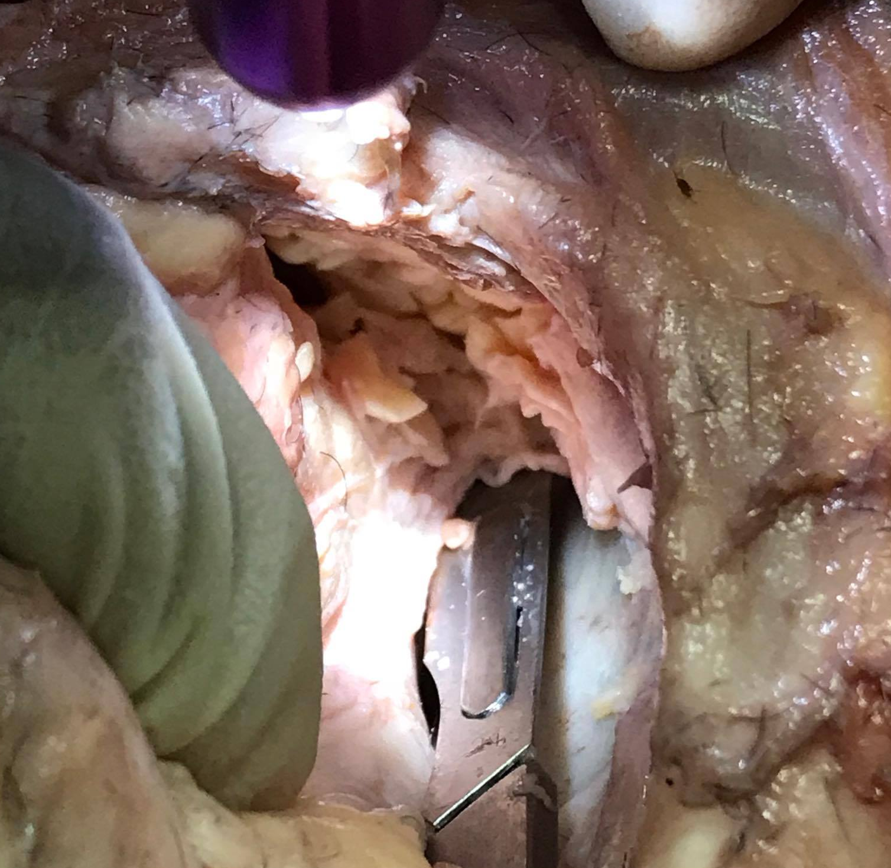
Optic neve and muscular attachments

Slide 16
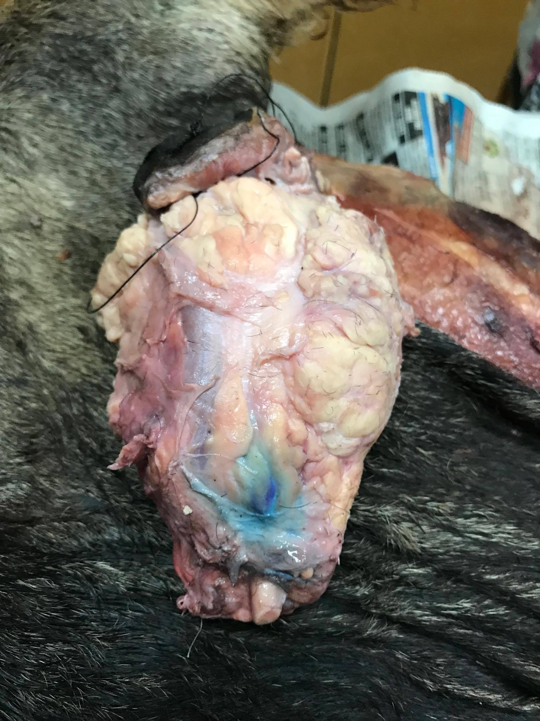
Evidence of nerve block and Optic nerve

Slide 17
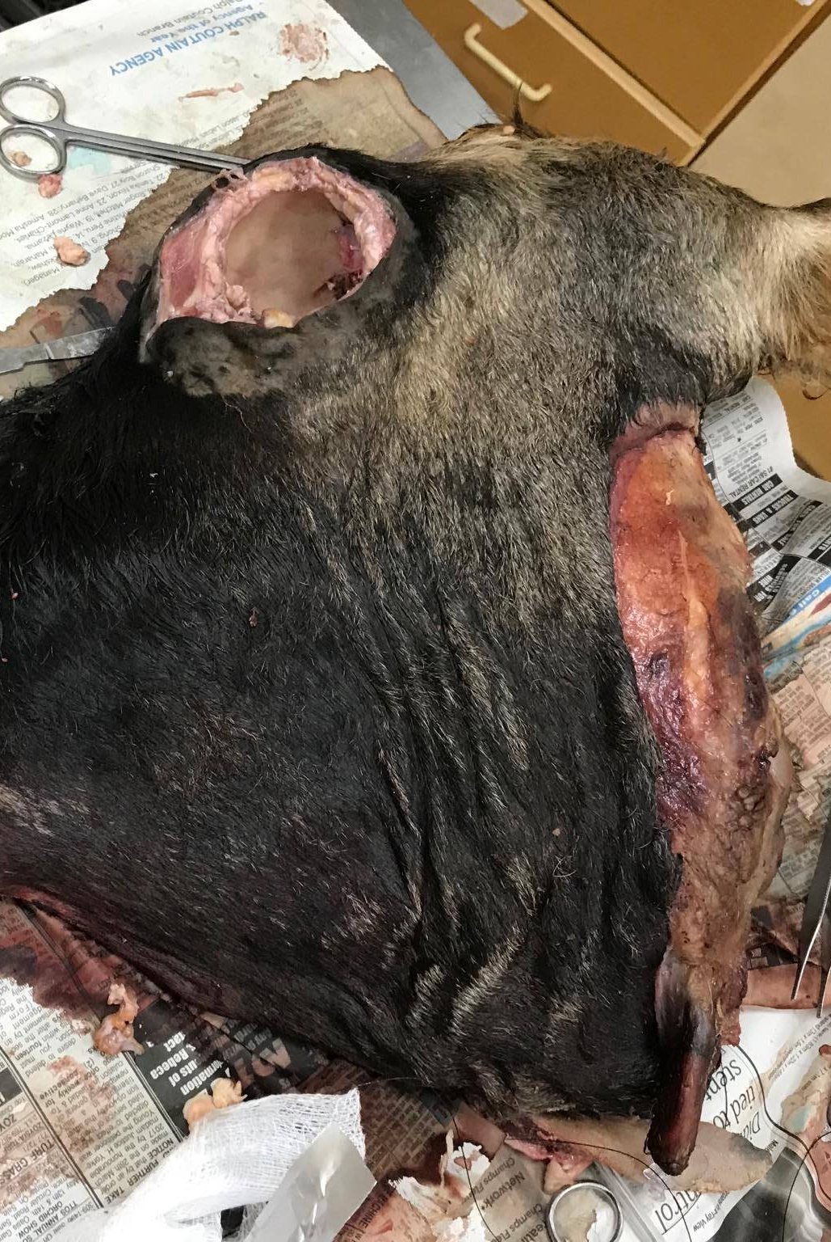
Cleaned orbit

Slide 18
Cruciate Closure Skin Hypodermic needle

