Slide 1
Pre-Operation
Lab 11

Slide 2
Signalment
Species: Bovine
Breed: Jersey Holstein mixed
Sex: Female
Age: >4 years
Weight: 500kg
ASA grade: 2

Slide 3
Physical Examination
Please look at the video for details on how to physically examine a cow.
https://www.youtube.com/watch?v=B-a9bxCD1MU&t=170s
Also note that special attention was placed at station 3.

Slide 4
Indications
Indications for transpalpebral enucleation, third eye removal, and subconjunctival injection of antibiotics are:
Congenital disease
Orbital Inflammation and cellulitis
Neoplasia: squamous cell carcinoma
Trauma and inflammation to the adnexa of the eye, orbit or globe.
Painful glaucomatous eyes.
Heavy load of Parasites: Thelazia spp

Slide 5
Instruments
Coveralls and boots
Gloves
Drapes
Cotton/ gauze
Basic Ophthalmic instrument set
Small towel clamps
# 9 blade handle
Small mayo Scissors
General suture scissors
Small stitch scissors
Forceps Adson brown
Curved hemostats
Kelly hemostats
Needle holder
Metzenbaum scissors
Polypropylene Sutures 3-0, 4-0, 5-0 and 6-0

Slide 6
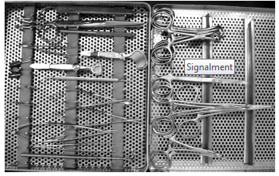
Instruments

Slide 7
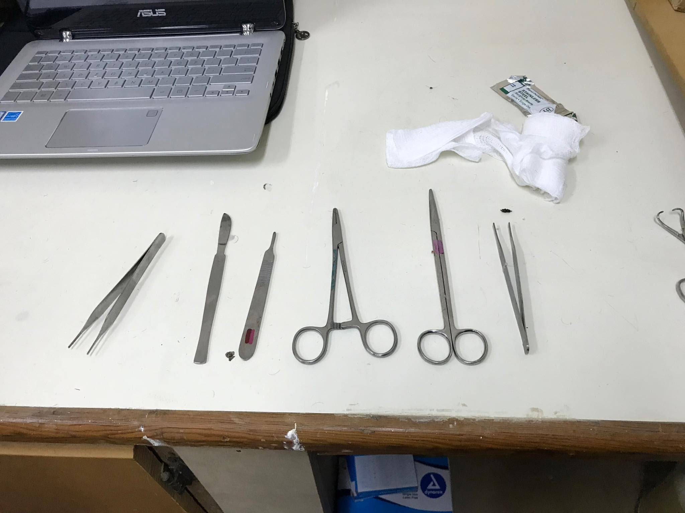
Instruments

Slide 8
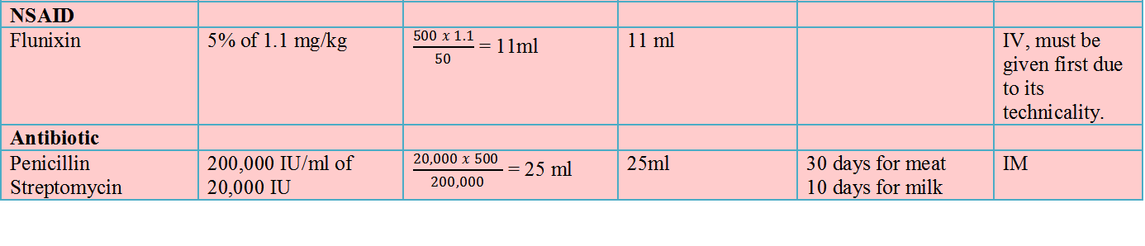
Drugs

Slide 9
Reversal Drugs

Slide 10
Preparation of surgical site
The animal was restrained in a chute, since this procedure is done standing.
After which the halter was tied to the opposite side of the affected eye.
The ketamine stun was given at this time.
The jugular vein was clipped on both side of the neck. Then an 18” catheter was placed in the left side of the neck so IV injections can be given such as Flunixin, also if there is a lot of hemorrhaging fluids can be administered quickly.
After 15 minutes the head was then further secured to one side with the ears was pulled back. The unaffected eye was covered using gauze and tape.

Slide 11
Preparation of the surgical site
Following that the area was clipped 1 inch around the animal’s eye. The eyelashes was also trimmed at this point in time.
Sterile saline was used to clean the area since the other chemical such as alcohol and iodine will be very irritating.
Next the surgical site was draped.
After which the nerve blocks was done.
NOTE: this is explained separately.
After the nerve blocks was done the animal moved unto surgery.

