Slide 1
Intra-Operation
Mammary Laceration

Slide 2
Superficial wounds
In the cased of superficial wounds these steps should be followed.
Thorough gentle cleansing with non-irritant dilute antiseptic eg. Povidone-iodine or chlorhexidine.
Leave the superficial wounds un-sutured, but dress with a bland antiseptic cream eg Chlorhexidine gluconate after debridement of traumatized and avascular tissue with fine sharp scissors and rat-tooth forceps.

Slide 3
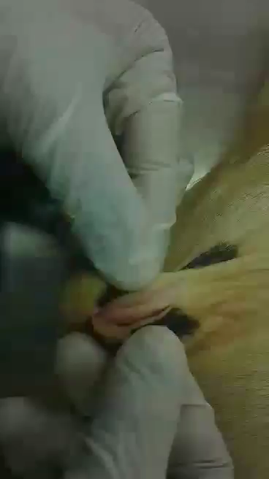
Please press play ☺

Slide 4
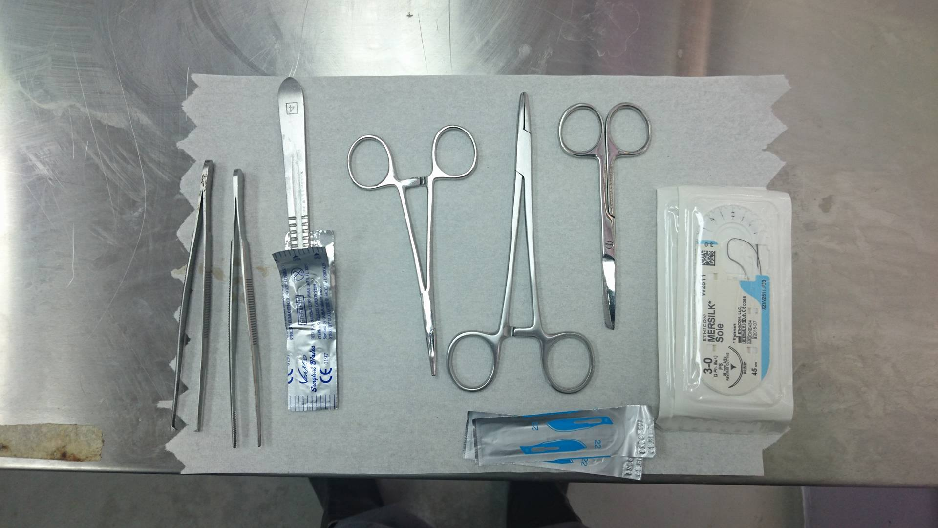

Slide 5
Laceration repair
The 3-3-3 rule was used (3-0 needle, sutures 3mm apart and 3mm away from the incision) to close the 3 layers.
Note this laceration was spiral.
Firstly the submucosa and mucosa was repaired using a simple continuous pattern with a 3-0 vicrly swedged-on atraumatic needle.
The muscular and the subcutaneous layers was also closed with simple continuous pattern using a 3-0 vicrly swedged-on atraumatic needle.
Note that after each layer of closure, a leak test was done.
Some walking sutures were placed to suture some areas.

Slide 6
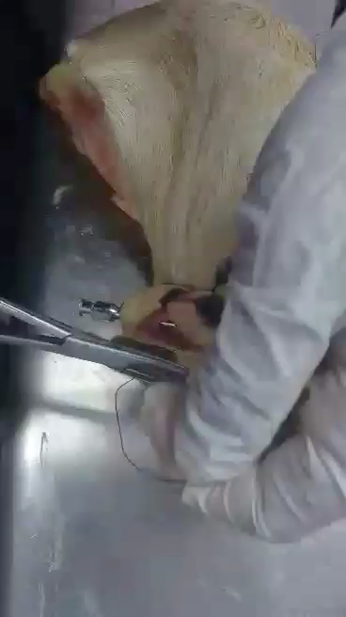
Please Press play ☺

Slide 7
Laceration repair
2-0 synthetic nonabsorbable monofilament Prolen was used. The suture pattern used to close the skin was vertical mattress. Vertical mattress was used to ensure no dead space, added strength since the dermal and epidermal is involved and bring the skins edges together aesthetically pleasing manner.
A self retaining cannula was used to prevent apposition of the teat canal.
After two weeks the sutures can be removed. Hand milking is not recommended, machine milking in preferred after 2-3 months/

Slide 8
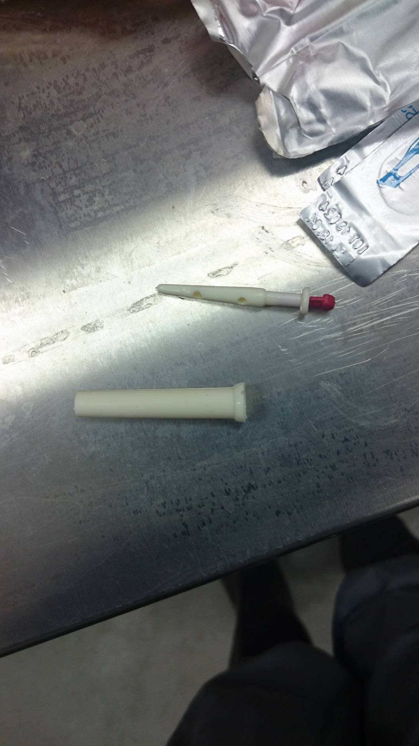

Slide 9
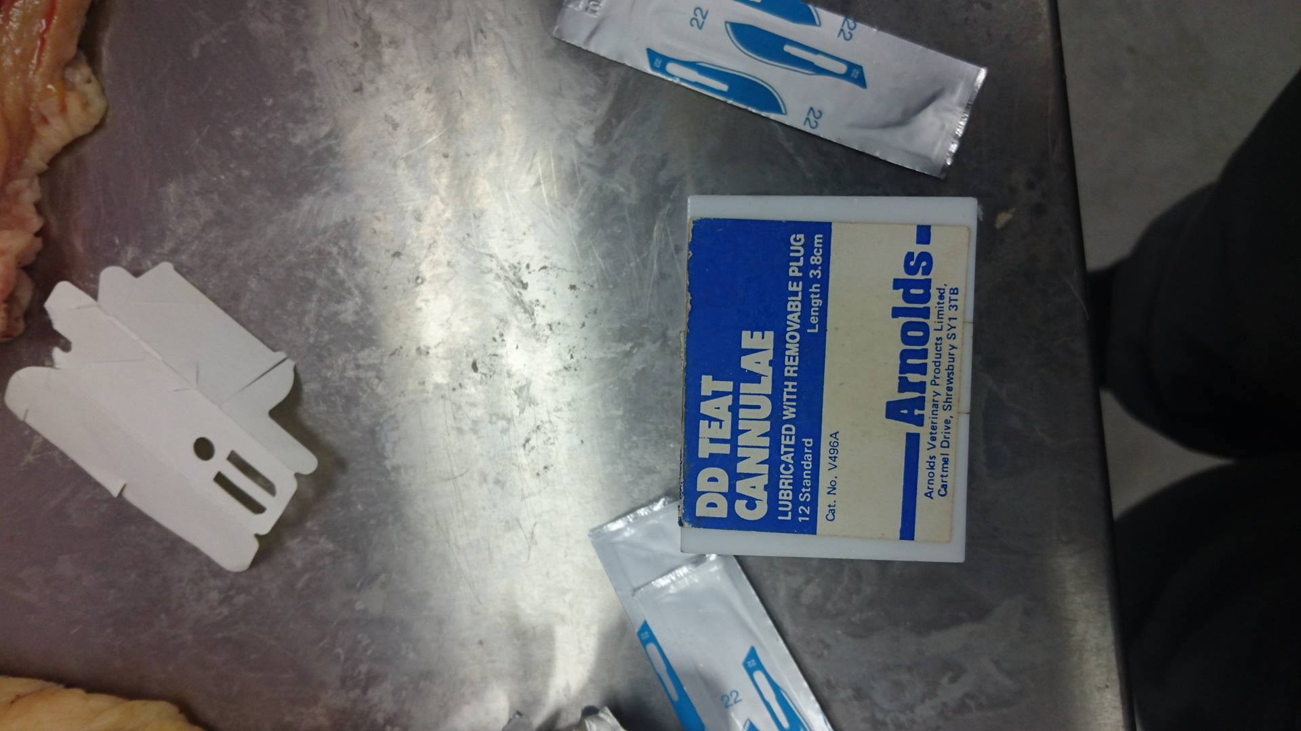

Slide 10
