Slide 1
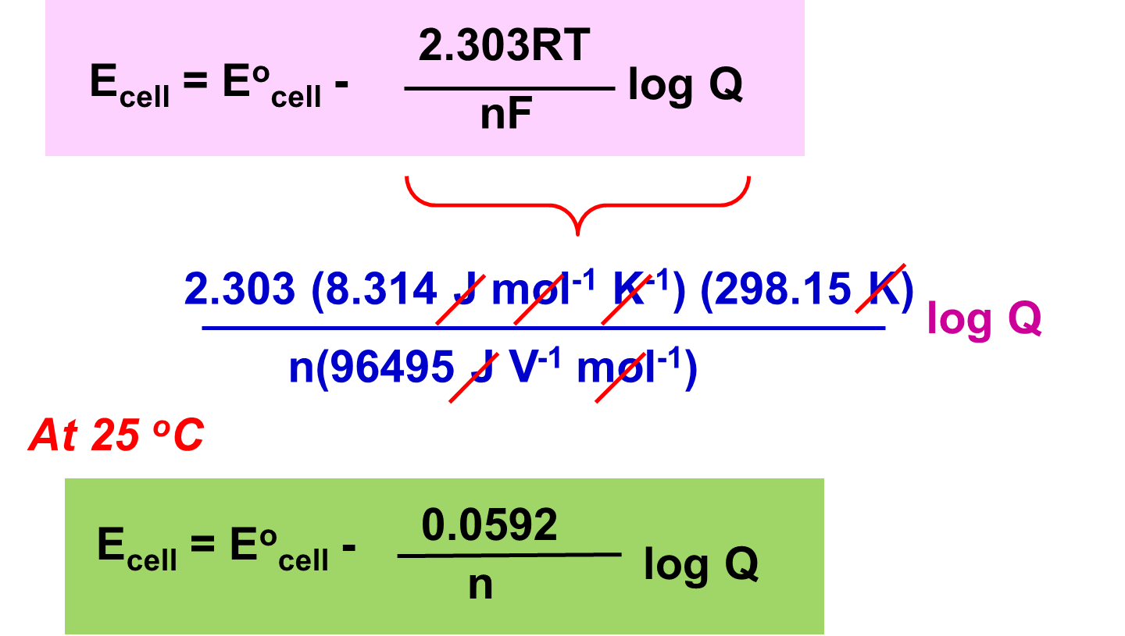
Nernst equation
RT
E_{cell} = Eº_{cell} -
ln Q
nF
where
Q = reaction quotient
n = number of moles of e⁻

Slide 2
The Nernst equation for the general equation :
aA + bB cC + dD
At 25 ºC
0.0592
[C]^{c} [D]^{d}
E_{cell} = Eº_{cell} -
log
n
[A]ª[B]^{b}
Only species with concentration or partial pressure are included Q expression. Solid and liquid are excluded.
E_{cell} could be increased by decreasing the Q, this can be done by
Increasing the concentration of reactant or
Decreasing the concentration of product

Slide 3
Tips for writing Nernst equation
Write two half-equations
Write overall equation by making e gain = e loss
Determine n
Determine Q
Substitute into Nernst equation

Slide 4
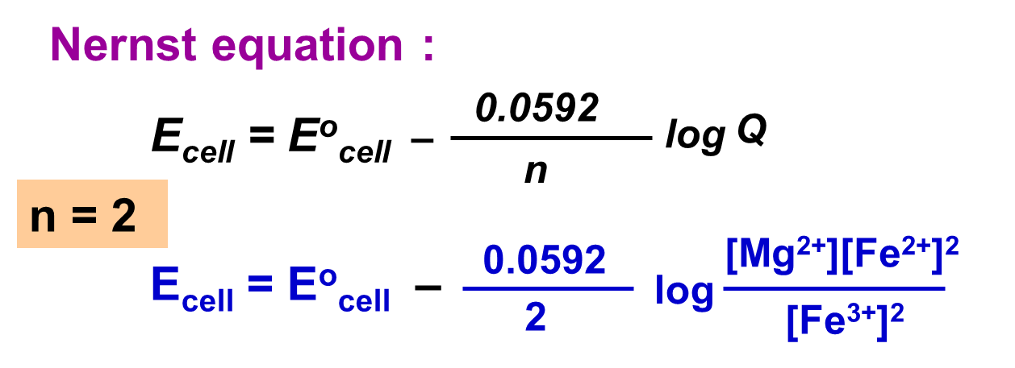
Mg(s) + 2Fe³⁺(aq, 5.0 M) Mg²⁺(aq, 10.0 M) + 2Fe²⁺(aq,1.0 M)
anode (ox) :
Mg(s) → Mg²⁺(aq) + 2e-
cathode (red) :
Fe³⁺(aq) + e⁻ → Fe²⁺(aq)
× 2
Overall :
Mg(s) + 2Fe³⁺(aq) Mg²⁺(aq) + 2Fe²⁺(aq)

Slide 5
Eº_{cell} = Eº_{cathode} – Eº_{anode}
o
o
= E_{Fe /Fe} – E_{Mg /Mg}
3+
2+
2+
= +0.77 – (– 2.37)
= + 3.14 V
Nernst equation :
0.0592
[Mg²⁺][Fe²⁺]²
E_{cell} = Eº_{cell} –
log
2
[Fe³⁺]²
0.0592
(10.0)(1.0)²
E_{cell} = 3.14 –
log
2
(5.0)²
= + 3.153 V

Slide 6
Uses of Nernst equation
To calculate E_{cell} at non-standard condition.
To predict spontaneity of a cell reaction at non-standard condition.
E_{cell} > 0 spontaneous reaction.
E_{cell} > 0 non-spontaneous reaction. E_{cell} = 0 reaction is at equilibrium.
To calculate concentration of ions or partial pressure of a gas in a galvanic cell at non-standard condition.

