Slide 1

Cell Notation for representing the cell diagram
components of anode compartment
(oxidation half-cell)
components of cathode compartment
(reduction half-cell)
Salt bridge
Right for Reduction⇒ 2R
Zn(s) + Cu²⁺(aq) ⎯→ Zn²⁺(aq) + Cu(s)
From Anode To Cathode
⇒ FAT Cat
e- flow
Zn(s) | Zn²⁺(aq) || Cu²⁺(aq) | Cu (s)
Phase boundary

Slide 2
Anode (Ox) :
× 2
Cr(s) Cr³⁺(aq) + 3e⁻
Cathode (Red) :
Cu²⁺(aq) + 2e⁻ Cu(s)
× 3
Overall reaction: 2Cr(s) + 3Cu²⁺(aq) 2Cr³⁺(aq) + 3Cu(s)
Cell Diagram
e⁻
V
salt bridge
Anode (-)
Cathode (+)
Cr(s)
Cu(s)
Cr³⁺(aq)
Cu²⁺(aq)
Cr(s) | Cr³⁺(aq) || Cu²⁺(aq) | Cu (s)
Cell Notation

Slide 3
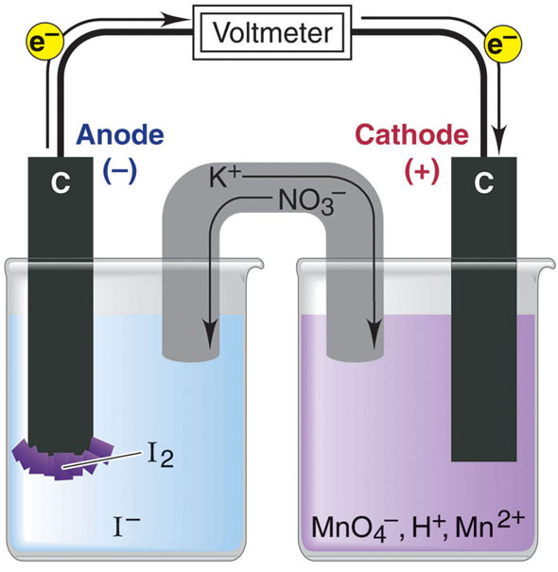
2MnO₄⁻(aq) + 16H⁺(aq) + 10I⁻(aq) 2Mn²⁺(aq) + 5I₂(s) + 8H₂O(l)
Oxidation half-reaction
2I⁻(aq) I₂(s) + 2e⁻
Reduction half-reaction
MnO₄⁻(aq) + 8H⁺(aq) + 5e⁻
Mn²⁺(aq) + 4H₂O(l)
Cell Diagram
Cell Notation
graphite (s) | I⁻(aq) | I₂(s) || H⁺(aq), MnO₄⁻(aq) , Mn²⁺(aq) | graphite (s)
inert electrode

Slide 4
Anode (Ox) :
× 2
Fe³⁺(aq) Fe³⁺(aq) + e⁻
Cathode (Red) :
Cl₂ (g) + 2e⁻ 2Cl⁻ (aq)
Overall reaction: 2 Fe³⁺(aq) + Cl₂ (g) 2Fe³⁺(aq) + 2Cl⁻ (aq)
e⁻
V
Cell Diagram
salt bridge
Anode (-)
Cathode (+)
Pt Eletrode
Cl₂ (g) at 1 atm, 25 ºC
Fe³⁺(aq) 1 M
Pt Electrode
Cl⁻ (aq) 1 M
Fe²⁺(aq) 1 M
Cell Notation
Pt (s) | Fe²⁺(aq, 1 M),Fe³⁺(aq, 1 M) ||
Cl₂(g, 1 atm) | Cl⁻ (aq, 1 M) | Pt (s)

