Slide 1
Equine Examination
DISTANCE AND PHYSICAL EXAMINATION

Slide 2
DISTANCE EXAMINATION
O | Outline | What does the overall appearance look like? Both from the side and behind: Symmetry, Coat and Skin, Bloating, Muscle mass, Abdominal shape
B | Body Condition | Determination of BCS see below for parameters
S | Stance | Is the horse standing normally? This can be an indicator of pain = possibly Colic. Observe for any sweating, quivering, flared nostrils, pawing, rolling, biting at the flank, kicking at the belly or stretching.
E | Eating behaviour | Is the horse interested in eating?
R | Respiration | How is the horse breathing? And nasal discharges? Nostrils flared = Pain
V | Vaginal discharge | Identify the absence or presence of vaginal discharge from the reproductive tract, the quality and character
E | Eyes and Ears | Are the Eyes Bright or Dull? Position of Ears; Erect or droopy? Evaluates attitude, demeanour and pain
D | Defecation | What does the manure look like? Define colour, consistency, contents
Stand away from the horse and assess the parameters and visible features
Use the acronym OBSERVED

Slide 3
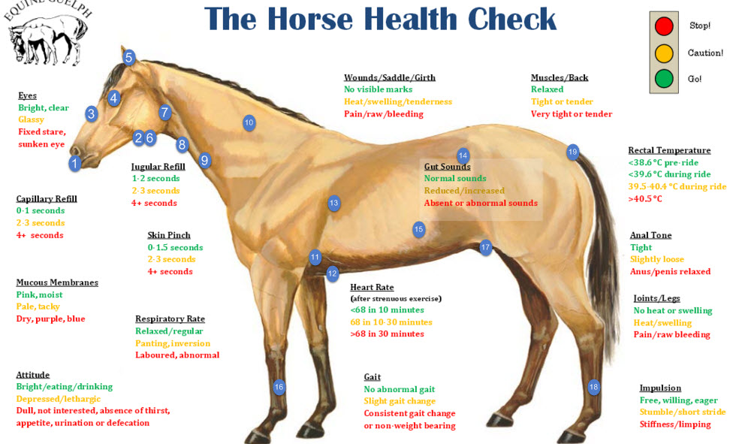
PHYSICAL EXAMINATION

Slide 4
Physical examination can be general or focused
General physical exam evaluates all organ systems to detect any abnormalities that can be potentially remote from the primary problem.
Example: Horse with severe bacterial pneumonia can develop laminitis even-though the horse presented for coughing and fever
Focused physical exam evaluates any abnormalities that are possibly associated with a specific organ system or can be related to a differential diagnosis for the presenting complaint
Example: Horse with cough will have a focused exam on the respiratory system.

Slide 5
HEAD
1) Mouth and Nose:
Mucous membranes assess the Cardiovascular/Respiratory/GIT systems. Done by raising the upper lip to evaluate CPR, moistness, icterus, hyperemia, cyanosis, pallor, ulceration, and petechial.
Tongue is grasped through the interdental space to evaluate for oral ulceration.
Check nostrils and mouth for odour and presence of bacterial infection, evaluates the respiratory system
2) Submandibular Lymph Nodes:
Located in the intramandibular space
Checked for any enlargement and painful response.
3) Percuss the sinuses:
Assess the Respiratory system
Resonance will be greatly increased if the tongue is held out of the mouth.
Compare the resonance on both sides while also noting if the horse seems painful to objects during this procedure.
Check for facial symmetry, general attitude and expression.

Slide 6
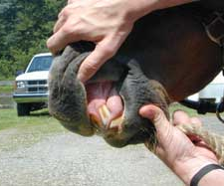
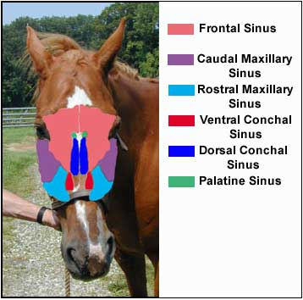
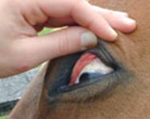
4) Eyes:
Sclera is checked for signs of Icterus, petechia, vesicles, or injection by placing the thumb over the upper lid and grasping the bottom of the halter and rotating the horse’s head away to expose the sclera
Manice reflex assess the Neurological system and can be conducted to check for nervous signs
5) Ears:
Slowly and gently palpate the ear for temperature if there is a suspicion that the horse may be in cardiovascular shock and experiencing poor peripheral perfusion or fungal infections.
6) Facial artery:
Evaluates the Cardiovascular system
It is palpated at the ventral aspect of the mandible for pulse rate.
There is an increased pulse when the horse has colic.

Slide 7
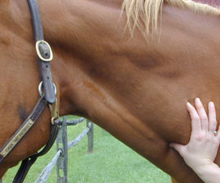
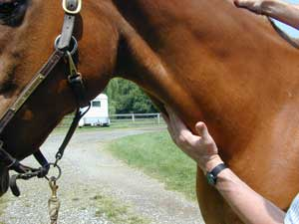
NECK
1) Larynx:
Palpate the dorsal aspect of the larynx on both sides noting any asymmetry or muscle atrophy.
If laryngeal hemiplegia is present the muscular process of the arytenoid cartilage may feel more pronounced with muscle atrophy
2) Trachea:
Palpate the trachea for any abnormalities such as irregular cartilage rings or fractures.
3) Jugular vein:
The left jugular vein assess the Cardiovascular system
Occlude and palpate to evaluate jugular fill
If the jugular remains distended, it indicates possible blockage to the heart.
4) Skin tent:
Tent the skin on neck to evaluate hydration status

Slide 8
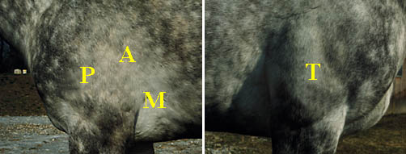
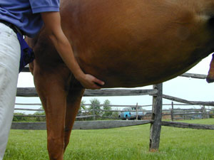
Left side
1) Heart:
Auscultation of the heart on the left cranial ventral thorax.
Remember P.A.M (Pulmonary, Aortic, Mitral)
The Pulmonary valve is found at the 3rd intercostal space at costochondral junction
The Aortic valve is found at the 4th intercostal space, just below the level of the shoulder
The Mitral valve or Left AV is found at the 4th intercostal space at level of olecranon
N.B: On the right side = The Tricuspid valve/Right AV is found at the 3rd to 4th intercostal space between the olecranon and the costochondral junction
2) Ventral thoracic midline:
Firm, upward pressure is applied on midline to evaluate for the presence of ventral edema

Slide 9
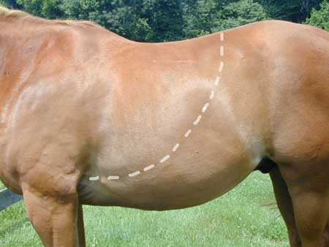
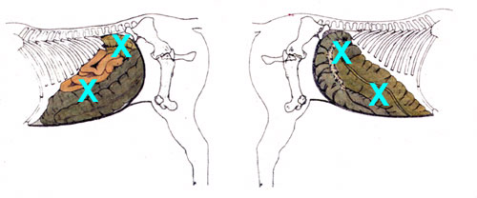
3) Lungs:
Auscultate the lungs to evaluate the respiratory system
Compare lungs sounds in the ventral, dorsal and mid thorax.
4) Abdomen:
Auscultate and Percuss the abdomen for GIT sounds and high-pitched resonant sounds associated with gas-distended bowel.
Assessing the GIT motility and looking for signs of colic
Note the frequency, duration, intensity and location of intestinal sounds (caecum or ventral colon)
Mixing contractions are weak, low to moderately pitched and last 10-20 seconds.
These sounds are present at any one site and have been described as equal to 10 contractions every 3-5 minutes
N.B: on the Left Side, there is the Distal left Ventral Colon while the Right Side has the Cecum and segments of the small intestines

Slide 10
5) Forelimbs:
Evaluate temperature of the distal extremities by running the hand down the forelimb
If cardiovascular shock is a concern, then the temperature of the hoof is also palpated
If laminitis is a concern, then the digital pulses are evaluated.
6) Inguinal area:
The inguinal area is then carefully palpated to evaluate testicles in stallions, scrotal remnants in geldings, and the mammary gland in mares.
7) Hindlimbs:
Visual inspected for joint effusion or distal limb edema

Slide 11
Tail
1) Tail:
Carefully raise the tail from the side and take the rectal temperature
Note the tail tone, anal reflexes, faecal staining and vaginal discharge.

Slide 12
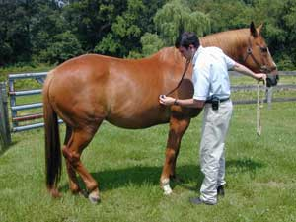
RIGHT SIDE
The process for examining the right side of the horse is similar to the left.
Auscultate the GIT, lungs and heart

Slide 13
REFERENCES
Diagnosing Horse Lameness - The Veterinary Process: Equimed - Horse Health Matters [Internet]. EquiMed. [cited 2020Oct4]. Available from: https://equimed.com/health-centers/lameness/articles/diagnosing-horse-lameness-the-veterinary-process# :~:text=A systematic lameness exam is,treatment plan can be implemented.&text=A physical examination of the,evidence of injury or stress.
The Basic Physical Examination [Internet]. The Horse. 2019 [cited 2020Oct4]. Available from: https://thehorse.com/14385/the-basic-physical-examination/
Howard Ketover DVM. The Physical Examination - 120 Seconds and $0 [Internet]. Irongate Equine Clinic. Irongate Equine Clinic; 2015 [cited 2020Oct4]. Available from: https://www.irongateequine.com/education/the-fast-free-physical-examination
(Information adapted from Years 1 to 3 DVM Skills Classes, UWI SVM)

