Slide 1
Drugs used for nerve blocks in horses

Slide 2
Why use drugs?
To help diagnose lameness
To allow surgical procedures to be performed
To temporarily relieve pain

Slide 3
Local Anesthetic Agents
Allows for some surgical procedures to be done without the need for general anesthesia
Provides temporary pain relief
Equipment:
25-gauge, 5/8 inch needle. (nerves below the carpus/hock
22/20 gauge, 3.8cm needle (nerves of the proximal limb)
25 guage needle for subcutaneous deposition.
Most common drug used:
Lidocaine HCl (2%)
- provides pain relief for about 30-45 minutes
Mepivacaine HCl (2%)
- preferred drug due to less tissue reaction
- lasts 90-120 minutes
Bupivacaine HCl
- used for pain relief that lasts 4-6 hours
- These drugs are mostly used to induce regional anesthesia during lameness examination

Slide 4
Uses of Local Anesthetics

Slide 5
Onset and Duration of Local Anesthetic drugs

Slide 6
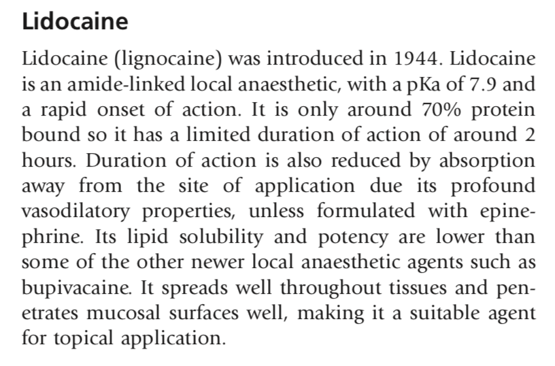
Lidocaine

Slide 7
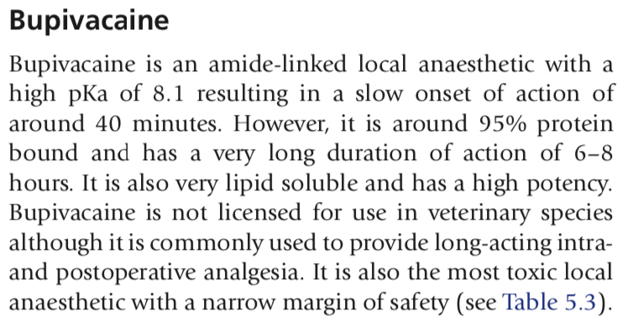
Bupivacaine

Slide 8
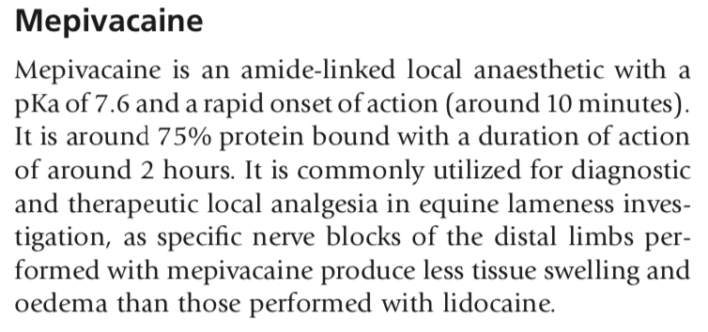
Mepivacaine

Slide 9
Volumes of Anesthetic Agents Used in Nerve Blocks- FORELIMB
Palmar Digital Nerve Block: 1.5mL
Basisesamoid Nerve Block: 2.5-3mL
Palmar Nerve Block
2mL over each palmar nerve
1mL to the ramus communicans
1-2mL SC at distal end of each splint bone
High Palmar Nerve Block: 3-5mL over the palmar nerve
Lateral Palmar Nerve Block: 2mL

Slide 10
Volumes of Anesthetic Agents Used in Nerve Blocks- HINDLIMB
High Plantar Nerve Block: 3-4mL
Tibial Nerve Block: 20mL Mepivacaine HCl

