Slide 1
Burdizzos

Slide 2
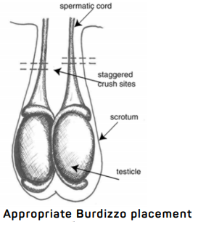
Burdizzos- stagger crushes to avoid necrosis of scrotum
Crushing the cord without cutting the skin on the lateral aspect of the scrotum on each side without crushing across entire neck of scrotum, this is to preserve blood supply to scrotum and prevent necrosis.
Ensure that the vascular supply to BOTH testicles have been crushed. The chords should be crushed twice per side to ensure this is done.

Slide 3
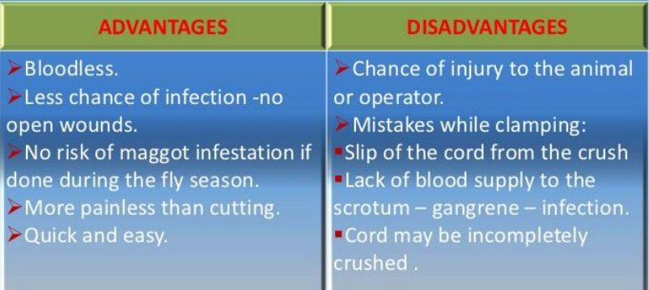

Slide 4
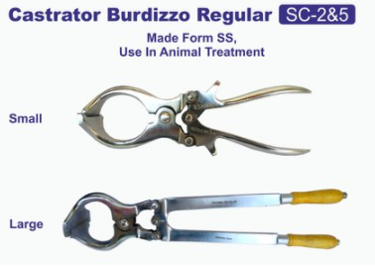
Why was this the chosen method for this case?
This method was chosen because: it is quick, less painful, decreased chance of complications such as infections or improper wound healing as there is no incisions involved.
It can be done on any age of buck, however the younger the better.
NOTE; the size of the animal will determine which size instrument can be used, but the burdizzo is commercially available in multiple sizes to suit the size of the animal.

