Slide 1
General Information
CASE 1: How to go about castrating a 4-month-old 7-kilogram goat kid on pasture

Slide 2
Definition:
Castration (also known as bilateral orchidectomy), is defined as the removal of the testicles.

Slide 3
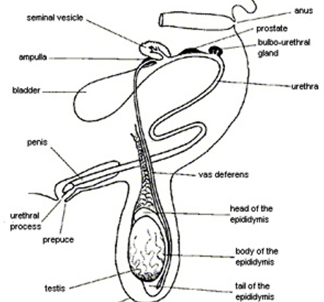
Reproductive tract of a male goat

Slide 4
Kids should be castrated by 2 weeks of age if they are to enter the food production system to be reared for meat as the testosterone can cause the meat to become tainted. It is advised that pet goats be castrated after 6-12 months of age however, as their growth may benefit from the production of sex hormones as well as to prevent the occurrence of uroliths.

Slide 5
Other reasons for castration include;
To prevent unwanted breeding and to make the animal easier to handle in the presence of females
To curb aggression or aggressive behaviour
To correct scrotal hernia, and for management of malignant disease or irreversible disease of the testicles

Slide 6
References for Case 1
1. Malone E, Norton E, Dobbs E, Ezzo A. Small ruminant castration [Internet]. Open.lib.umn.edu. [cited 8 October 2020]. Available from: https://open.lib.umn.edu/largeanimalsurgery/chapter/small-ruminant-castration/
2. Small ruminant castration [Internet]. [cited 8 October 2020]. Available from: https://open.lib.umn.edu/app/uploads/sites/208/2018/11/sm-rumin-castration-web-doc.pdf
3. goat-reproductive-tract [Internet]. 2008 [cited 9 October 2020]. Available from: https://thekebun.wordpress.com/2008/10/28/palpation-of-a-goat%E2%80%99s-testicles/
4. PALPATION OF A BUCK’S TESTICLES [Internet]. The Kebun. 2008 [cited 9 October 2020]. Available from: https://thekebun.wordpress.com/2008/10/28/palpation-of-a-goat%E2%80%99s-testicles/
5. Phipps A, Dunstan-Martin A. Castration: surgical options from Vetstream | Definitive Veterinary Intelligence [Internet]. Vetstream.com. [cited 9 October 2020]. Available from: https://www.vetstream.com/treat/bovis/freeform/surgery-options-for-bovine-castration
6. Diptee M. Penile, Preputial, & Testicular Surgery of Farm Animals. Presentation presented at; 2020.

