Slide 1
ANATOMY OF THE MALE REPRODUCTIVE SYSTEM
IN CATTLE

Slide 2
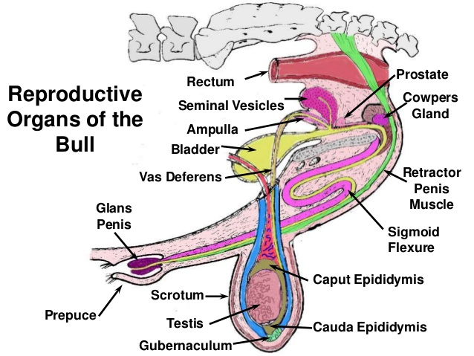
Reproductive organs

Slide 3
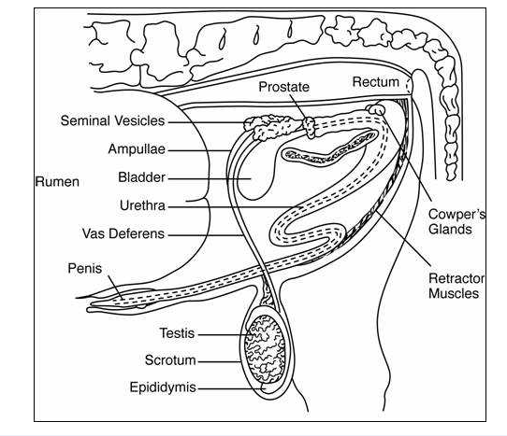

Slide 4
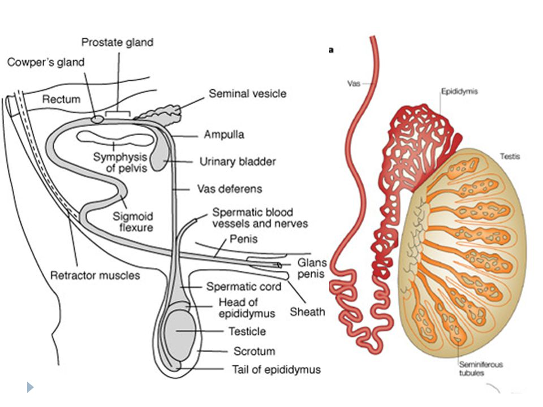
Testis anatomy

Slide 5
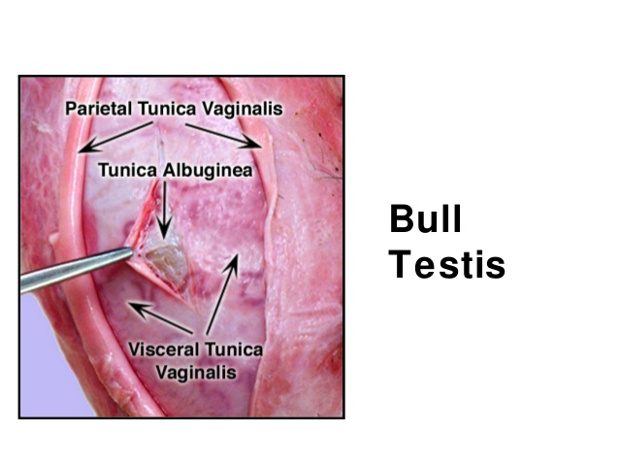

Slide 6
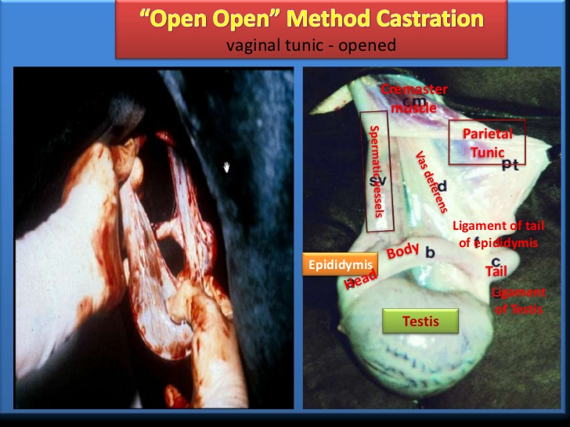
Vaginal tunic

Slide 7
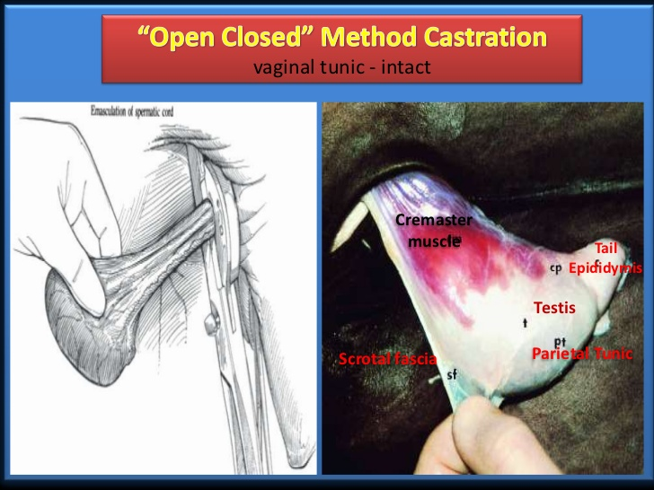

Slide 8
REFERENCES
Garry D. Lasaga Follow. Comparative Anatomy of Male Reproductive System [Internet]. SlideShare. 2019 [cited 2020Oct10]. Available from: https://www.slideshare.net/lasaga_garry/comparative-anatomy-of-male-reproductive-system
Maximizing Beef Bull Fertility and Reproduction [Internet]. The Beef Site. [cited 2020Oct10]. Available from: http://www.thebeefsite.com/articles/838/maximizing-beef-bull-fertility-and-reproduction/
Male Reproductive Anatomy of Cattle - ppt video online download [Internet]. SlidePlayer. [cited 2020Oct10]. Available from: https://slideplayer.com/slide/4404696/
Garry D. Lasaga Follow. Male Reproductive Anatomy - Univ. of Winsconsin (Madison) [Internet]. SlideShare. 2019 [cited 2020Oct10]. Available from: https://www.slideshare.net/lasaga_garry/male-reproductive-anatomy-univ-of-winsconsin-madison
Karthik DK. Castration Procedure in Farm Animals (Teaching PPT Material) [Internet]. SlideShare. 2012 [cited 2020Oct10]. Available from: https://www.slideshare.net/vetkkarthik/castration-in-large-animalsppt

