Slide 1
Surgical Castration
With proper ligation of the blood vessels.

Slide 2
Why was this method chosen?
Only 1 bull is being castrated (i.e. in this case, castration is not done on an intensive scale) so time taken to complete the castration is not an issue
Less traumatic than other methods
Decreased chances of swelling and bleeding & post-operative pain if done properly (since this is a working animal)
Since this is an older, more sexually mature bull, other methods may not be adequate to crush the spermatic cord/ occlude blood vessels

Slide 3
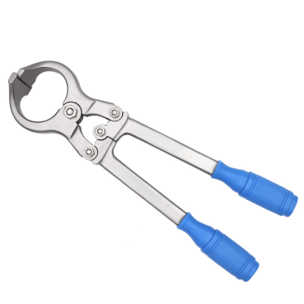
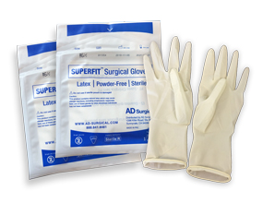
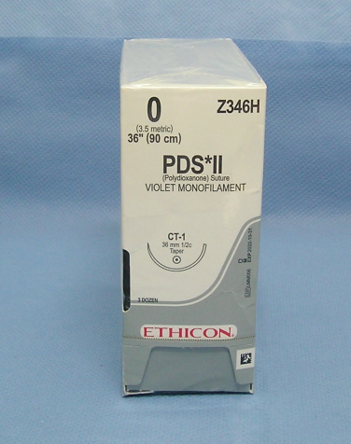
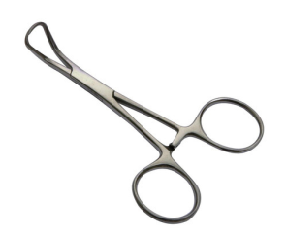
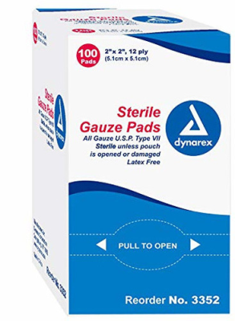
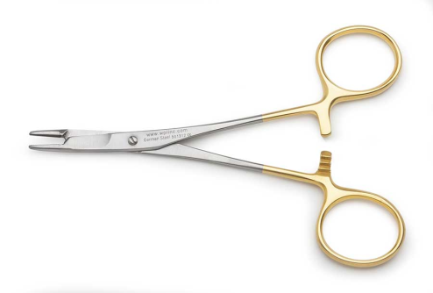
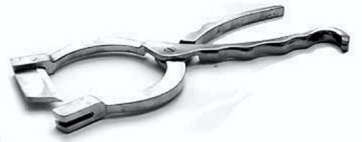
Equipment & Tools List:
Scalpel blade and handle or Newberry Knife
Burdizzo clamp
Needle Driver
Towel Clamps
PDS 0
Sterile Gauze
Sterile Gloves

Slide 4
Pre-operative Checklist:
Disinfection of all tools (iodine+alcohol solution for 10 minutes)
Restraint of bull in a chute (restrain the tail as well by tying it off to the side)
Sedate the bull
Give local anaesthetic (in the spermatic cord)
Surgical scrubbing of the scrotal sac with chlorhexidine followed by surgical prep with alternating iodine + alcohol
Sterile gloves on
Ready to go!

Slide 5
How it is done:
The testicles are pushed up the scrotal sac. The scrotal sac is then incised with a Newberry knife or the lower 2/3 of the scrotal sac is incised with a scalpel blade.
At this point the testicles should fall out of the scrotal sac and be exposed. If not, use a towel clamp to retrieve the testicles.
There would be bleeding. Use gauze to soak up any blood that may hinder your view.

Slide 6
How it is done continued……
Incise or use your hand to break the vaginal tunic to expose the spermatic cord and blood vessels
This is not a young animal therefore simply shaving through the vessels with a dull knife or pulling the vessels will not be substantial and may cause a lot of bleeding. Therefore the spermatic cord can be clamped with a Burdizzo clamp
Ligate the blood vessels proximally and distally (as close to the abdomen as possible) and incise the centre. This would ensure removal of the testicles without bleeding
(There are no video demos showing this exact method as I would personally prefer to ligate the vessels of an older bull as opposed to crushing with a Burdizzo or Emasculator only)

