Slide 1
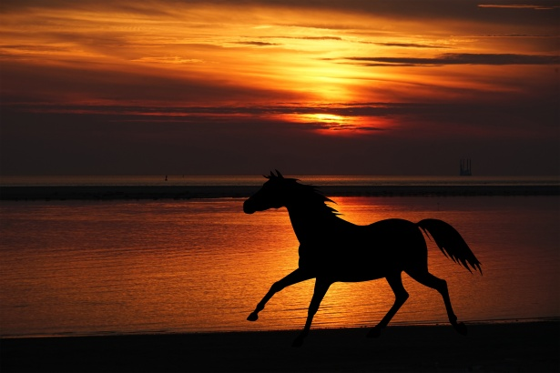
Castration of the Rig!
https://www.youtube.com/watch?v=v8oDfmBaUgI

Slide 2
What is a rig?
If one or both testes do not descend fully into the scrotum then the male horse is referred to as a rig/ridling or cryptorchid.
The testes of this animal can be located in one of 3 places:
Under the skin outside the inguinal canal
Within the inguinal canal
Inside the abdominal cavity
A high flanker is a horse with testes in the inguinal area outside the body cavity.

Slide 3
Why does this happen?
Genetic Predisposition
Insufficicent androgen (testosterone stimulation)

Slide 4
How does this affect the animal?
Sperm cannot be produced due to the elevated temperature.
If both testes are cryptorchid then the animal will be sterile.
The animal will be castrated and not used for breeding. Castrating should eiliminate undesired aggressive or stallion-like behaviours. Castration also prevents medical issues like testicular tumors.

Slide 5
How can this condition be diagnosed?
Medical Records
Sedation of the animal to thoroughly examine the external inguinal area
Rectal Palpation for abdominally retained tetes
Ultrasound examination
Hormonal testing and analysis of testosterone levels in a single blood sample.

