Slide 1
Tetanus Prophylaxis
All horses are at risk of development of tetanus.
It is a non-contagious disease caused by a neurotoxin produced by the anaerobic, spore-forming bacterium, Clostridium tetani.

Slide 2
Clostridium tetani organisms are present in the intestinal tract and faeces of horses, other animals and humans, and are abundant as well as ubiquitous in soil.
Spores survive in the environment for many years therefore infection is possible
Tetanus can be caused by infection of:
  puncture wounds (particularly those involving the foot or muscle),
  open lacerations
  surgical incisions
  exposed tissues such as the umbilicus of foals and reproductive tract of the postpartum mare (trauma or retained placenta)

Slide 3
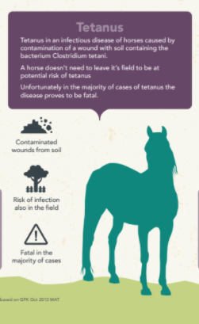

Slide 4
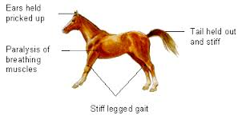
Clinical Signs

Slide 5
It is associated with HIGH case fatality rates
Therefore prophylactic administration of formalin inactivated, adjuvant tetanus toxoid would prevent deaths due to contamination of the open wound associated with castrations.

Slide 6
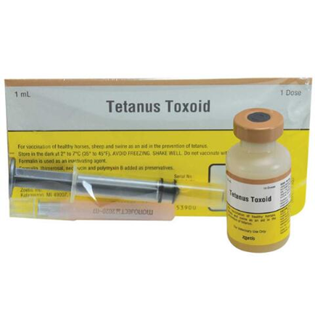

Slide 7
References
Tetanus | AAEP [Internet]. Aaep.org. n.d [cited 16 October 2020]. Available from: https://aaep.org/guidelines/vaccination-guidelines/core-vaccination-guidelines/tetanus#:~:text=Adult%20horses%2C%20previously%20vaccinated%20against,time%20of%20injury%20or%20surgery.
Ribeiro MG, Nardi Júnior GD, Megid J, Franco MM, Guerra ST, Portilho FV, Rodrigues SA, Paes AC. Tetanus in horses: An overview of 70 cases. Pesquisa Veterinária Brasileira. 2018 Feb;38(2):285-93.

