Slide 1
http://www.free-powerpoint-templates-design.com
OMENTUM

Slide 2
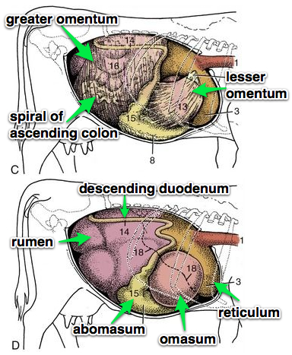
The Omentum refers to the thick, double-layered connecting peritoneum between the Stomachs and Abdominal Wall and Abdominal Organs
It can be divided into the:
GREATER OMENTUM
LESSER OMENTUM

Slide 3
The LESSER OMENTUM
Covers the right side of the omasum
Connects the omasum to the liver
Connects the leser curvature of the absomasum to the cranial duodenum
The GREATER OMENTUM (also called the ‘omental curtain’) is elongated and folds over on itself creating a:
Superficial Leaf: arises from the left longitudinal groove of the rumen
attaches to the greater curvature of the abomasum and the descending duodenum
It also extends on the ventral abdomen from where it was attached to the rumen
Deep Leaf: arises from the right longitudinal groove of the rumen
Extends and attaches to the descending duodenum
The caudal edge of the greater omentum is the joining of the lesser and greater omentum where they meet at the caudal edge of the rumen
On the left side: attaches to the caudal groove of the rumen
On the right side: attaches to the descending duodenum

Slide 4
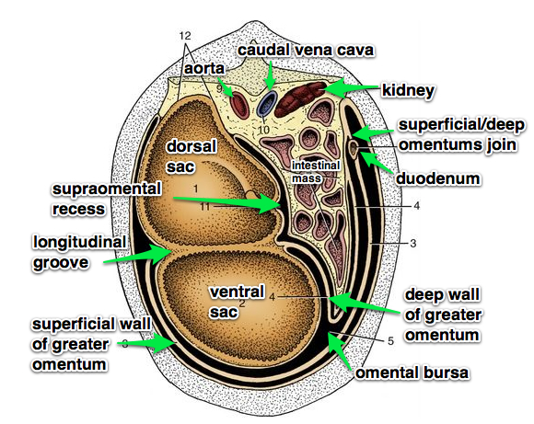
Dorsal
Other Structures:
Omental bursa
The space between the superficial and deep leaves of the Greater omentum
Omental (epiploic) foramen
The openining between the omental bura and the [general] peritoneal cavity
Located medially to the liver (the caudate lobe) and between the vena cava & portal vein
Supraomental recess
The space above the deep leaf of the Greater omentum
Opens caudally
Contains the intestines
Ventral

Slide 5
