Slide 1
Vascular Ligation + Teat Amputation
In Goats
This can be done either Unilaterally or Bilaterally

Slide 2
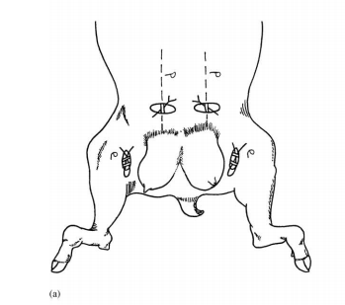
At the level of the external inguinal ring, make an oblique, linear incision about 5cm in length
  This is about 6-8cm dorsolateral to the base of the caudolateral border of the mammary gland

Slide 3
Bluntly dissect the underlying tissue Intel the external pudendal vein and artery are located.
Isolate and ligate the vessels using a transfixation ligation + miller’s knot with an absorbable suture material such as 4-0 PDS II or VICRYL
  See “Radical Mastectomy” for video link to how this is done
  Double ligation is often the standard
Suture the subcutaneous tissue with the same suture material ( can do a simple continuous pattern) then suture the skin using a non-absorbable suture material such as 4-0 Nylon (can use a simple interrupted pattern)

Slide 4
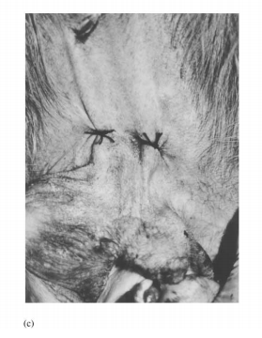
Ligate the caudal epigastric/ milk vein percutaneously using a non-absorbable suture material such as 4-0 Nylon
  Ligate the vessel cranial to the mammary gland
Amputate the gangrenous teat(s) by crushing the teat with an artery forceps then cutting it with scissors

Slide 5
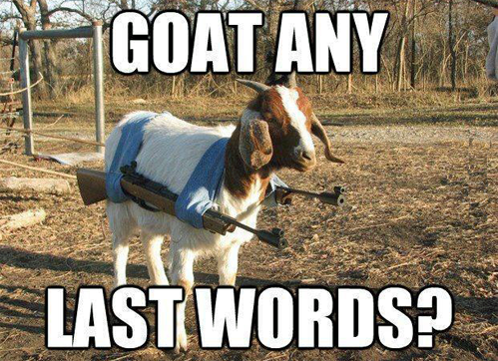
References:
El-Maghraby HM. Comparison of two surgical techniques for mastectomy of goats. Small Ruminant Research. 2001 Jun 1;40(3):215-21.

